Slide 1

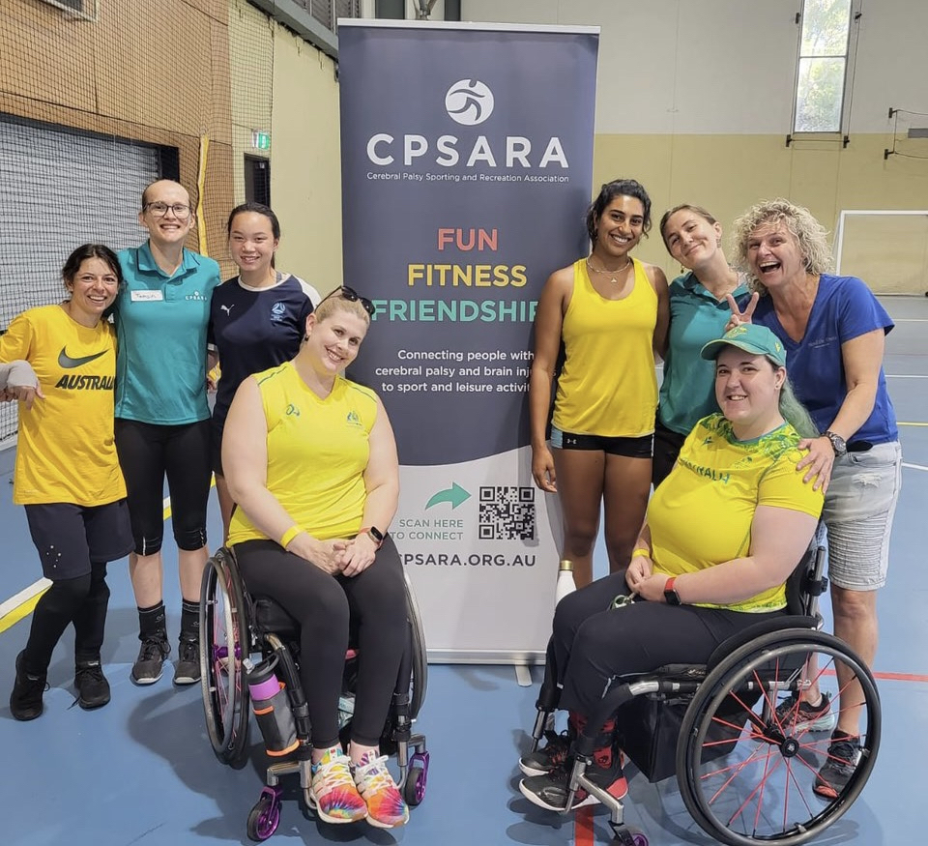


AGM/AWARDS NIGHT 2023
Welcome to
Thank you to our sponsors:

Slide 2

ANNUAL GENERAL MEETING
25th August 2023
1. Opening and Welcome
2. Apologies
3. Minutes of the Previous Annual General Meeting held 26th August 2022
4. Adoption of Annual Report
5. Adoption of the Financial Statement
6. Election of Office Bearers
7. Close of Meeting
Presentation of Awards
Upcoming Opportunities
Athlete Interview
CPSARA Zoom Photo
Agenda

Slide 3
Acknowledgement of Country
CPSARA would like to acknowledge the traditional custodians of the lands we meet on today. I am living on Dharug land. We would also like to pay our respects to the Elders both past and present, and extend that respect to any Indigenous Australians here with us today.

Slide 4
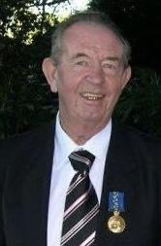

Slide 5
Annual Report
See Annual Report 2023 on CPSARA website
(Link sent in Zoom chat)

Slide 6
MINUTES OF THE 2022 ANNUAL GENERAL MEETING
Annual Report
See Annual Report 2023 on CPSARA website
(Link sent in Zoom chat)

Slide 7
CPSARA Presidents Report – 2023
Annual Report
See Annual Report 2023 on CPSARA website
(Link sent in Zoom chat)

Slide 8
Treasurer’s Report for AGM 2022/2023 Financial Year
Annual Report
See Annual Report 2023 on CPSARA website
(Link sent in Zoom chat)

Slide 9
Adoption of Annual Report
See Annual Report 2023 on CPSARA website
(Link sent in Zoom chat)

Slide 10
Adoption of the Financial Statement
See Annual Report 2023 on CPSARA website
(Link sent in Zoom chat)

Slide 11
Election of Office Bearers

Slide 12
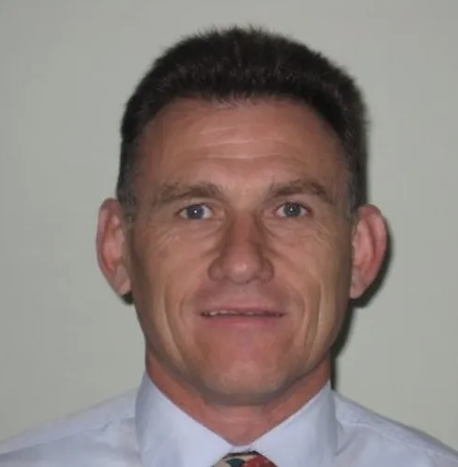
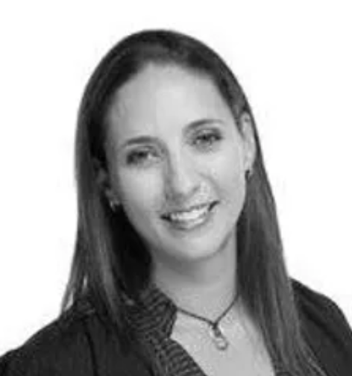
Ongoing office bearers
President (ongoing)
Brian Berry
Treasurer (ongoing)
Nicki Ashton

Slide 13
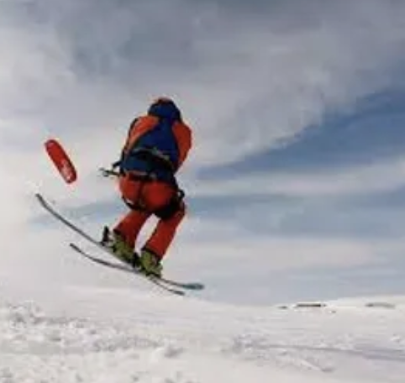
Election of Office Bearers
Vice-President (2 year term)
Murray Bartram
Nominated by Kerry West, Seconded by Brian Berry

Slide 14
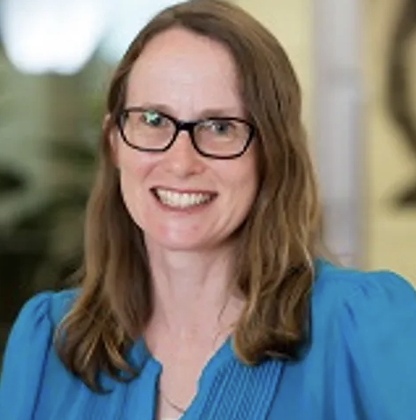
Election of Office Bearers
Secretary (2 year term)
Cathie Sherrington
Nominated by Brian Berry, Seconded by Kerry West

Slide 15
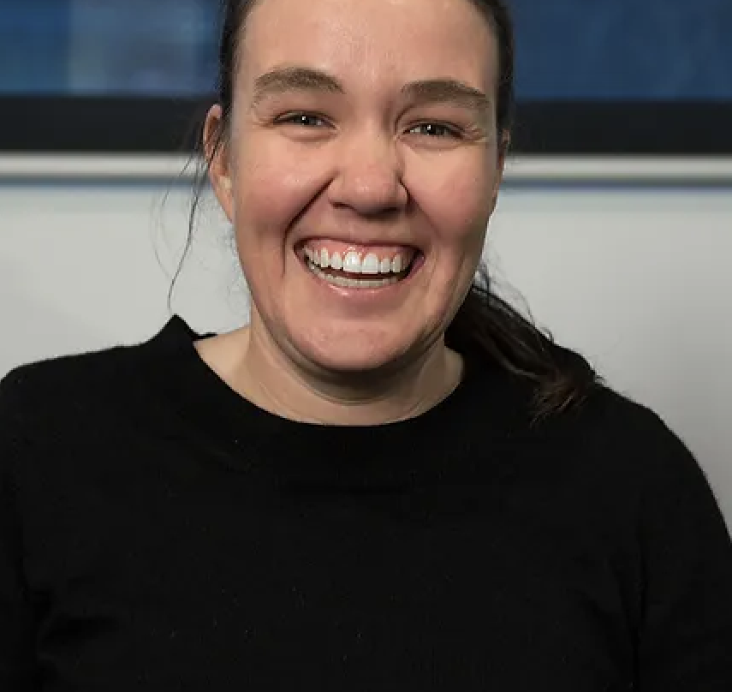
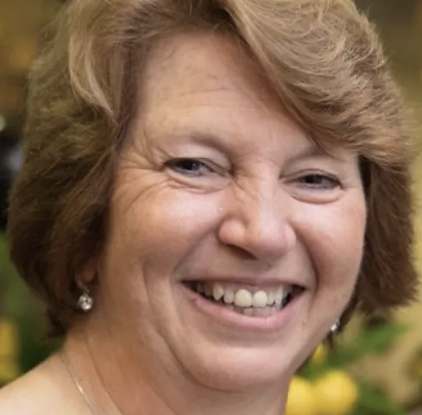
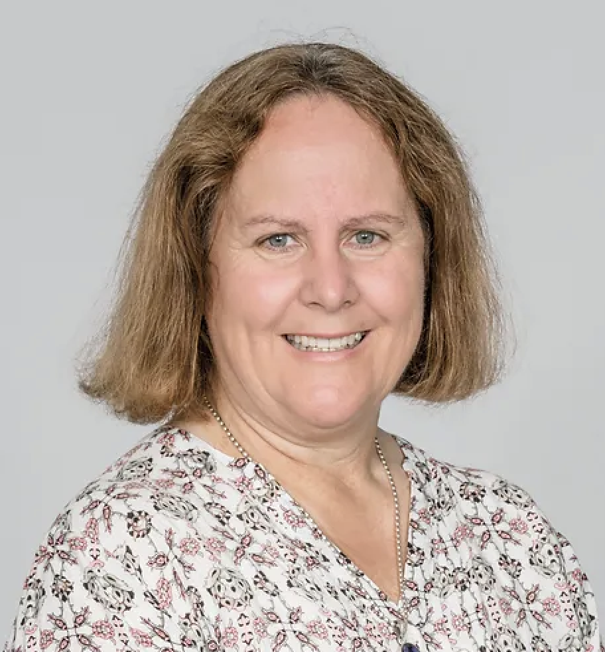
Election of Office Bearers
Ordinary Member – 3 Positions (1-year term)
Marita Morgan
Nominated by Cathie Sherrington, seconded by Murray Bartram
Heather Berry
Nominated by Brian Berry, seconded by Nicki Ashton
Kerry West
Nominated by C. Sherrington, seconded by Brian Berry

Slide 16
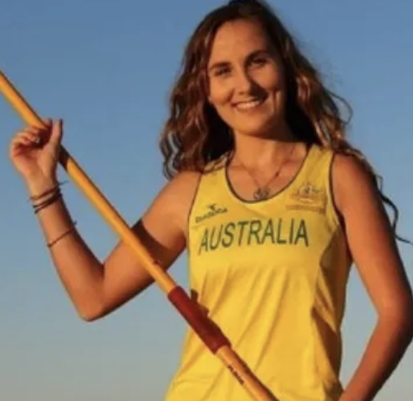
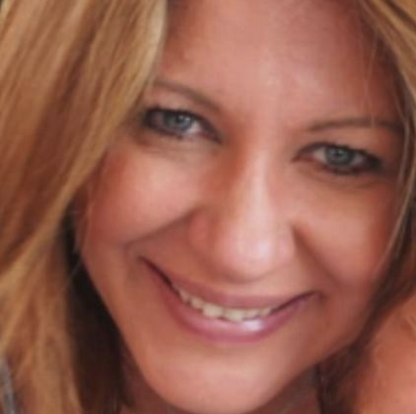
Election of Office Bearers
Additional Non-Voting Members (1-year term)
Rae Anderson
Nominated by Cathie Sherrington, seconded by Brian Berry
Kim Georgallis
Nominated by Cathie Sherrington, seconded by Brian Berry

Slide 17
Close of Meeting/Start of Awards Night

Slide 18
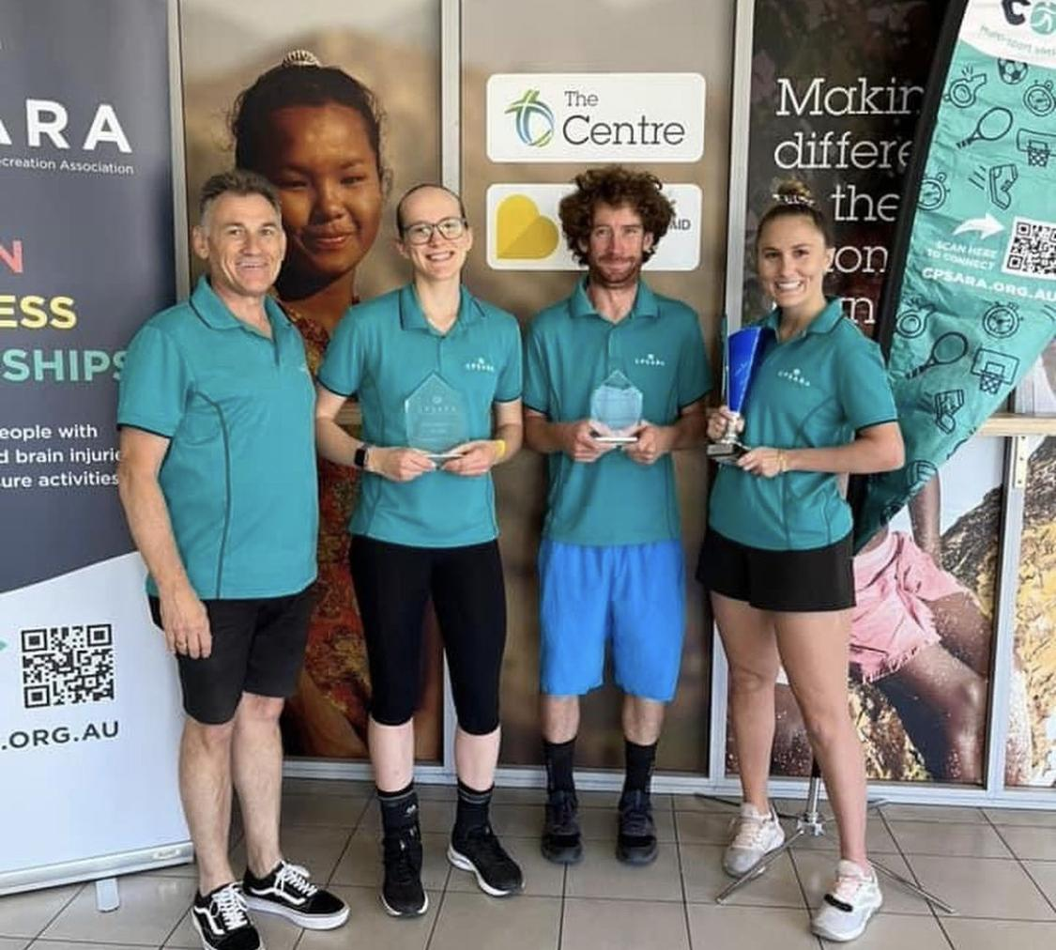
AWARDS NIGHT 2023
Welcome to
Thank you to our sponsors:

Slide 19
Margaret & Allan Gregson
Encouragement Awards
Swimming
Presented by Brian Berry

Slide 20
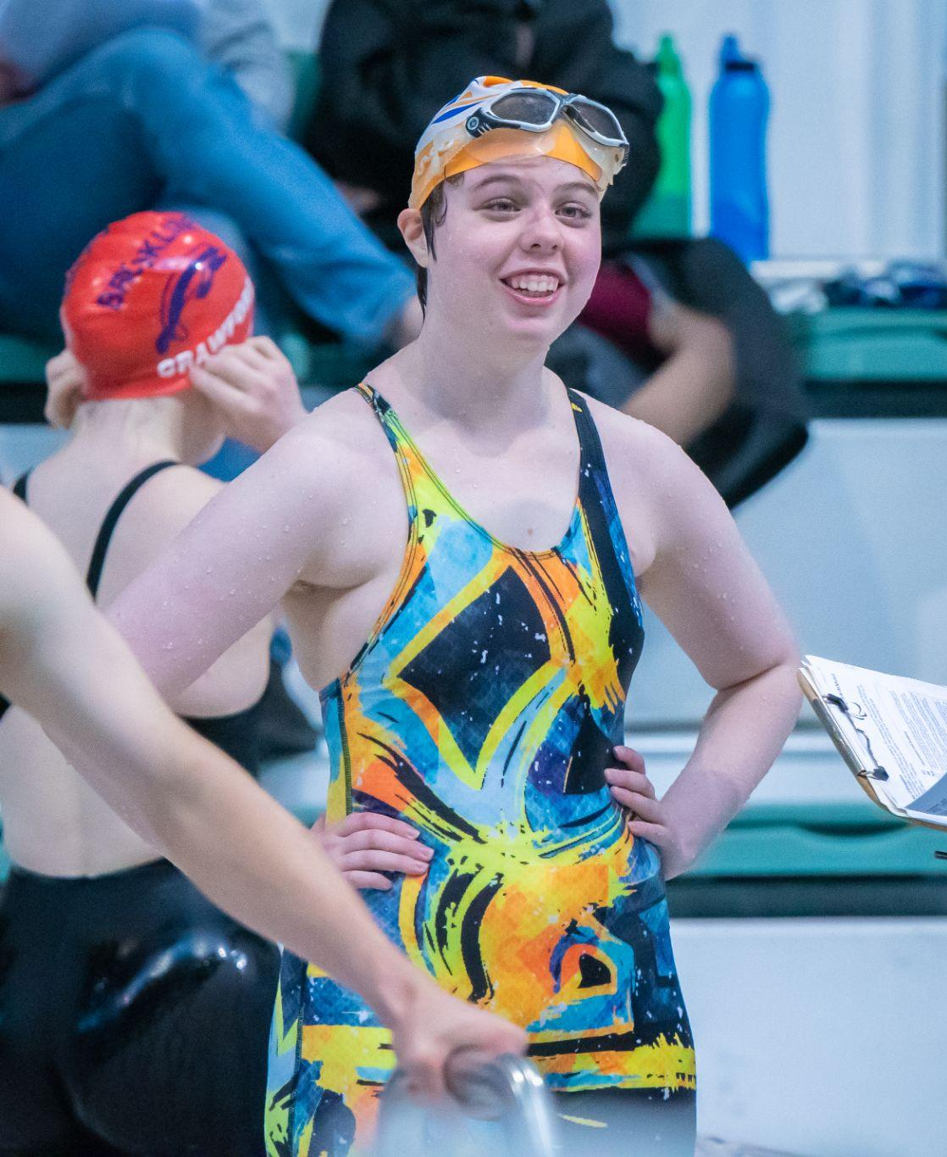
Margaret & Allan Gregson Encouragement Award
Swimming
Kaden Scott

Slide 21
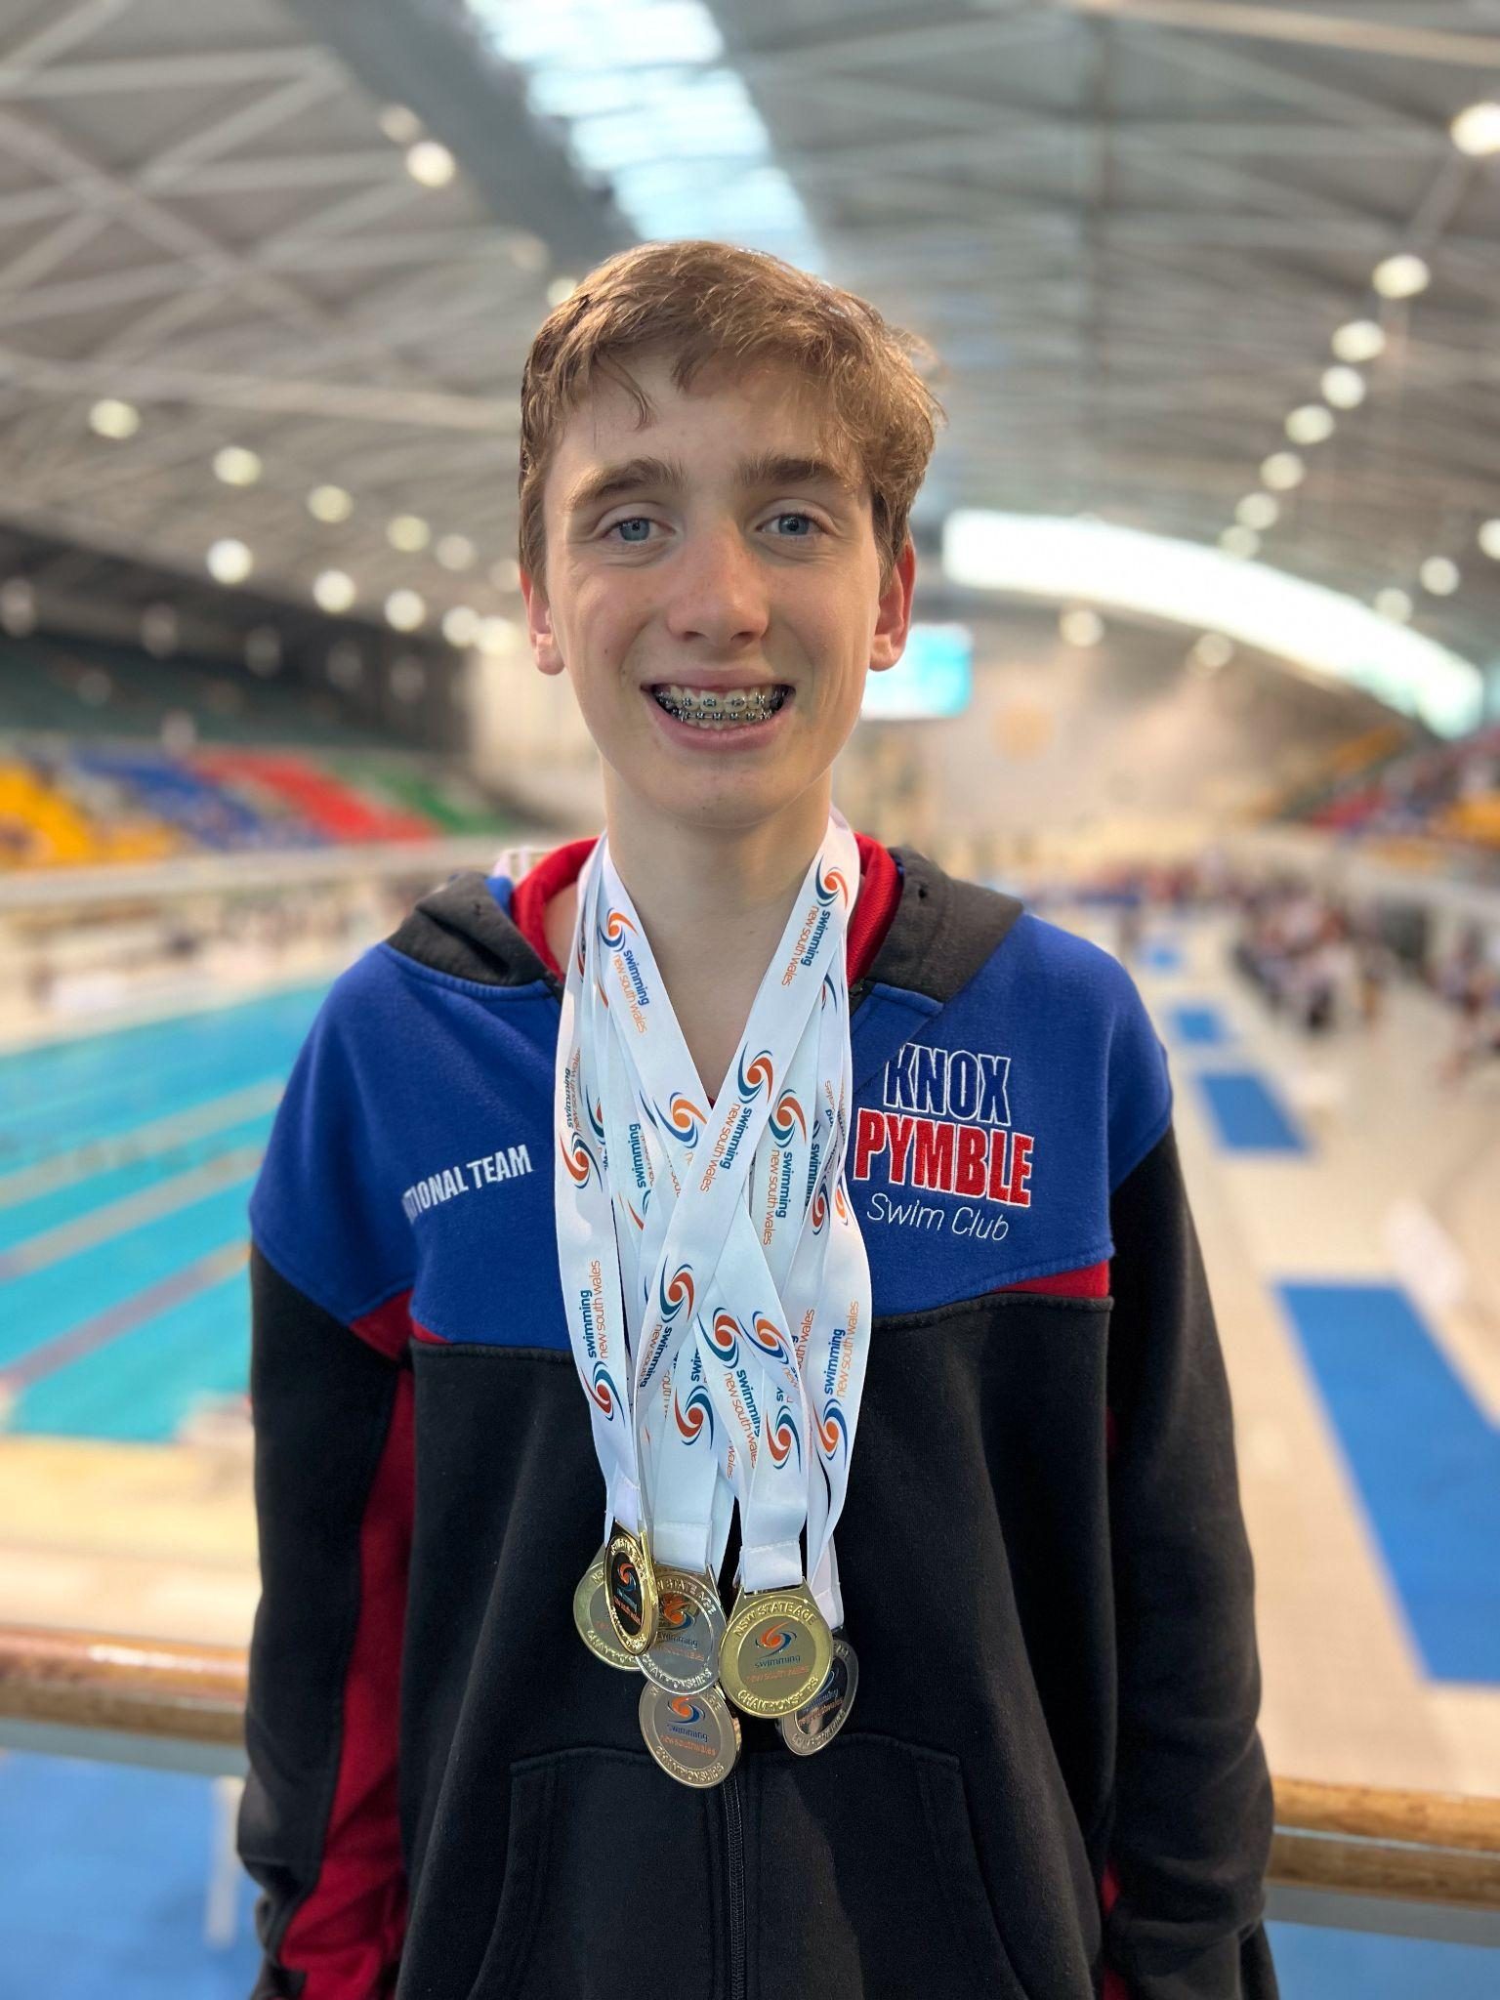
Margaret & Allan Gregson Encouragement Award
Swimming
Liam Togher

Slide 22
Margaret & Allan Gregson Encouragement Awards
Athletics
Presented by Brian Berry

Slide 23
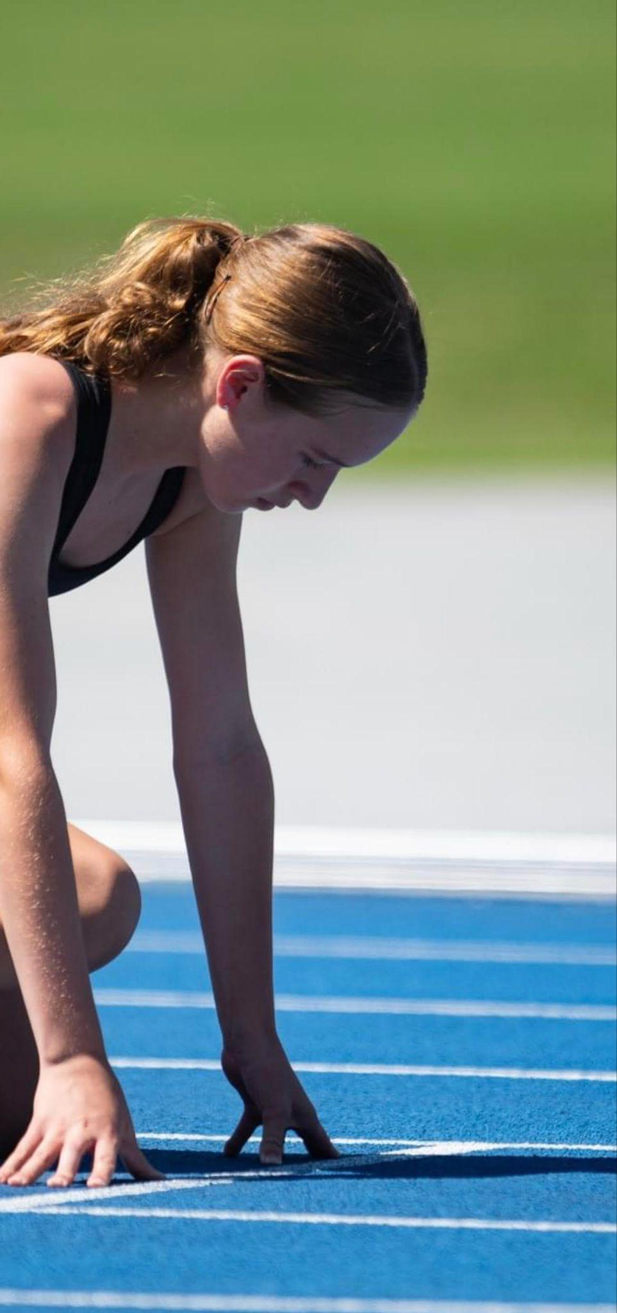
Margaret & Allan Gregson Encouragement Award
Athletics
Layla Sharp

Slide 24
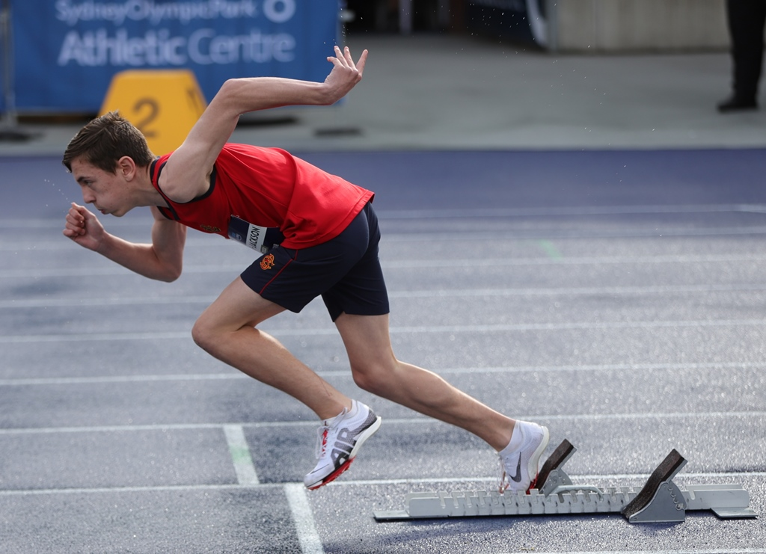
Margaret & Allan Gregson Encouragement Award
Athletics
Cooper Robb-Jackson

Slide 25
Ian Menzies Encouragement Award Football
Presented by Ian Menzies

Slide 26
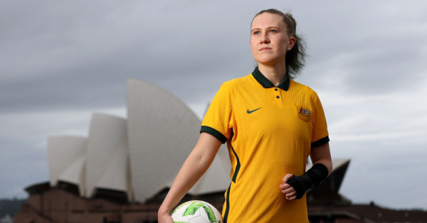
Ian Menzies Encouragement Award Football
Tahlia Blanshard

Slide 27
Bill Gurney Encouragement Award Football
Presented by Bill Gurney

Slide 28
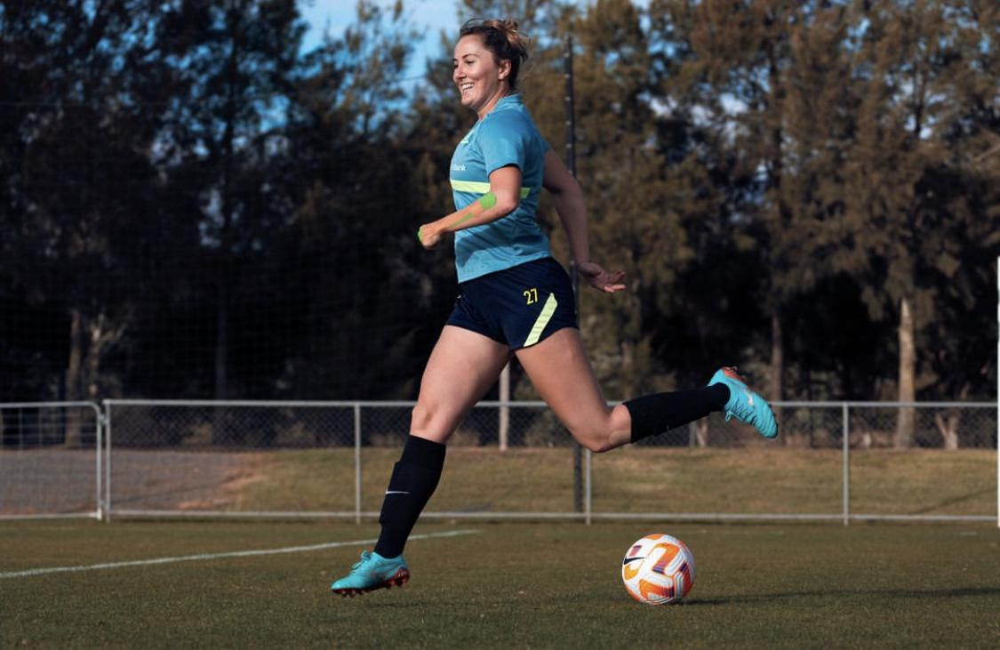
Bill Gurney Encouragement Award Football
Rae Anderson

Slide 29
David Campbell Encouragement Awards Football
Presented by Bill Gurney

Slide 30
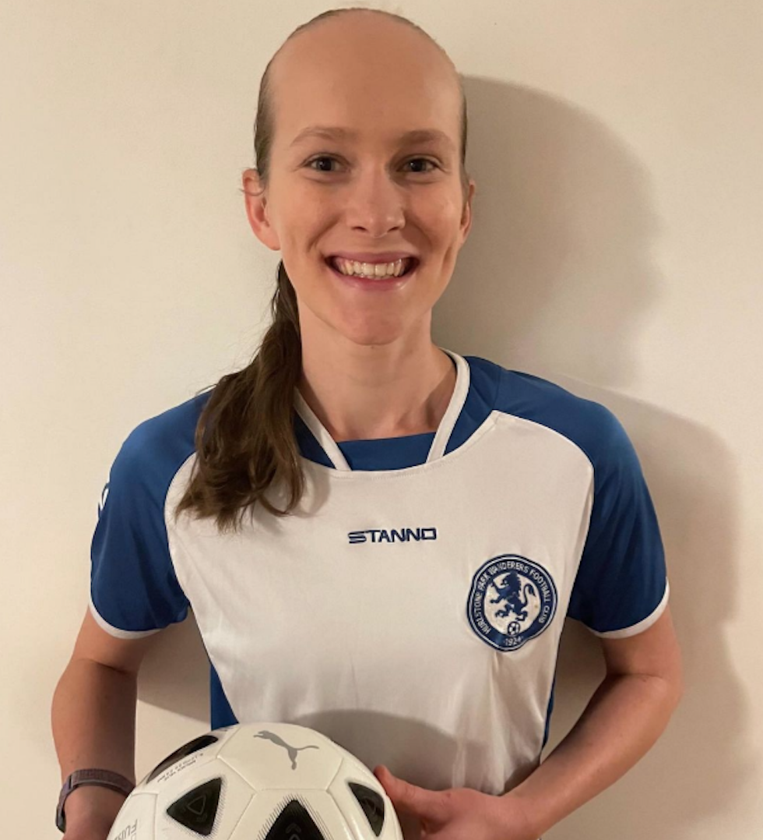
David Campbell Encouragement Award Football
Female
Tamsin Colley

Slide 31
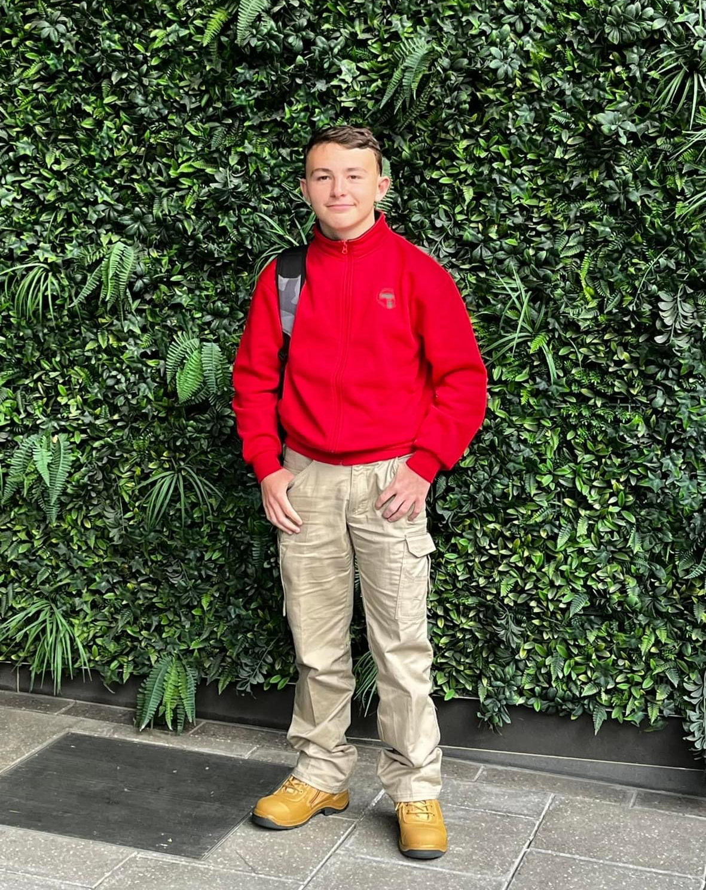
David Campbell Encouragement Award Football
Male
Cody Sneesby

Slide 32
Judy Webber Encouragement Award Various Sports
Presented by Marita Morgan

Slide 33
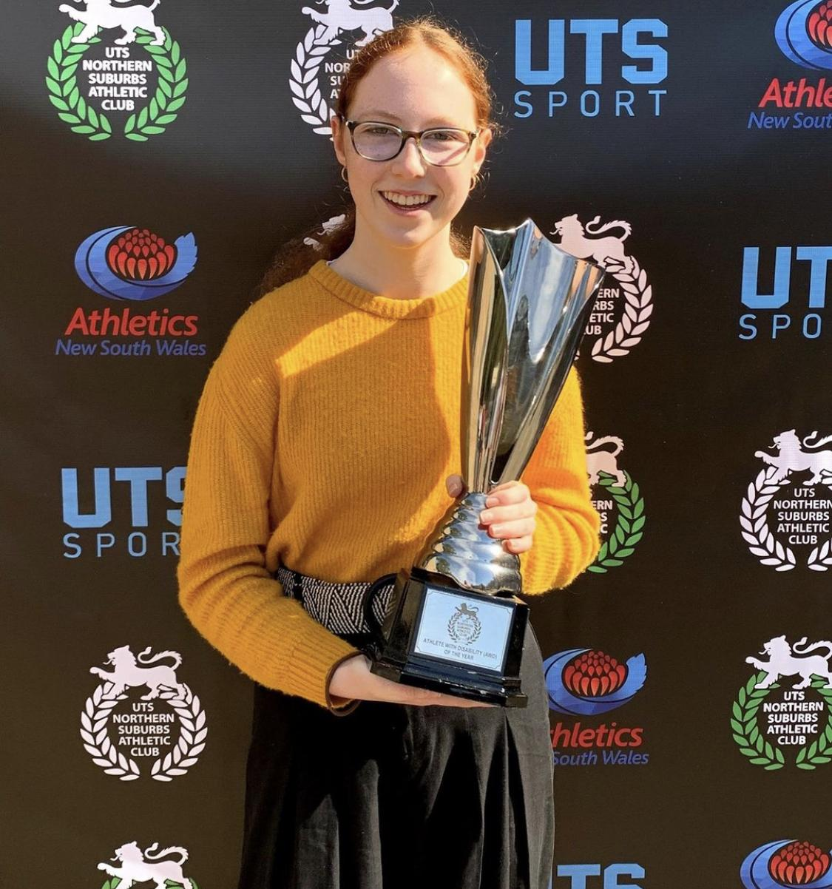
Judy Webber Encouragement Award Various Sports
Female
Isla
Gillespie

Slide 34
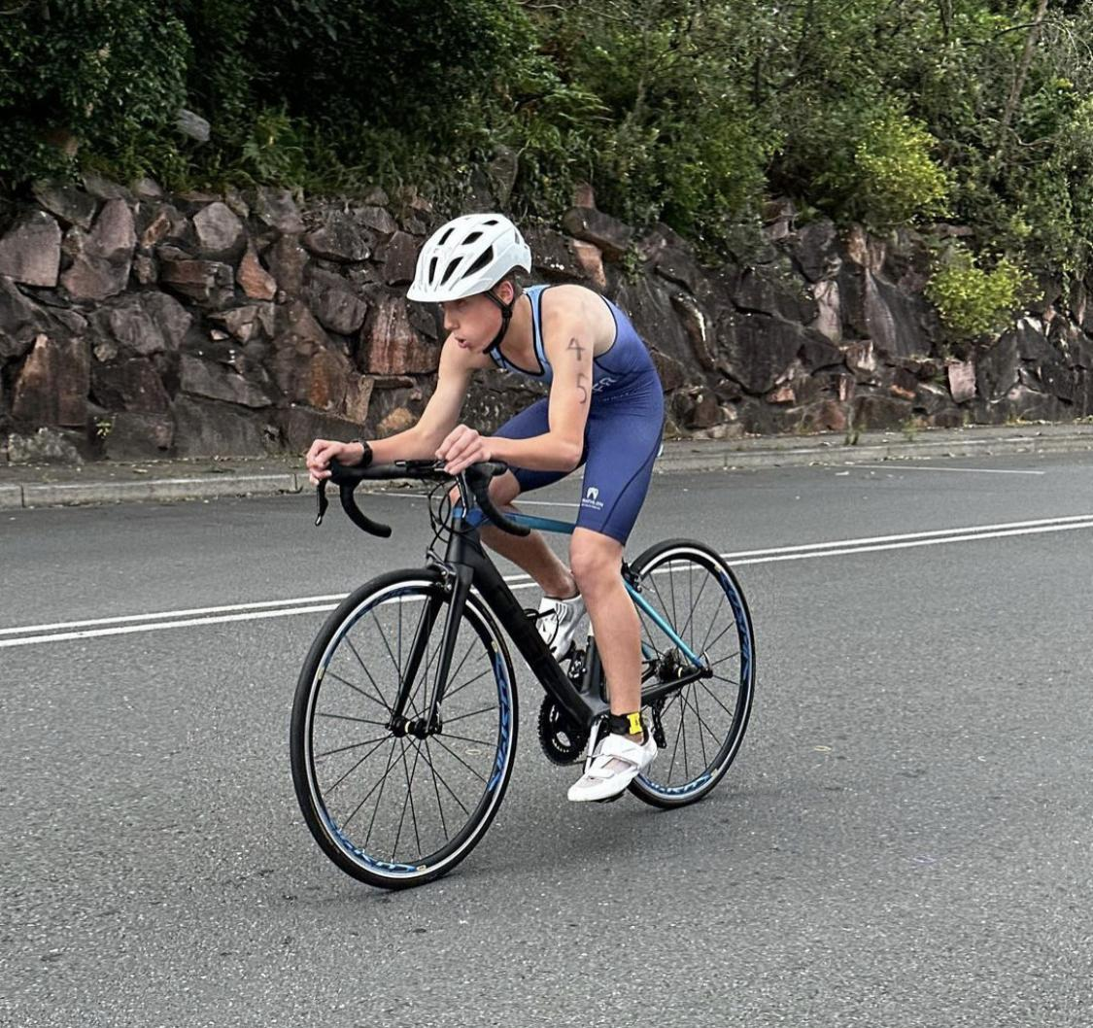
Judy Webber Encouragement Award Various Sports
Male
Matthew
Engesser

Slide 35
Dawn Fraser Award for Swimming
Presented by Marita Morgan

Slide 36
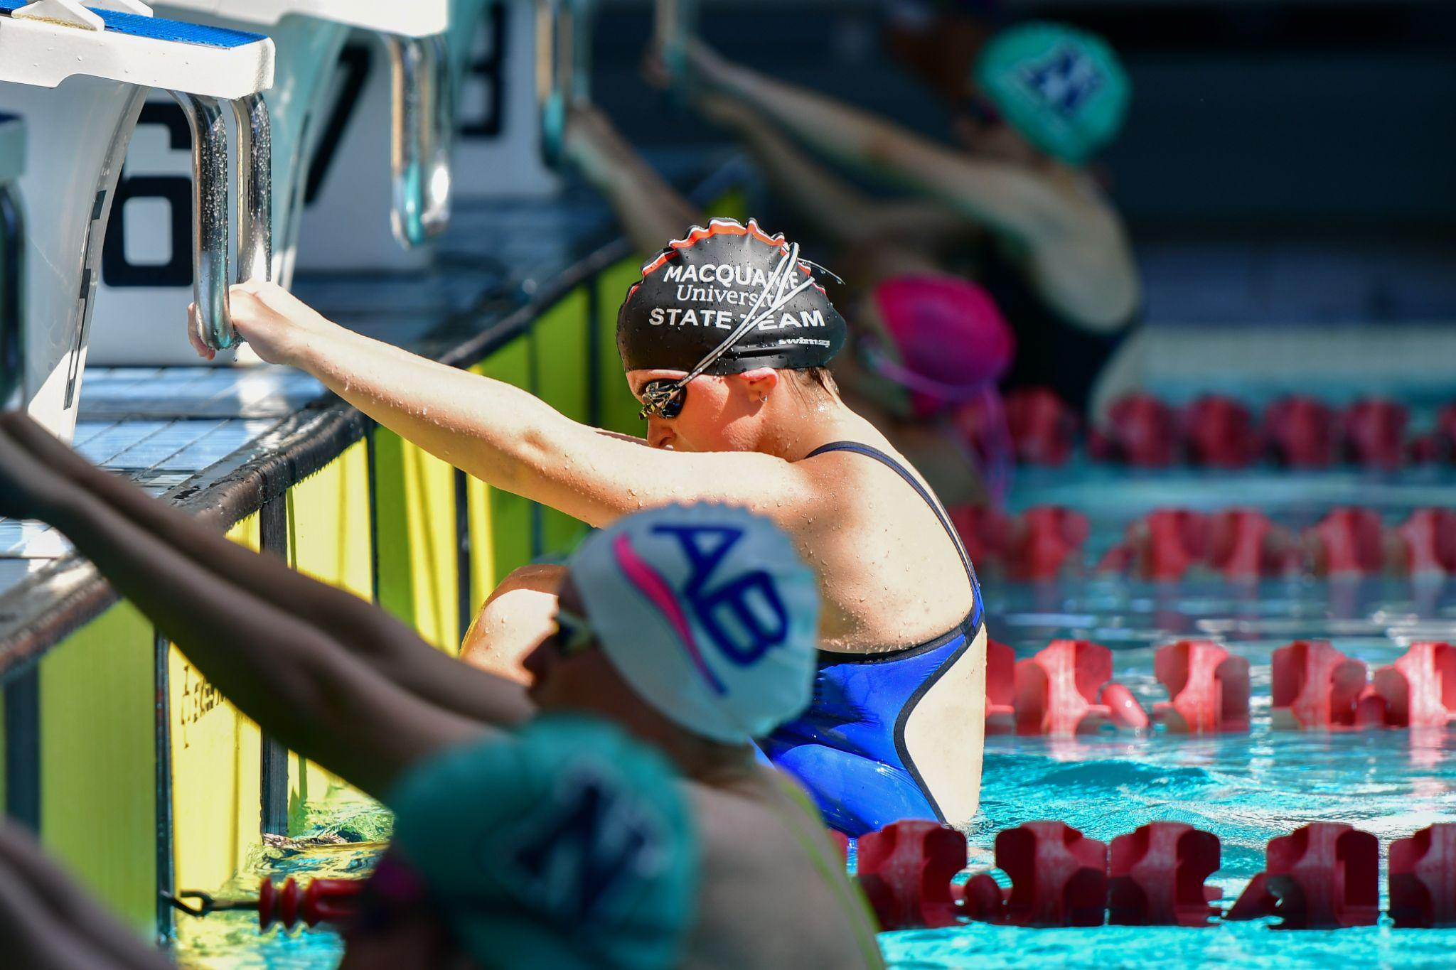
Dawn Fraser Award for Swimming
Female
Chloe Oates

Slide 37
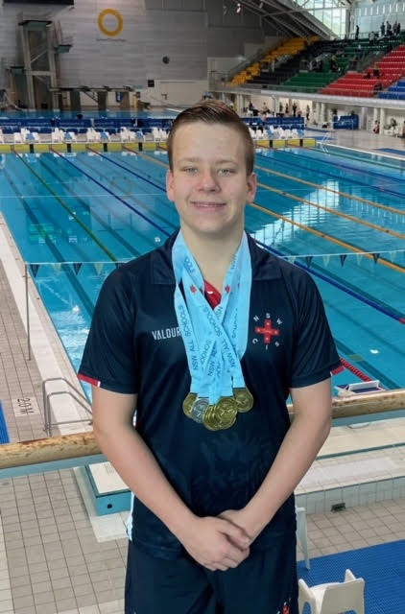
Dawn Fraser Award for Swimming
Male
Beau Matthews

Slide 38
Tim Sherry Award for Athletics
Presented by Kim Georgallis

Slide 39
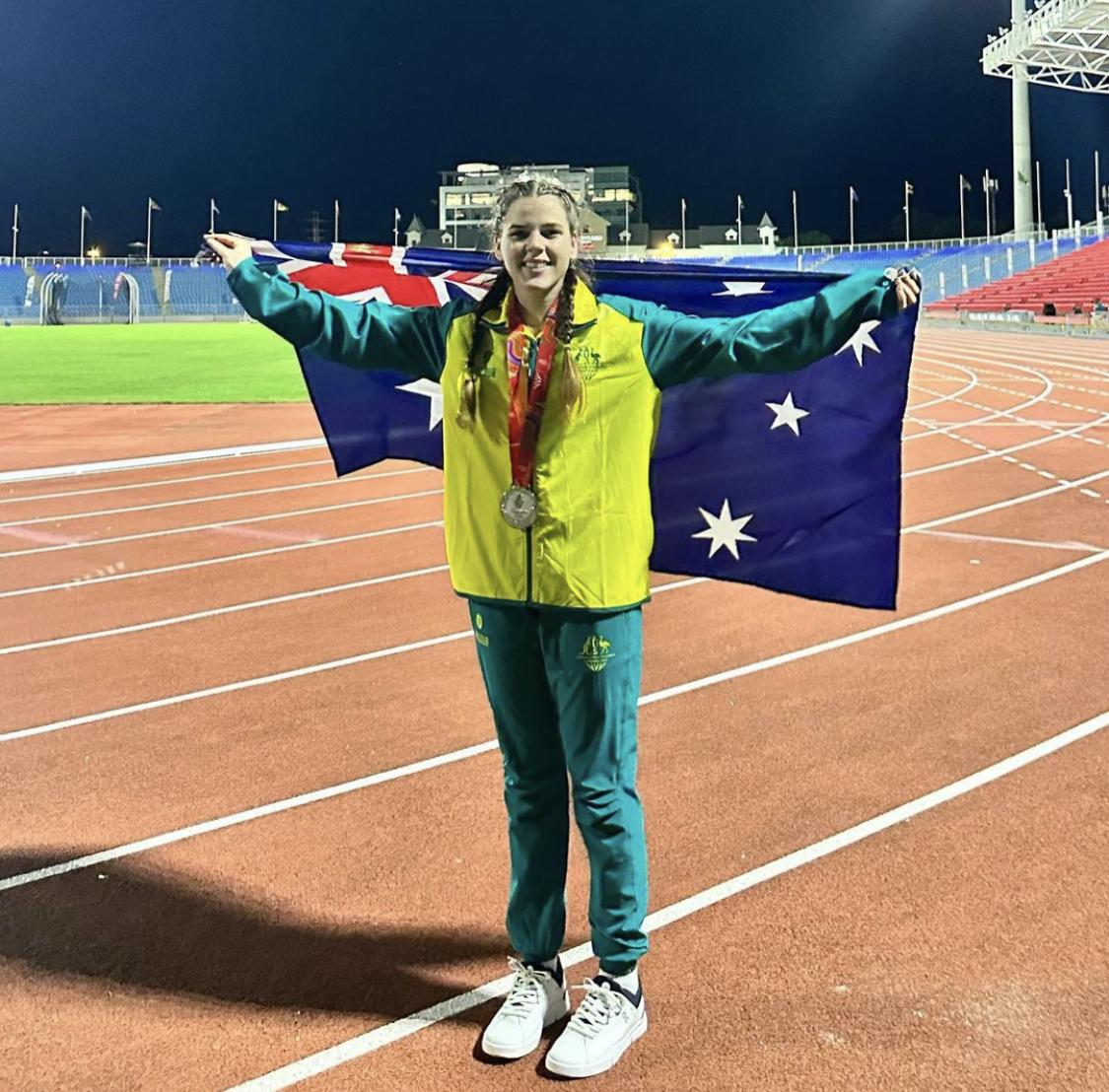
Tim Sherry Award for Athletics
Female
Indi Cooper

Slide 40
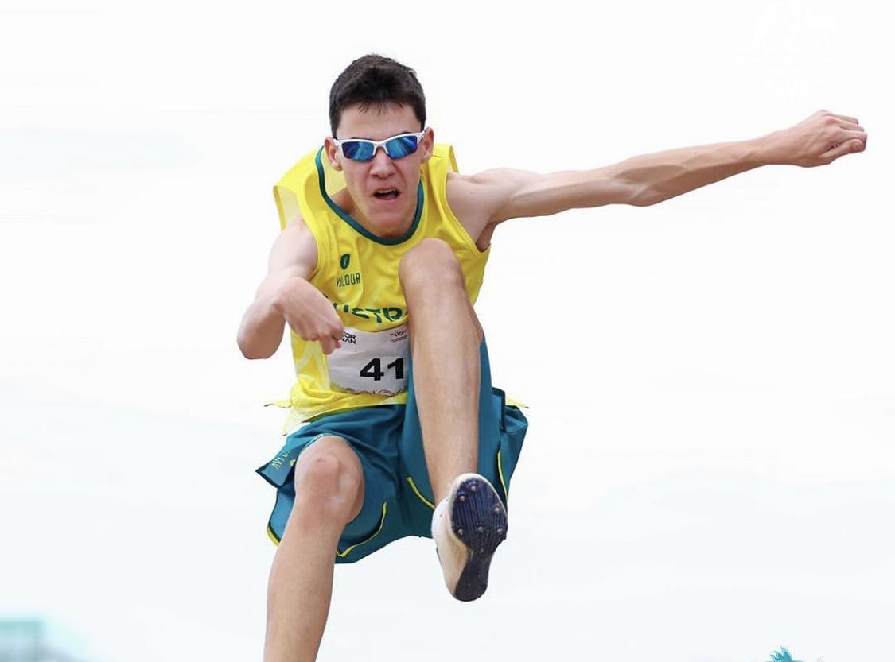
Tim Sherry Award for Athletics
Male
Jackson Love

Slide 41
Footballer of the Year
Presented by Ian Menzies

Slide 42
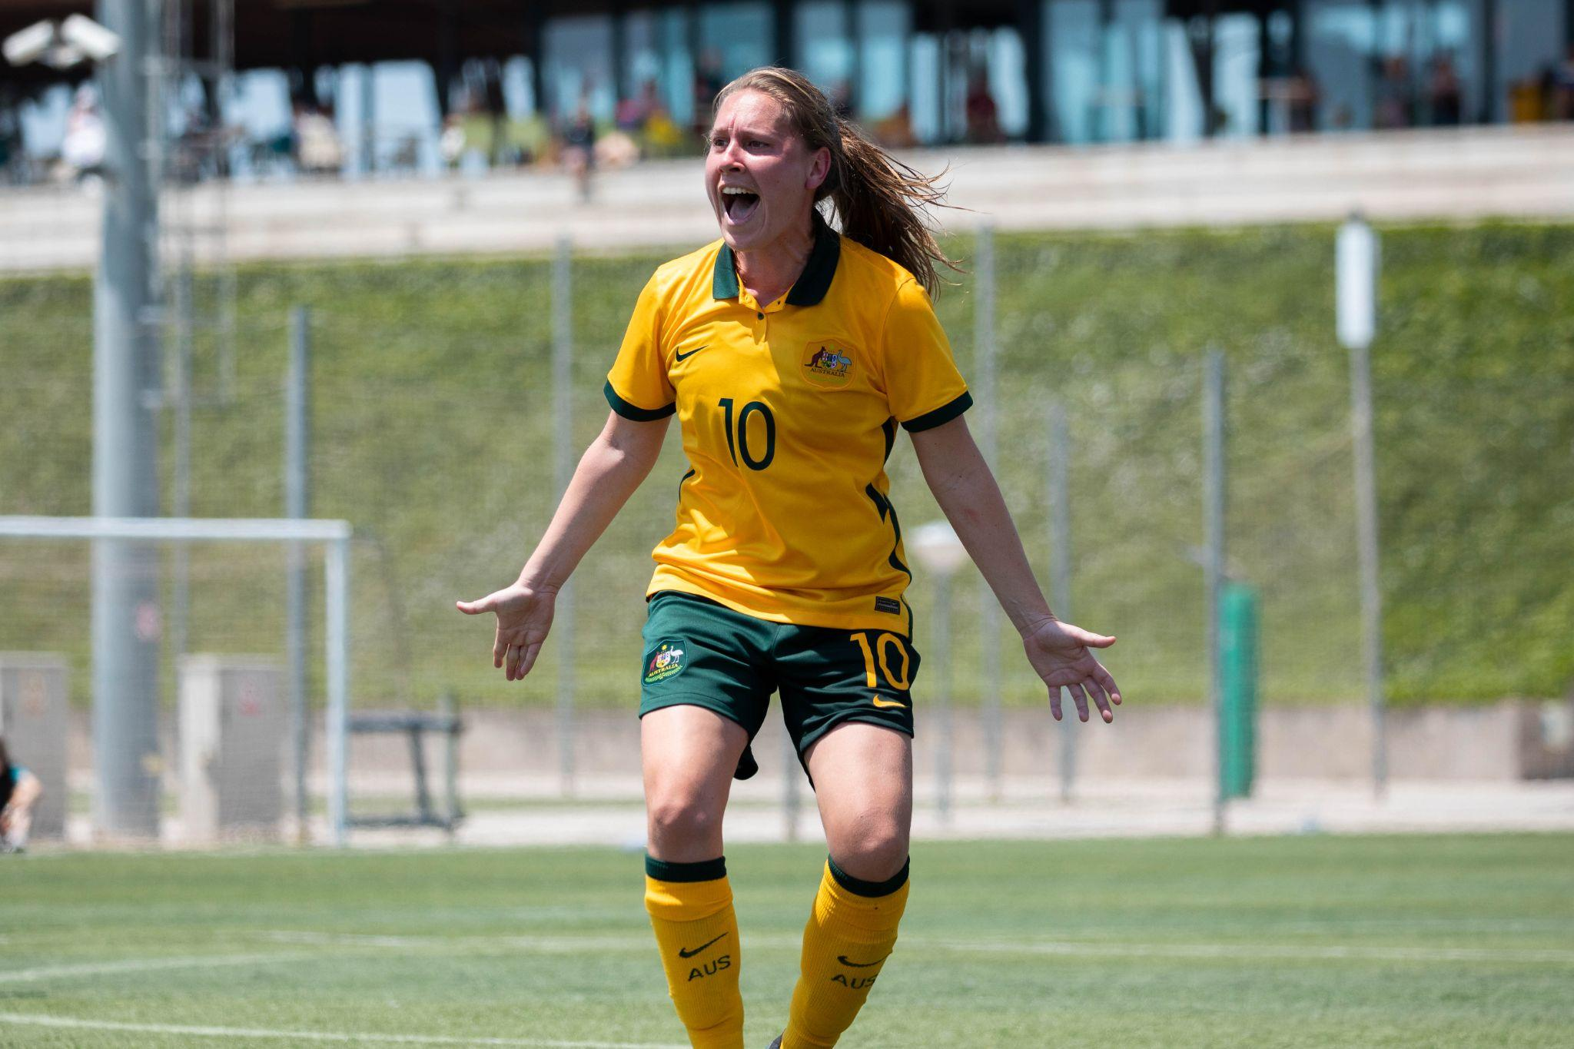
Footballer of the Year
Female
Georgia Beikoff

Slide 43
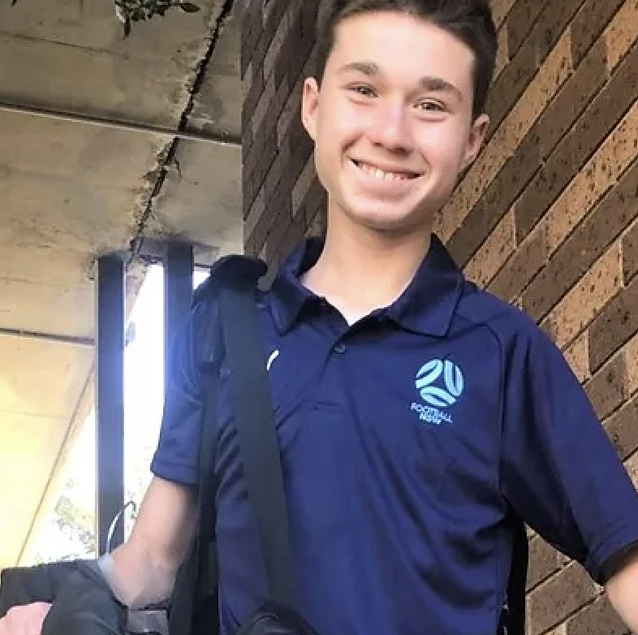
Footballer of the Year
Male
Tomas Scotti

Slide 44
President’s Award
Presented by Brian Berry

Slide 45
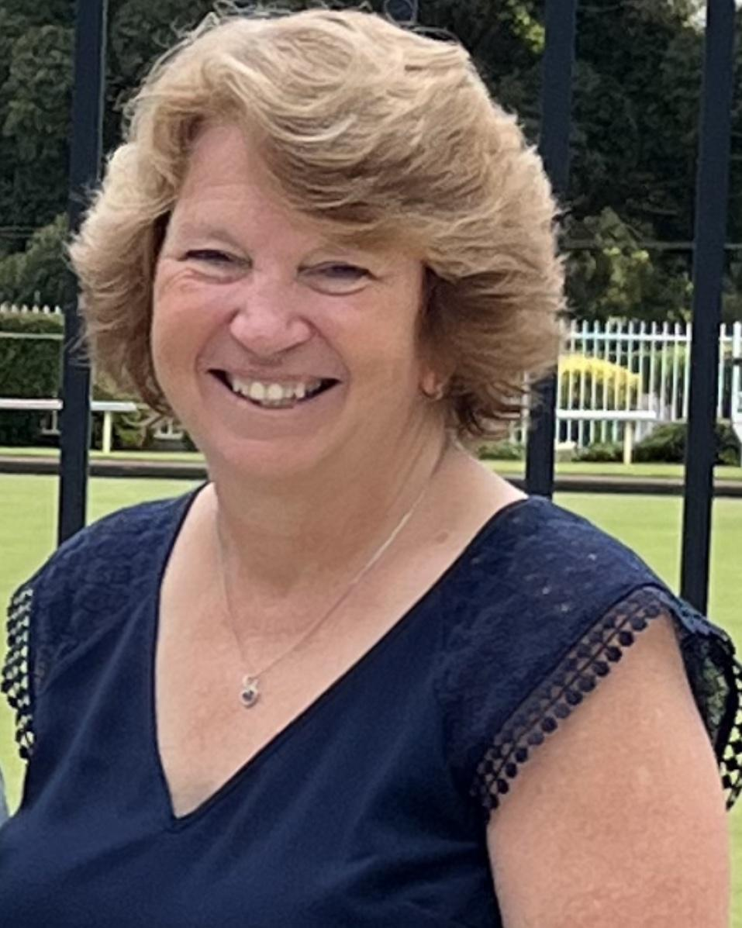
President’s Award
Heather Berry

Slide 46
Daniel Berry Inspirational Award
Presented by Heather Berry

Slide 47
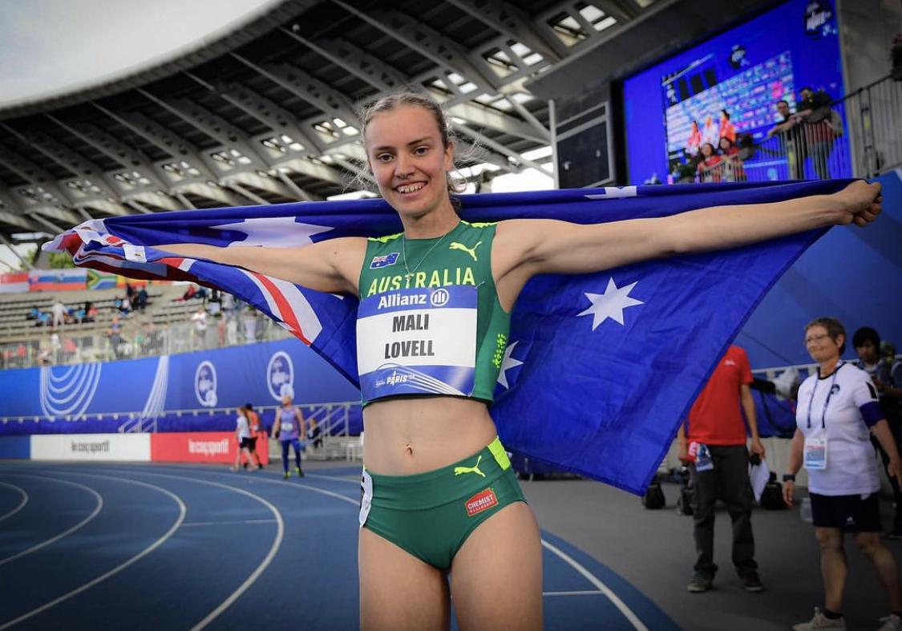
Daniel Berry Inspirational Award
Mali Lovell

Slide 48
Community Spirit Award
Presented by Murray Bartram

Slide 49
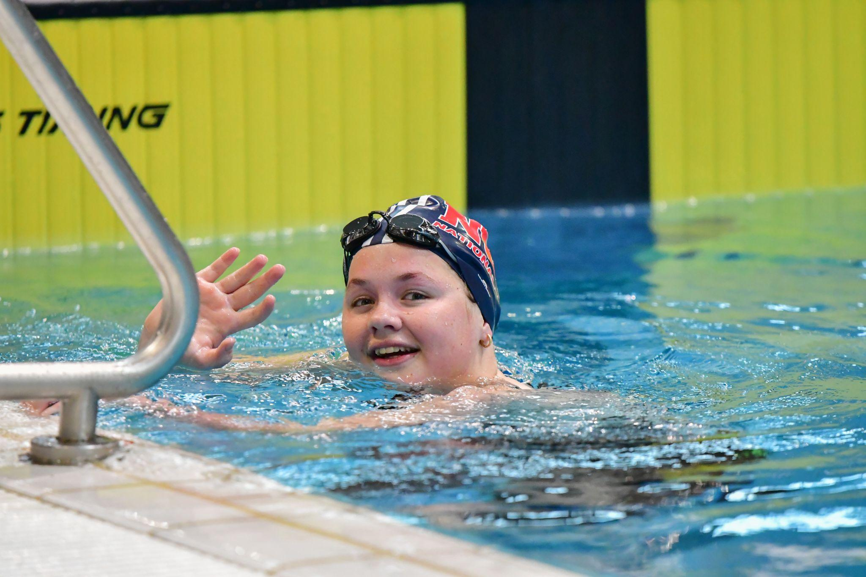
Community Spirit Award
Female
Victoria Robinson

Slide 50
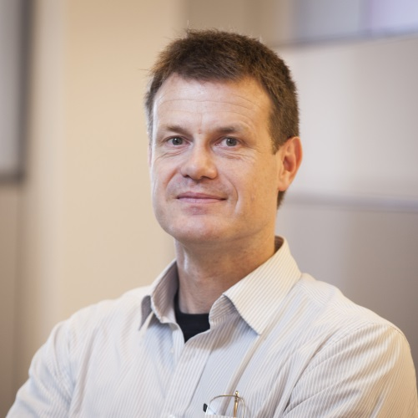
Community Spirit Award
Male
Ché Fornusek

Slide 51
Recognition of High Achievement Awards
Presented by Brian Berry

Slide 52
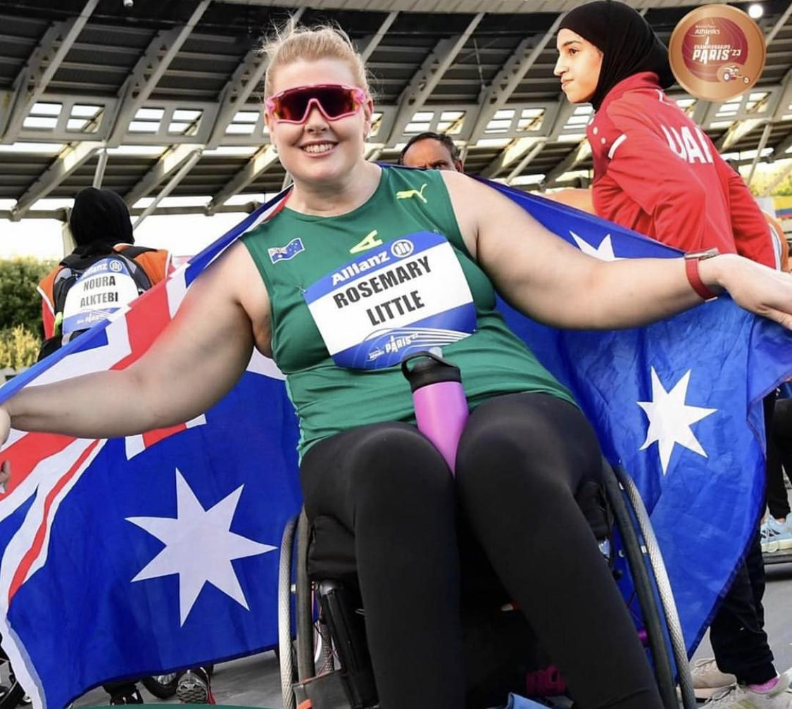
Recognition of High Achievement Awards
Rosemary Little

Slide 53
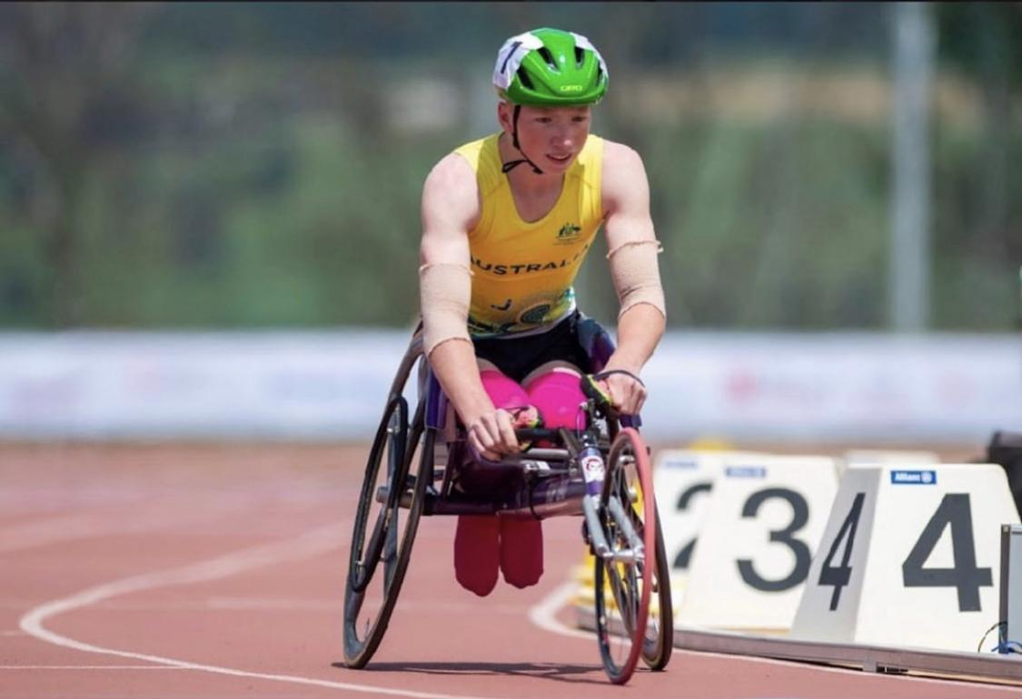
Recognition of High Achievement Awards
Waryk Holmes

Slide 54
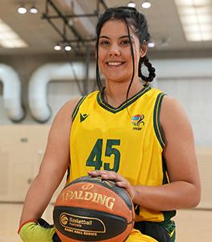
Recognition of High Achievement Awards
Breanna Fisk

Slide 55
CPSARA International Achievement Awards
Presented by Brian Berry

Slide 56
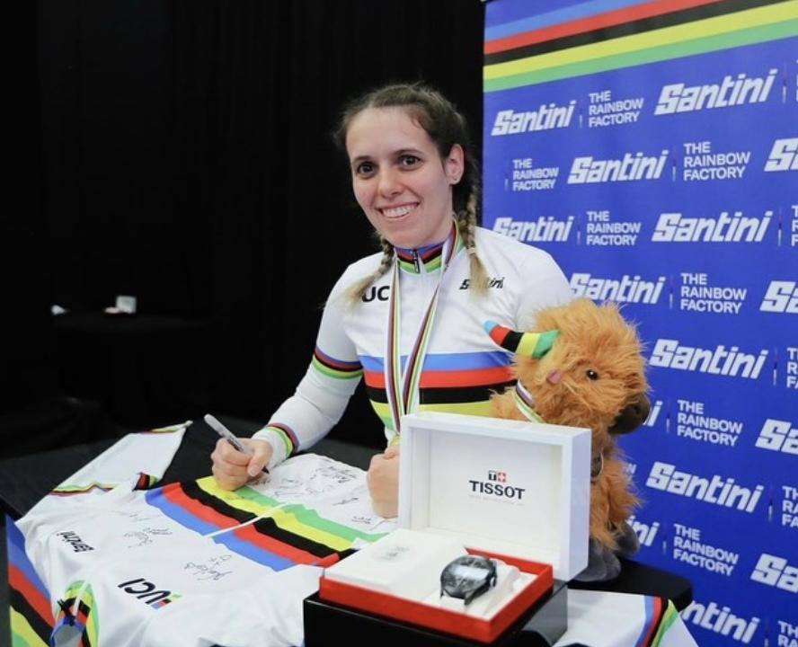
CPSARA International Achievement Awards
Amanda Reid

Slide 57
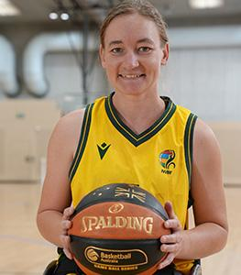
CPSARA International Achievement Awards
Jess Cronje

Slide 58
Athlete of the Year
Presented by Brian Berry

Slide 59
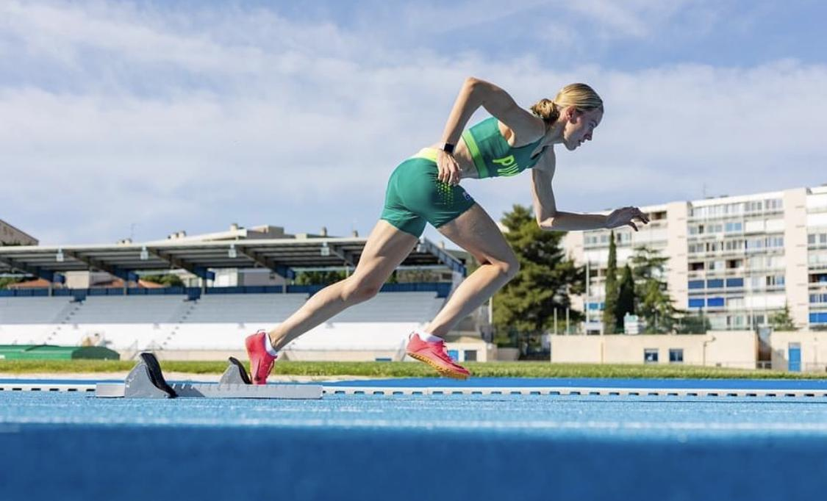
Athlete of the Year
Female
Mali Lovell

Slide 60
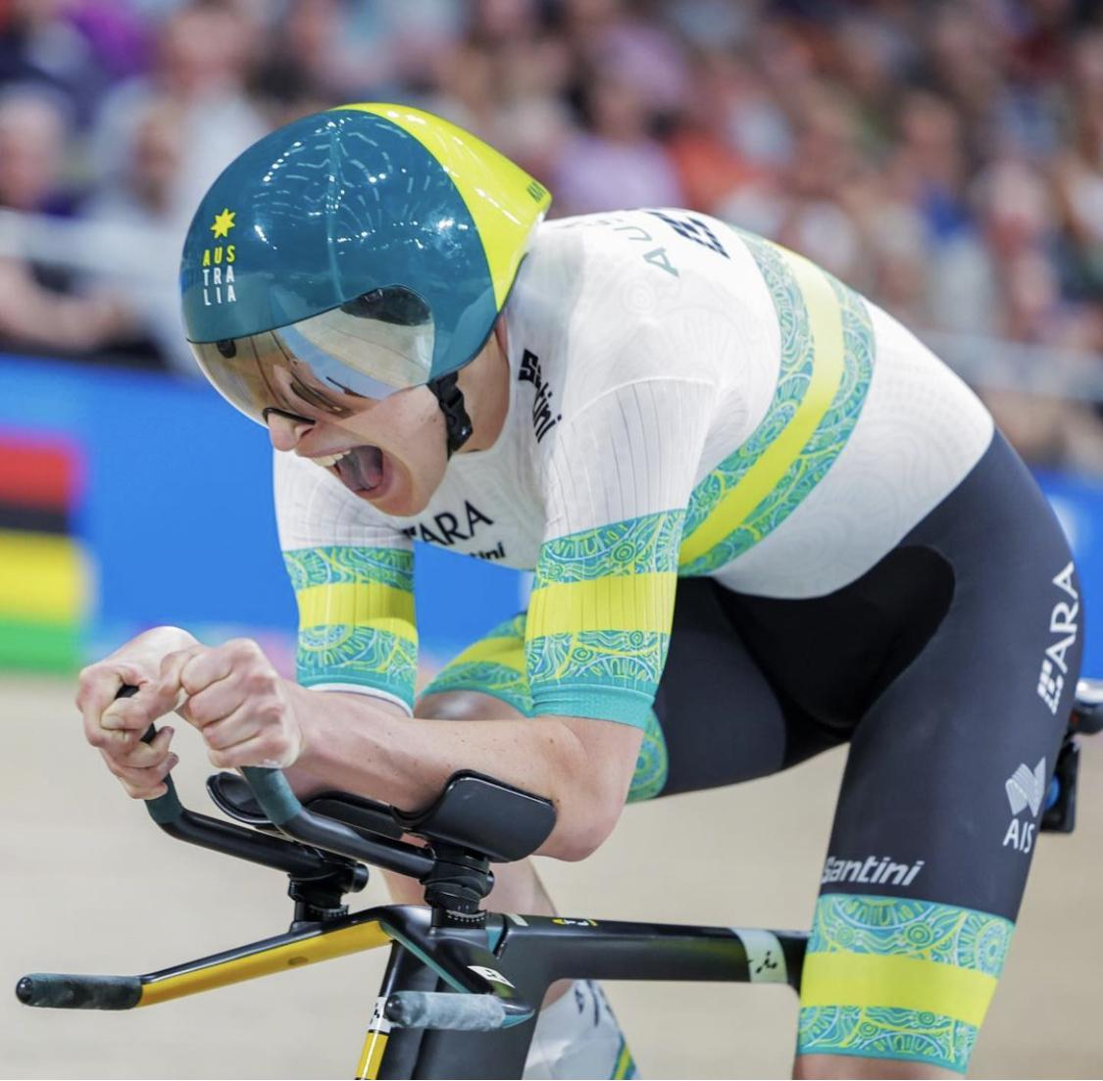
Athlete of the Year
Male
Gordon Allan

Slide 61
Upcoming Opportunities

Slide 62
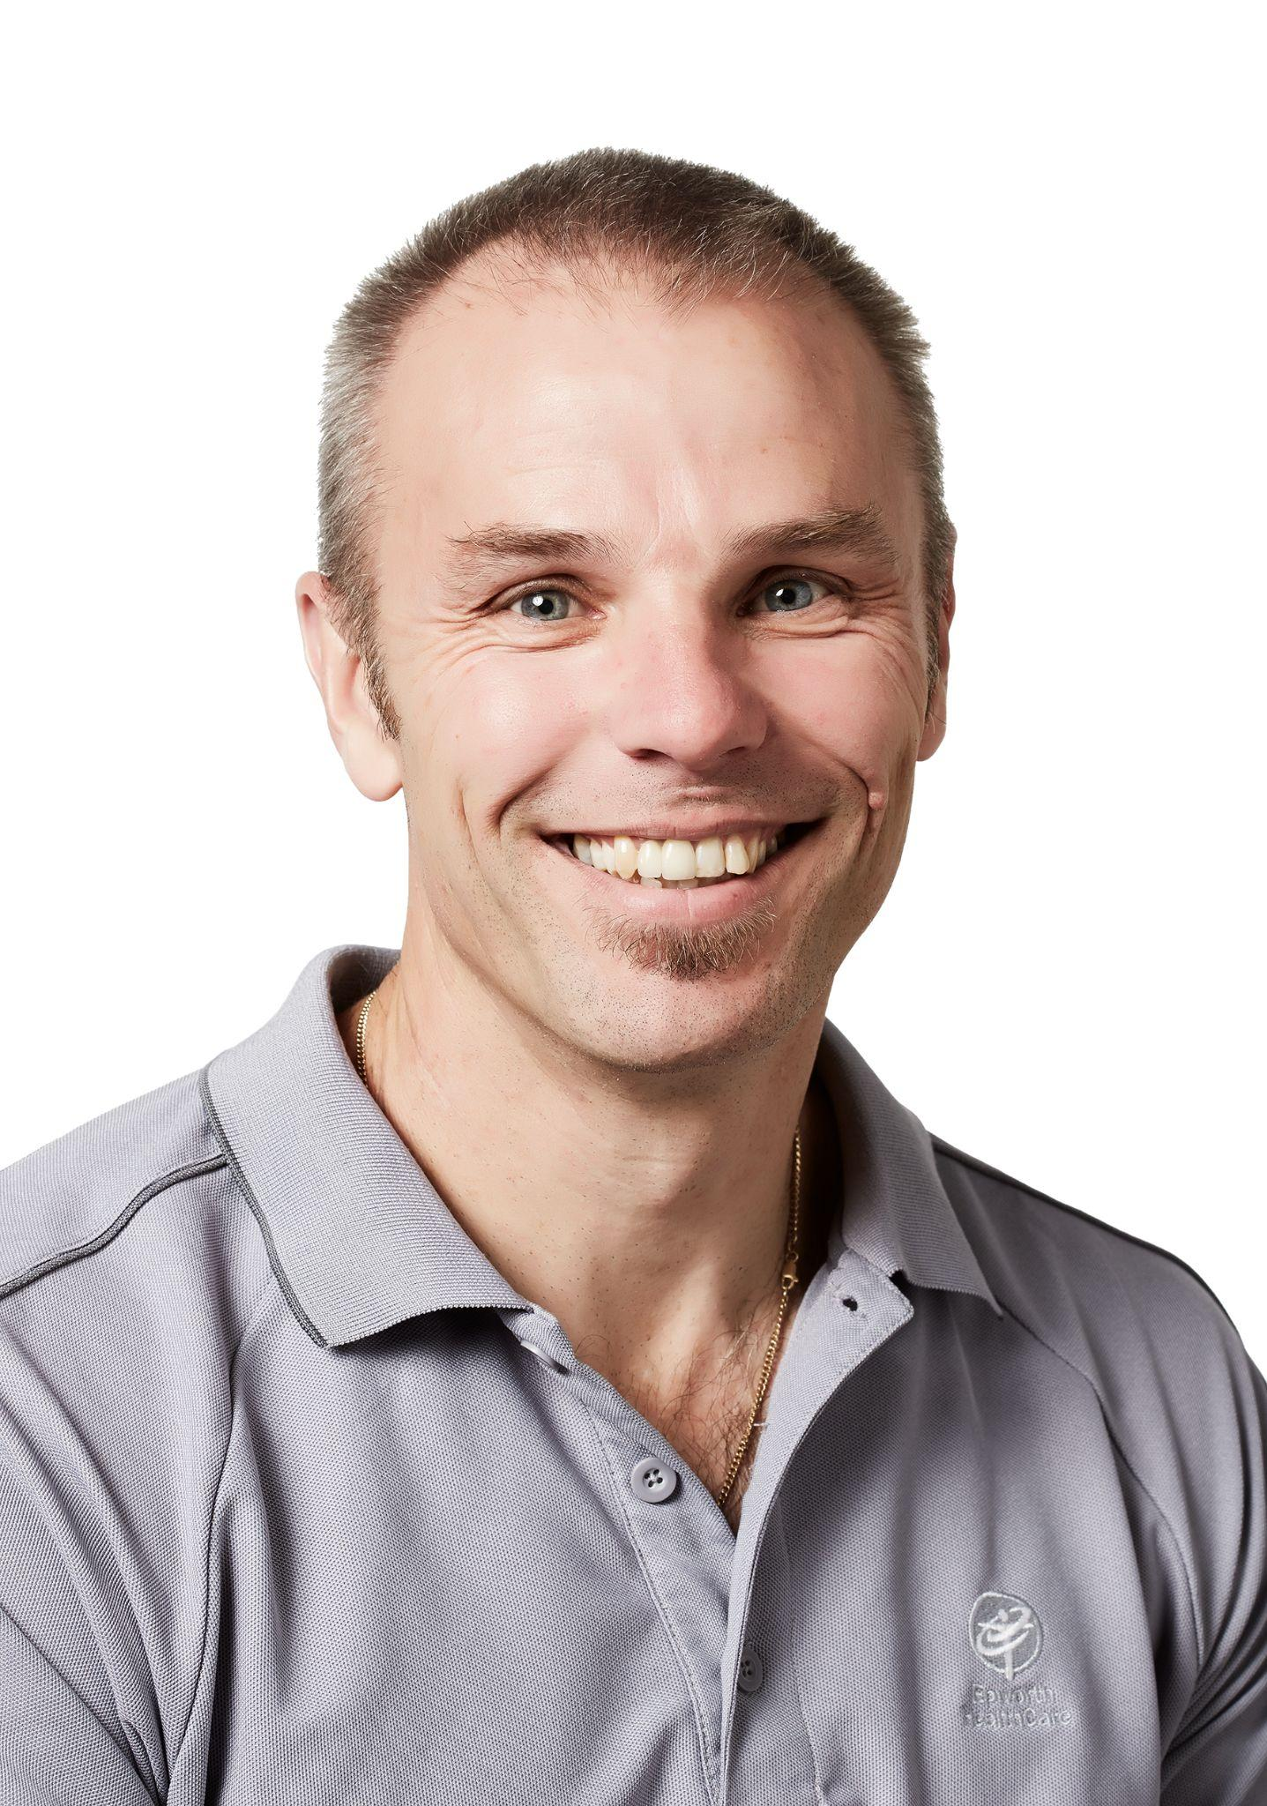


FREE Talk by Prof. Gavin Williams PhD FACP
What: Training running in people with
neurological problems
When: Monday 16th of October, 4-5pm
Where: Kerry Packer Education Centre,
Royal Prince Alfred Hospital
Who: Athletes, coaches and health professionals
Hear from a world renowned neurological physiotherapist to
get tips on how to improve your running technique!

Slide 63
CPSARA Athlete Funding Opportunity
As part of our commitment to members, we run an annual athlete funding program to contribute to the costs incurred by athletes in attending local or international competitions. Funding can be used to support sport related expenses such as entry fees, equipment and travel.
Funding for 2023 is now open. It covers events from 1 January 2023 – 31 December 2023
To be eligible for selection for funding, members must fill out the FUNDING APPLICATION FORM (posted in zoom chat) and email to secretary@cpsara.org.au by 30 NOVEMBER 2023.
The funding amounts are detailed below:
State based or national competition $250
International competition $500

Slide 64
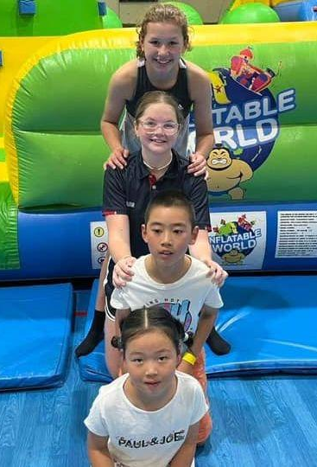
Social Event Dates
At CPSARA, we are all about connecting people with Cerebral Palsy and neurological conditions to each other and the community as well as to sport and recreation through FUN, FRIENDSHIPS AND FITNESS!
Following on from the huge successes of our recent CPSARA Connect Days and other social events, we are pleased to announce three more social events for the rest of 2023! These are:
CPSARA & City Community Tennis Social Event, 23rd of September 2023
CPSARA Connect Day @ Dural, 15th of October 2023
Members’ Sunday Picnic @ Wentworth Common, 19th of November 2023
You can register for any or all of these FREE events on our website at https://www.cpsara.org.au/upcomingevents. We hope to see you there! :)

Slide 65
CPSARA Athlete Interview
Interviewed by Murray Bartram

Slide 66
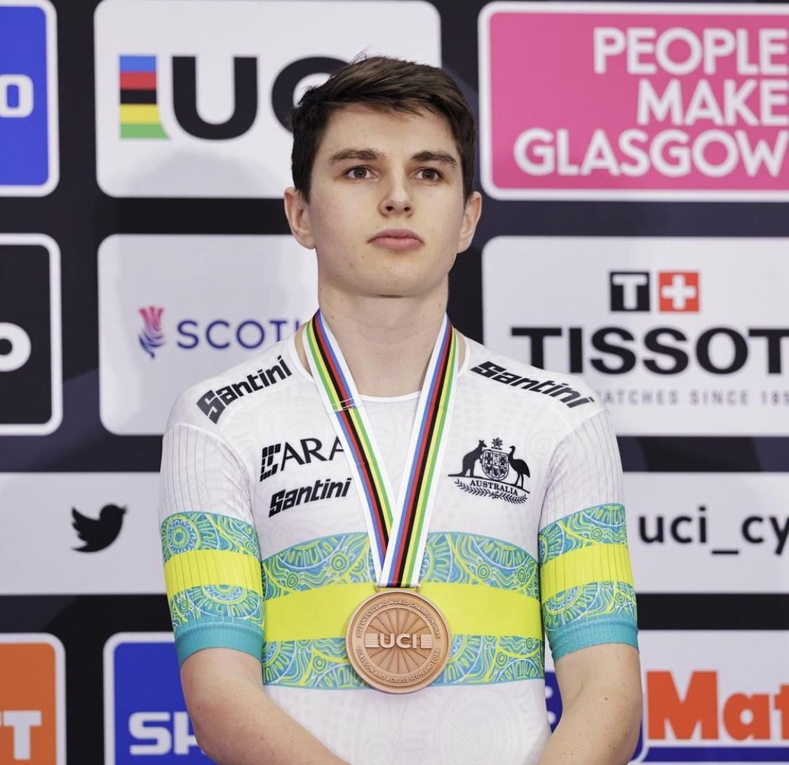
Gordon Allan
Guest Speaker
International Representative Cyclist
Recent UCI Cycling World Championship Bronze Medallist

Slide 67
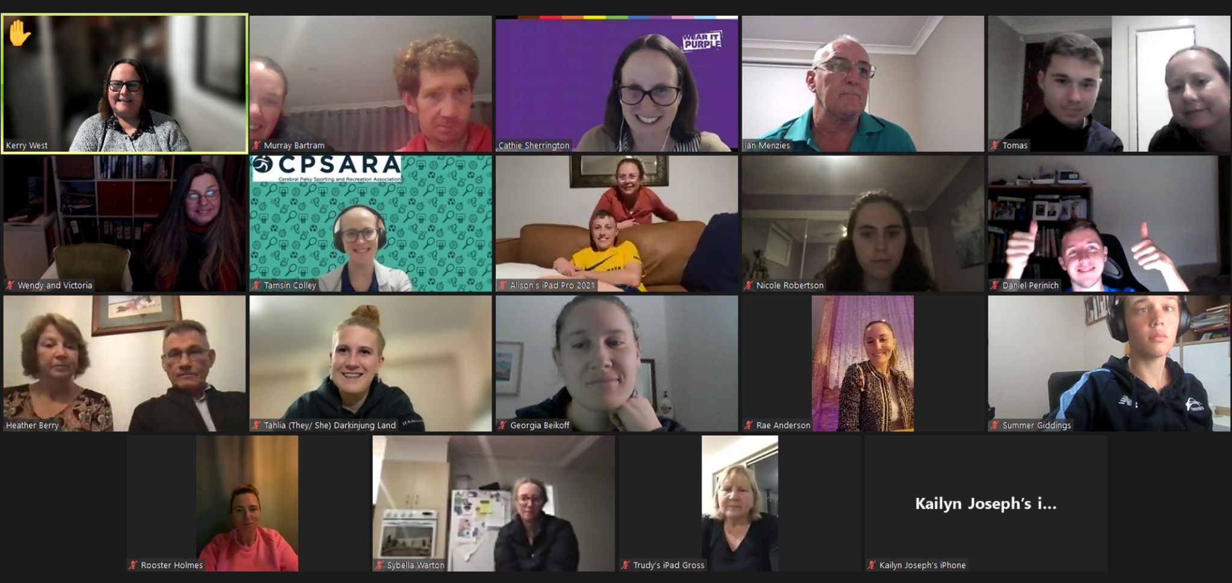
And finally… a CPSARA zoom photo!
One of our committee members will take a screenshot of the screen when you are all smiling!
If you don’t give permission for your photo to be used on CPSARA for promotional purposes, please turn your camera off for the photo.
Please see below for the photo from last year’s zoom AGM and awards night… let’s see if we can make it even better this time! :)

Slide 68
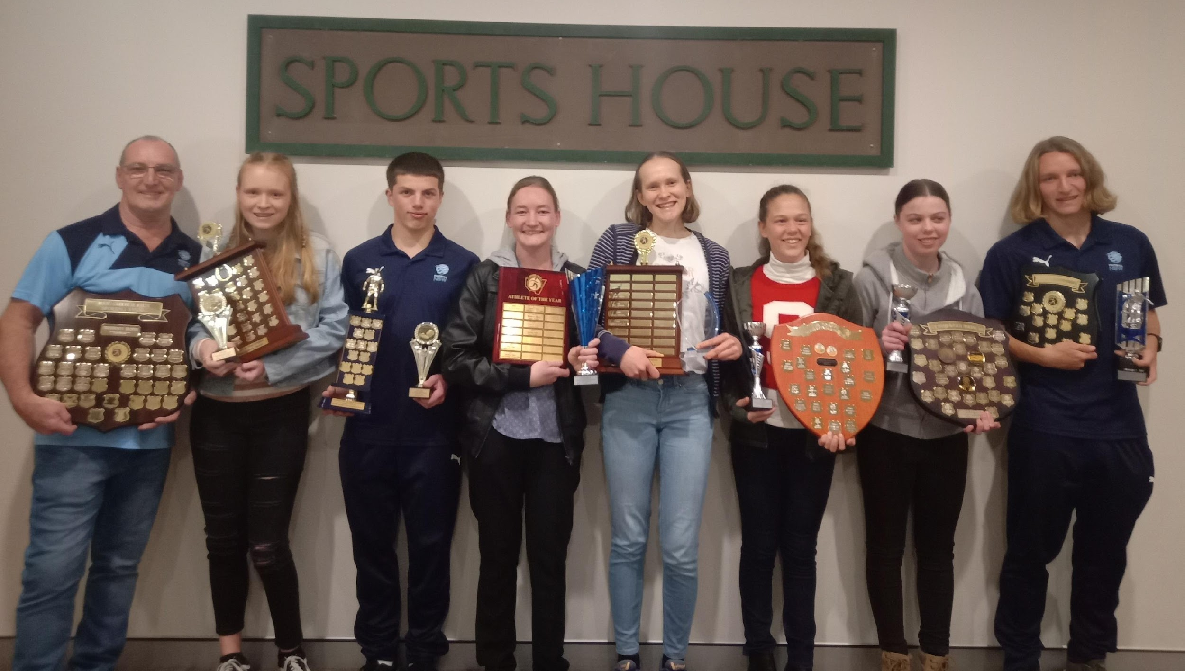
Congratulations to all award winners and to all CPSARA members on your outstanding accomplishments
Thank you for celebrating our CPSARA athletes’ achievements with us for the 2022/2023 season
Thank you to our sponsors:

