Slide 1
AGM/AWARDS NIGHT 2021
Welcome to
Thank you to our sponsors:

Slide 2
ANNUAL GENERAL MEETING 13th August 2021 1. Opening and Welcome 2. Apologies 3. Minutes of the Previous Annual General Meeting held 18th September 2020 4. Adoption of Annual Report 5. Adoption of the Financial Statement 6. Election of Office Bearers Vice-President – (2-year term) Secretary – (2-year term) Ordinary Member – 3 Positions (1-year term) 7. Close of Meeting Presentation of Awards Margaret & Allan Gregson Encouragement Awards: Presented by Margaret Gregson Swimming Athletics David Campbell Encouragement Award Football: Presented by Bill Gurney Ian Menzies Encouragement Award Football: Presented by Ian Menzies Bill Gurney Encouragement Award Football: Presented by Bill Gurney Judy Webber Encouragement Award Various Sports: Presented by Murray Bartram Dawn Fraser Award for Swimming : Presented by Margaret Gregson Tim Sherry Award for Athletics: Presented by Kim Georgallis Footballer of the Year: Presented by Ian Menzies President’s Award: Presented by Brian Berry Daniel Berry Inspirational Award: Presented by Heather Berry & Brian Berry Athlete of the Year: Presented by Kerry West Community Spirit Awards: Presented by Brian Berry Life Membership Awards: Presented by Brian Berry
Agenda

Slide 3
Annual Report
See Annual Report 2020 on CPSARA website (Link sent in Zoom chat)

Slide 4
MINUTES OF THE 2020 ANNUAL GENERAL MEETING
Annual Report
See Annual Report 2021 on CPSARA website (Link sent in Zoom chat)

Slide 5
Treasurer’s Report for AGM 2020/2021 Financial Year
Annual Report
See Annual Report 2021 on CPSARA website (Link sent in Zoom chat)

Slide 6
CPSARA Presidents Report – 2021
Annual Report
See Annual Report 2021 on CPSARA website (Link sent in Zoom chat)

Slide 7
Adoption of Annual Report
See Annual Report 2021 on CPSARA website (Link sent in Zoom chat)

Slide 8
Adoption of the Financial Statement
See Annual Report 2021 on CPSARA website (Link sent in Zoom chat)

Slide 9
Election of Office Bearers
Secretary (2 year term)
See Annual Report 2021 on CPSARA website (Link sent in Zoom chat)

Slide 10
Ordinary Member – 3 Positions (1-year term)
See Annual Report 2021 on CPSARA website (Link sent in Zoom chat)

Slide 11
Close of Meeting/Start of Awards Night
See Annual Report 2021 on CPSARA website (Link sent in Zoom chat)

Slide 12
AWARDS NIGHT 2021
Welcome to
Thank you to our sponsors:

Slide 13
Murray Bartram Recreational Athlete International Representative Athlete

Slide 14
Margaret & Allan Gregson Encouragement Award Swimming
Presented by Margaret Gregson

Slide 15
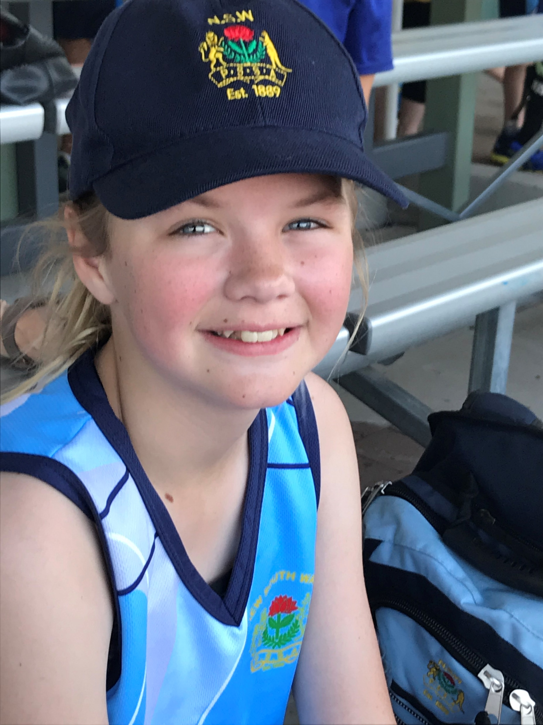
Margaret & Allan Gregson Encouragement Awards Swimming Female
Victoria Robinson

Slide 16
Margaret & Allan Gregson Encouragement Awards Swimming Female
Ali Green

Slide 17
Margaret & Allan Gregson Encouragement Awards Athletics
Presented by Margaret Gregson

Slide 18
Margaret & Allan Gregson Encouragement Awards Athletics Male
Jackson Love

Slide 19
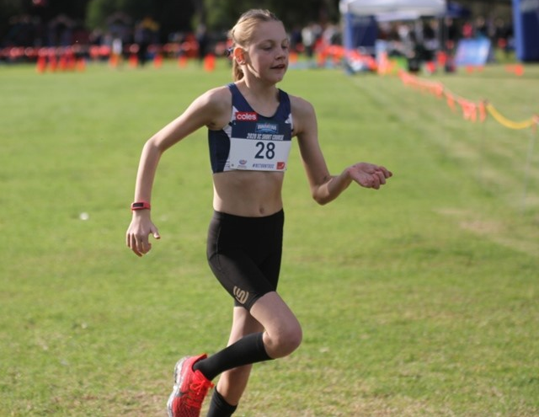
Margaret & Allan Gregson Encouragement Awards Athletics Female
Abbie Peet

Slide 20
David Campbell Encouragement Award Football
Presented by Bill Gurney

Slide 21
David Campbell Encouragement Award Football
Nicholas Khamis

Slide 22
Ian Menzies Encouragement Award Football
Presented by Ian Menzies

Slide 23
Ian Menzies Encouragement Award Football
Matthew Engesser

Slide 24
Bill Gurney Encouragement Award Football
Presented by Bill Gurney

Slide 25
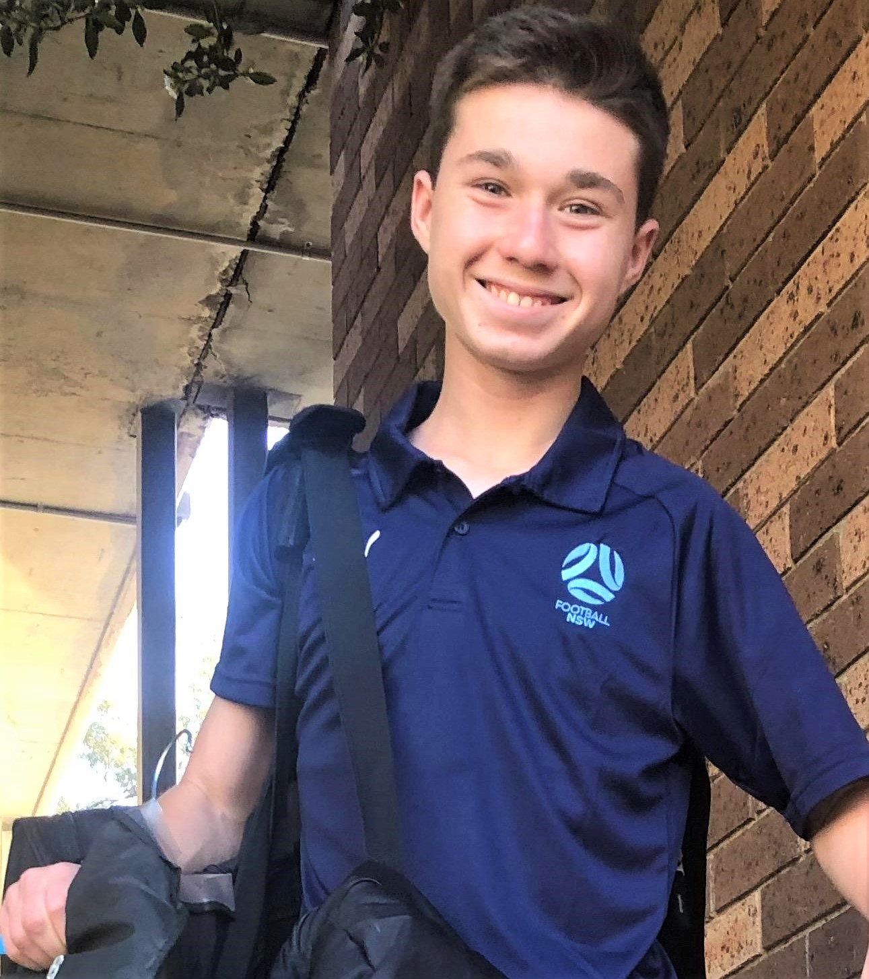
Bill Gurney Encouragement Award Football
Tomas Scotti

Slide 26
Judy Webber Encouragement Award Various Sports
Presented by Murray Bartram

Slide 27
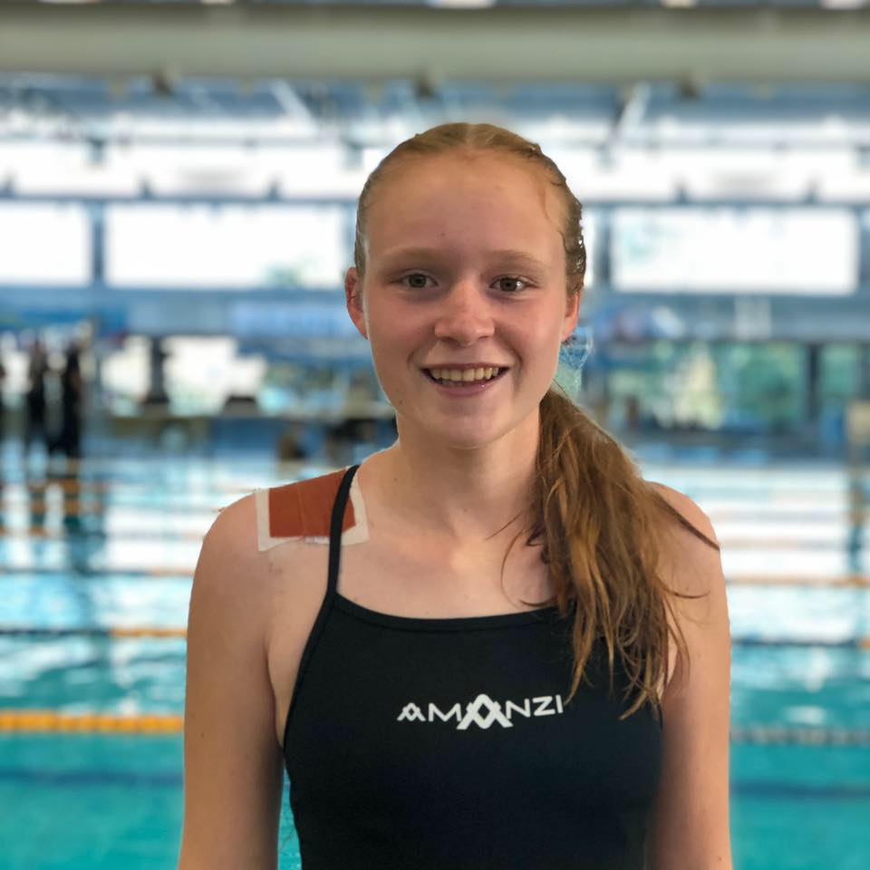
Judy Webber Encouragement Award Various Sports
Madelaine Goodridge

Slide 28
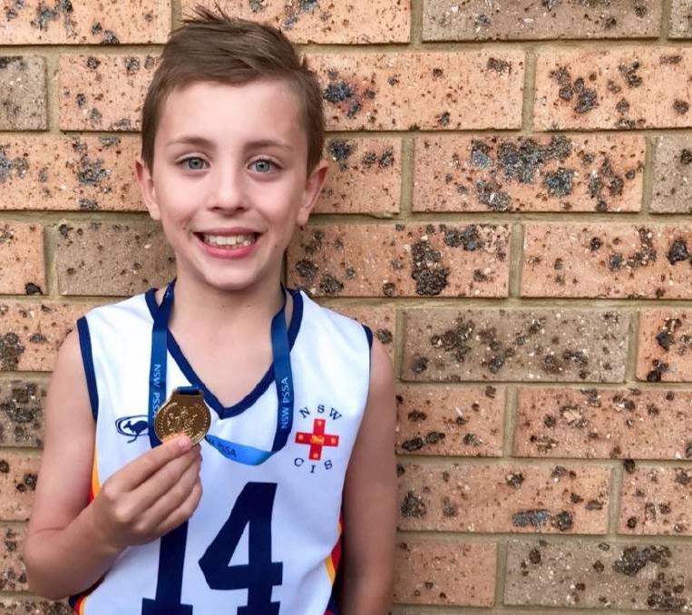
Judy Webber Encouragement Award Various Sports
Cooper Robb-Jackson

Slide 29
Dawn Fraser Award for Swimming
Presented by Margaret Gregson

Slide 30
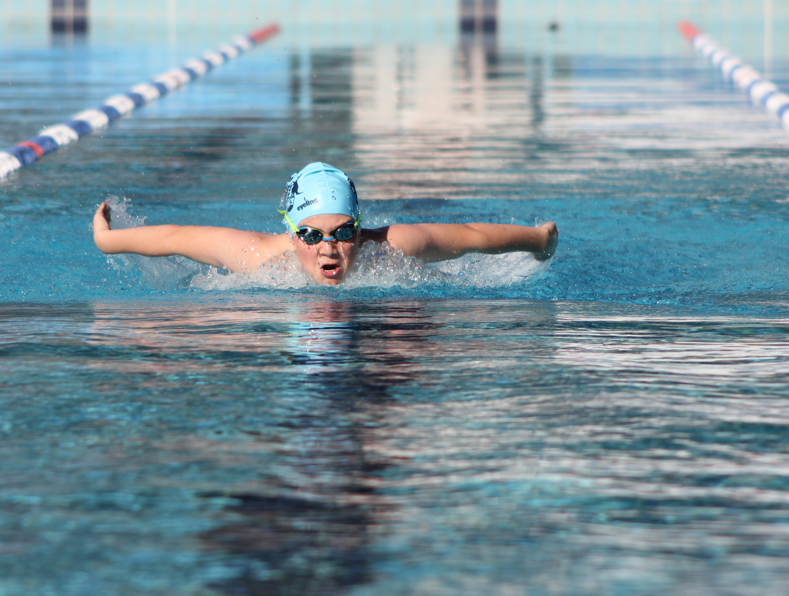
Dawn Fraser Award for Swimming Junior
Declan Budd

Slide 31
Dawn Fraser Award for Swimming Senior
Tahlia Blanshard

Slide 32
Tim Sherry Award for Athletics
Presented by Kim Georgallis

Slide 33
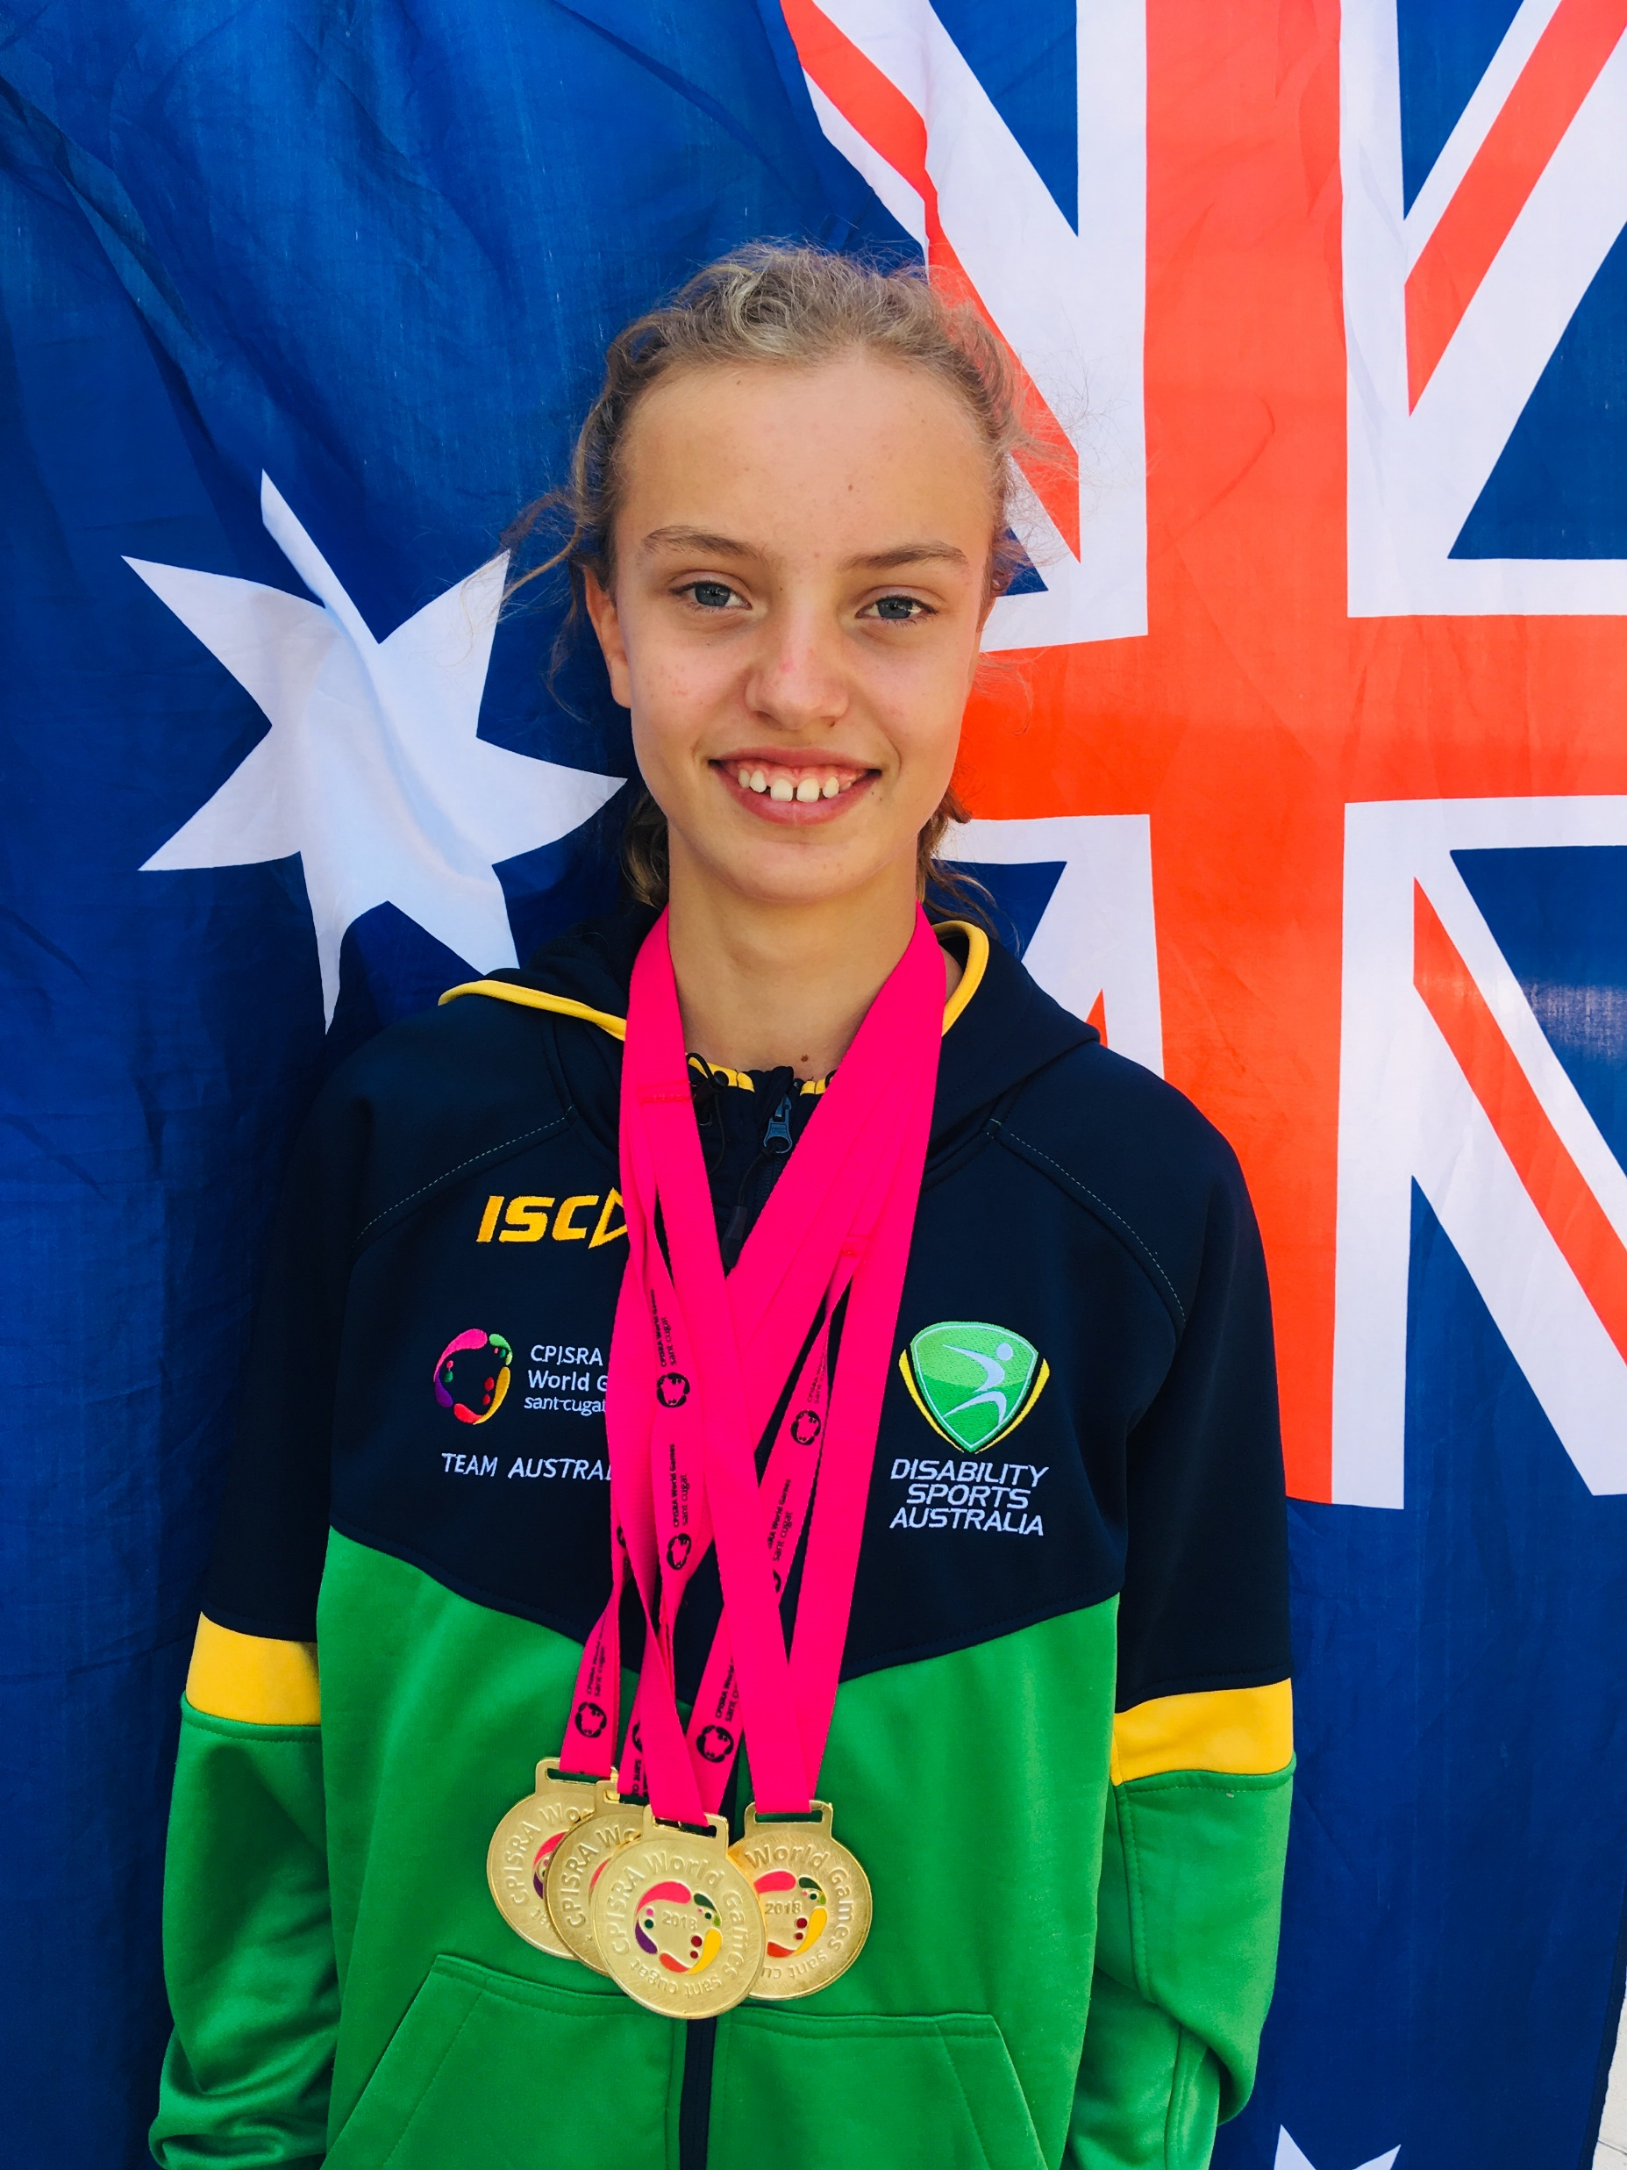
Tim Sherry Award for Athletics
Mali Lovell

Slide 34
Tim Sherry Award for Athletics
Kailyn Joesph

Slide 35
Footballer of the Year
Presented by Ian Menzies

Slide 36
Footballer of the Year
Ben Atkins

Slide 37
President’s Award
Presented by Brian Berry

Slide 38
President’s Award
Nicki Ashton

Slide 39
Daniel Berry Inspirational Award
Presented by Heather Berry & Brian Berry

Slide 40
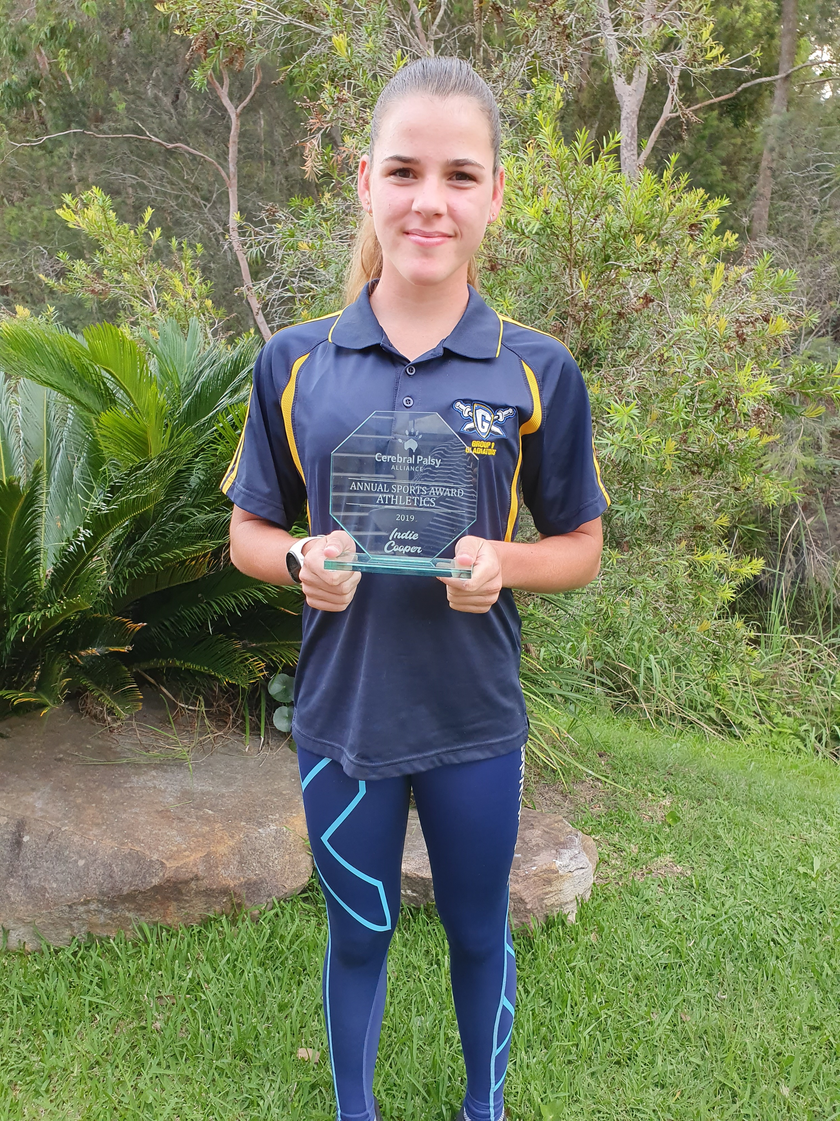
Daniel Berry Inspirational Award
Indiana Cooper

Slide 41
Athlete of the Year
Presented by Kerry West

Slide 42
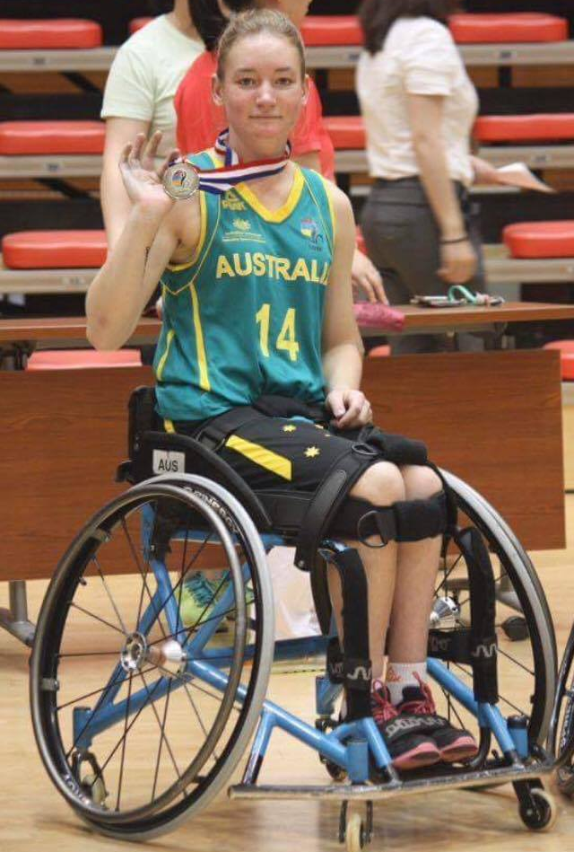
Athlete of the Year
Jess Cronje

Slide 43
Athlete of the Year
Gordon Allan

Slide 44
Athlete of the Year
Amanda Reid

Slide 45
Community Spirit Award
Presented by Brian Berry

Slide 46
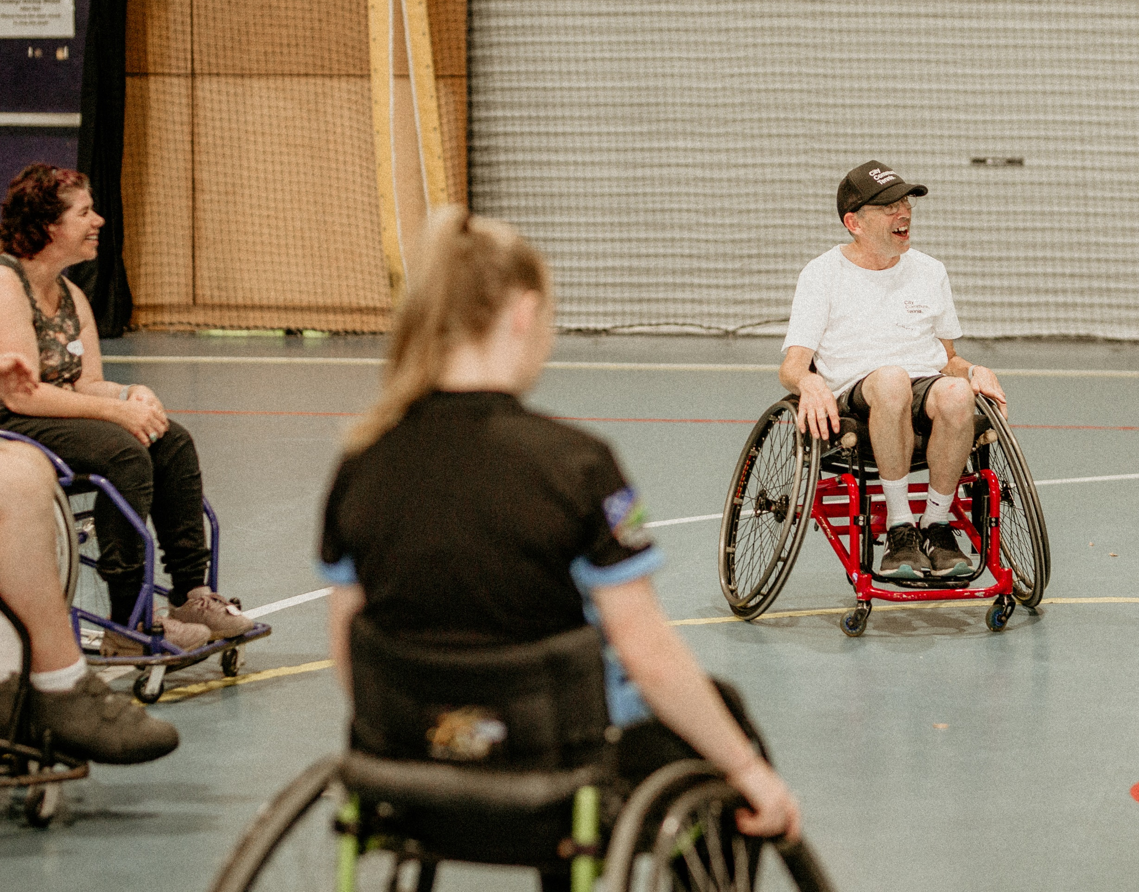
Community Spirit Award
Anthony Marmont

Slide 47
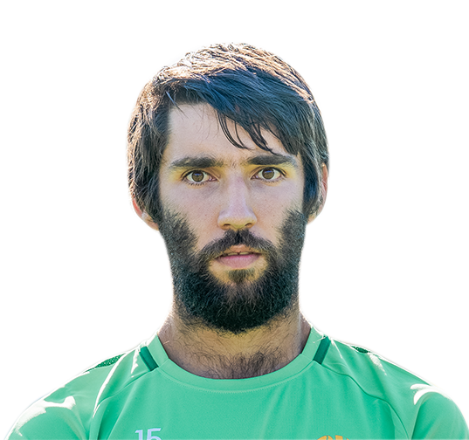
Community Spirit Award
Ben Sutton

Slide 48
Life Membership Awards
Presented by Brian Berry

Slide 49
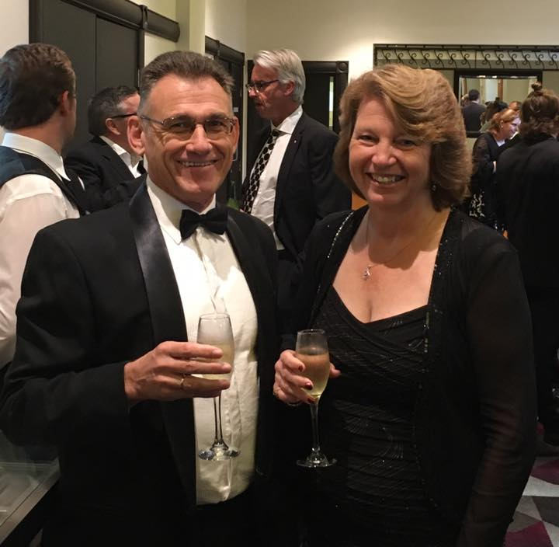
Life Membership Awards
Heather Berry

Slide 50
Life Membership Awards
Nicki Ashton

Slide 51
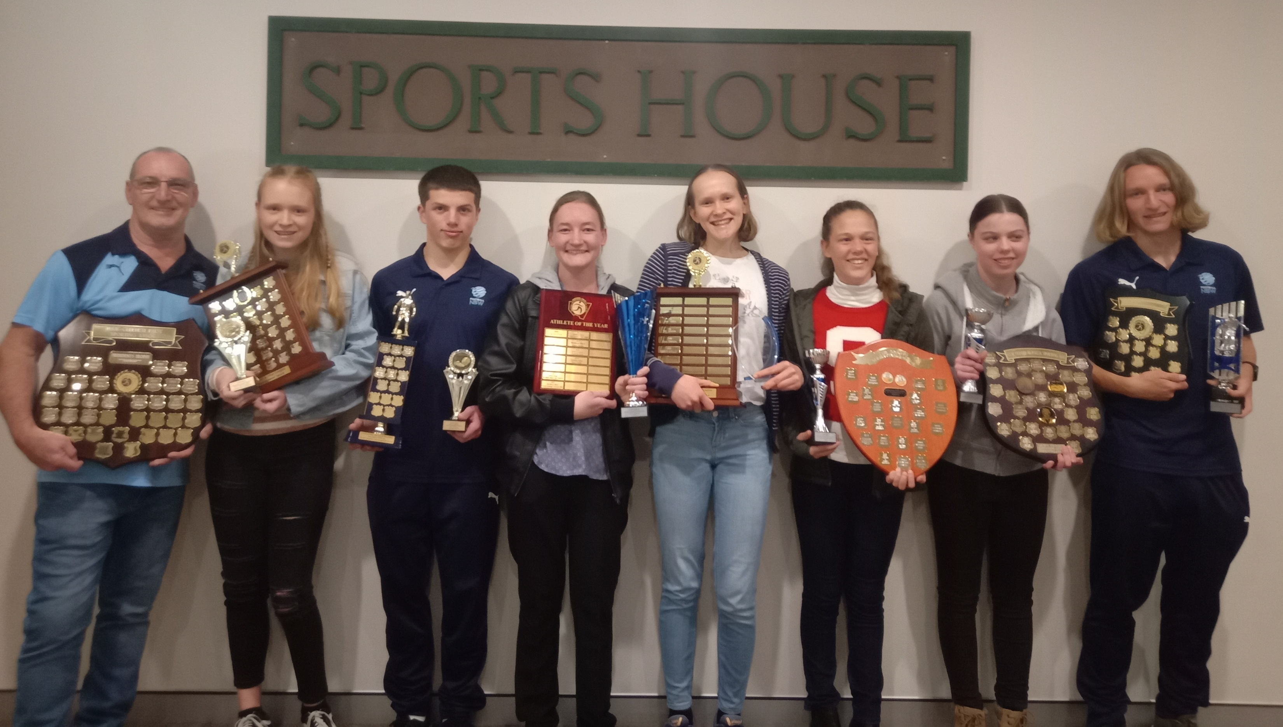
Congratulations to all award winners and to all CPSARA members on your outstanding accomplishments Thank you for celebrating our CPSARA athletes’ achievements with us for the 2020/2021 season
Thank you to our sponsors:

