Slide 1
AGM/AWARDS NIGHT
Welcome to
Thank you to our sponsors:

Slide 2
ANNUAL GENERAL MEETING 18th September 2020 1. Opening and Welcome 2. Apologies 3. Minutes of the Previous Annual General Meeting held 23th August 2019 4. Adoption of Annual Report 5. Adoption of the Financial Statement 6. Election of Office Bearers President – (2-year term) Treasurer – (2-year term) Ordinary Member – 3 Positions (1-year term) 7. Close of Meeting Presentation of Awards CPSARA Participation Enhancement Activity Small Grants: Presented by Rae Anderson Margaret & Allan Gregson Encouragement Awards: Presented by Margaret Gregson Swimming Athletics David Campbell Encouragement Award Football: Presented by Bill Gurney Bill Gurney Encouragement Award Football: Presented by Bill Gurney Ian Menzies Encouragement Award Football: Presented by Ian Menzies Judy Webber Encouragement Award Various Sports: Presented by Murray Bartram Dawn Fraser Award for Swimming : Presented by Margaret Gregson Tim Sherry Award for Athletics: Presented by Kim Georgallis Footballer of the Year: Presented by Ian Menzies President’s Award: Presented by Brian Berry Daniel Berry Inspirational Award: Presented by Heather Berry Athlete of the Year: Presented by Kerry West Recognition of High Achievement Awards: Presented by Brian Berry Life Membership Awards: Presented by Nicki Ashton
Agenda

Slide 3
Annual Report
See Annual Report 2020 on CPSARA website (Link sent in Zoom chat)

Slide 4
MINUTES OF THE 2019 ANNUAL GENERAL MEETING
Annual Report
See Annual Report 2020 on CPSARA website (Link sent in Zoom chat)

Slide 5
Treasurer’s Report for AGM 2019/2020 Financial Year
Annual Report
See Annual Report 2020 on CPSARA website (Link sent in Zoom chat)

Slide 6
CPSARA Presidents Report – 2020
Annual Report
See Annual Report 2020 on CPSARA website (Link sent in Zoom chat)

Slide 7
ATHLETICS REPORT (FROM CATHIE SHERRINGTON)
Annual Report
See Annual Report 2020 on CPSARA website (Link sent in Zoom chat)

Slide 8
CYCLING REPORT (FROM ROSS ALLAN)
Annual Report
See Annual Report 2020 on CPSARA website (Link sent in Zoom chat)

Slide 9
SWIMMING REPORT (FROM KERRY WEST)
Annual Report
See Annual Report 2020 on CPSARA website (Link sent in Zoom chat)

Slide 10
PARALYMPIC 7-A-SIDE FOOTBALL REPORT (FROM MURRAY BARTRAM)
Annual Report
See Annual Report 2020 on CPSARA website (Link sent in Zoom chat)

Slide 11
Adoption of Annual Report
See Annual Report 2020 on CPSARA website (Link sent in Zoom chat)

Slide 12
Adoption of the Financial Statement
See Annual Report 2020 on CPSARA website (Link sent in Zoom chat)

Slide 13
Election of Office Bearers
President – (2-year term)
Treasurer – (2-year term)
See Annual Report 2020 on CPSARA website (Link sent in Zoom chat)

Slide 14
Ordinary Member – 3 Positions (1-year term)
See Annual Report 2020 on CPSARA website (Link sent in Zoom chat)

Slide 15
Close of Meeting/Start of Awards Night
See Annual Report 2020 on CPSARA website (Link sent in Zoom chat)

Slide 16
AWARDS NIGHT
Welcome to
Thank you to our sponsors:

Slide 17
CPSARA Participation Enhancement Activity Small Grant Funding Scheme 2020
Presented by Rae Anderson
This scheme aims to provide small grants to CPSARA NSW members to run initiatives to promote participation in sport for children or adults with cerebral palsy and other neurological conditions. Initiatives may include, but are not limited to, sporting events, education events, short films or campaigns.

Slide 18
CPSARA Participation Enhancement Activity Small Grant Funding Scheme 2020
Sydney AthsAbility 2020
by Tamsin Colley & Christian Georgallis
AIM
This carnival aims to empower young people with a disability in Sydney through a come-and try day / friendly carnival and improve participation in para-athletics.
PURPOSE
- For people of any age with a disability of any magnitude to come and try athletics and get involved with CPSARA, and for people who already participate in para-athletics to catch up with others and get a competition experience in a friendly environment as the COVID-19 restrictions ease.
CPSARA Promotional Video
by Christian Georgallis
AIM
Raise awareness of the options and benefits of participation in sport for individuals with cerebral palsy
Encourage enrolment of members to the organization
Showcase the benefits of participation in sport for individuals with cerebral palsy.
How the organization helps support individuals with cerebral palsy to get involved in sport,
How to become a member including its many benefits such as being a part of an inclusive community
Share with media organizations to seek further promotion

Slide 19
Margaret & Allan Gregson Encouragement Award Swimming
Presented by Margaret Gregson

Slide 20
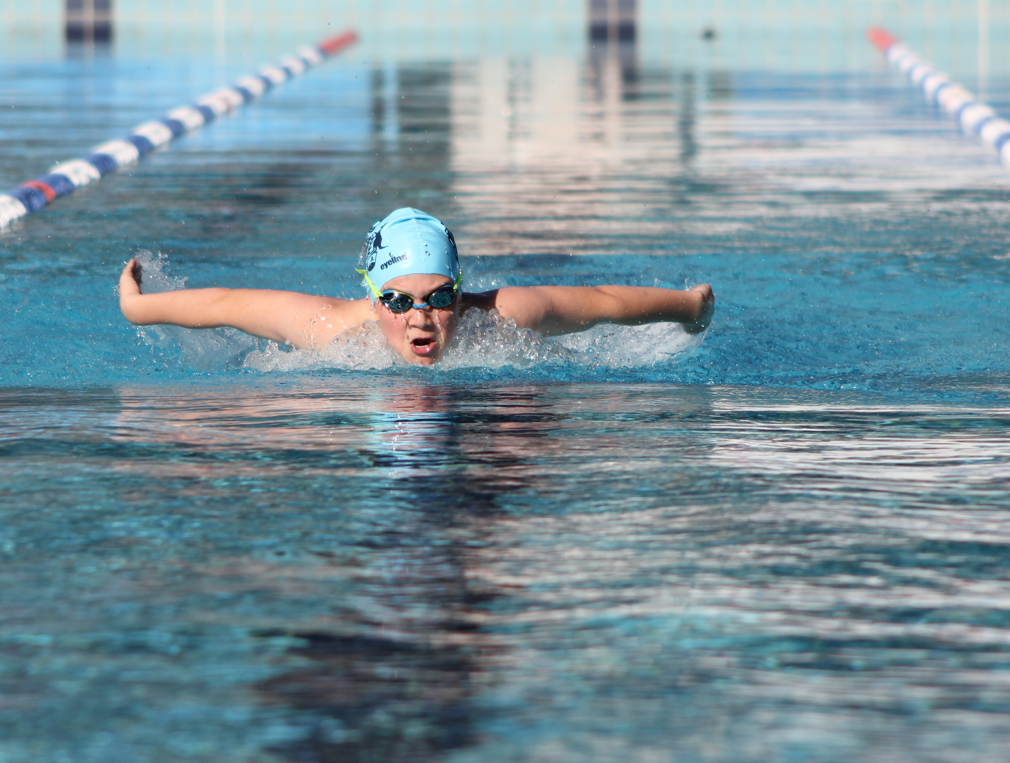
Margaret & Allan Gregson Encouragement Awards Swimming Male
Declan Budd

Slide 21
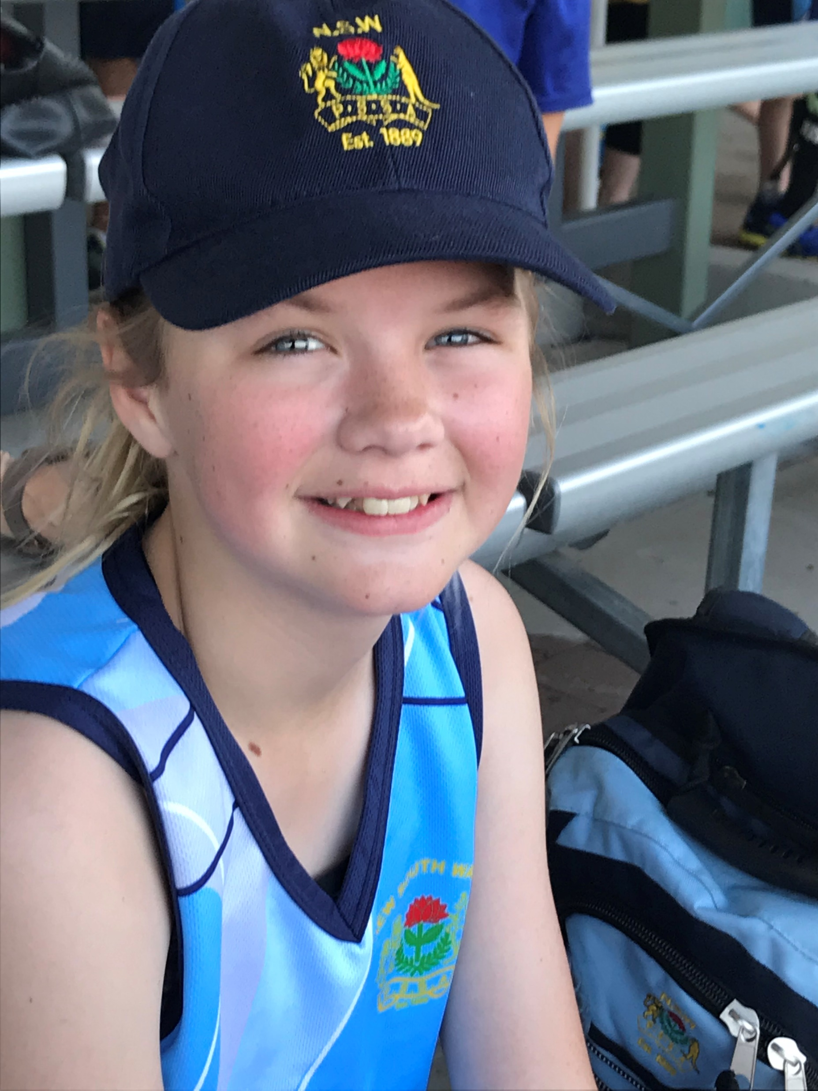
Margaret & Allan Gregson Encouragement Awards Swimming Female
Victoria Robinson

Slide 22
Margaret & Allan Gregson Encouragement Awards Athletics
Presented by Margaret Gregson

Slide 23
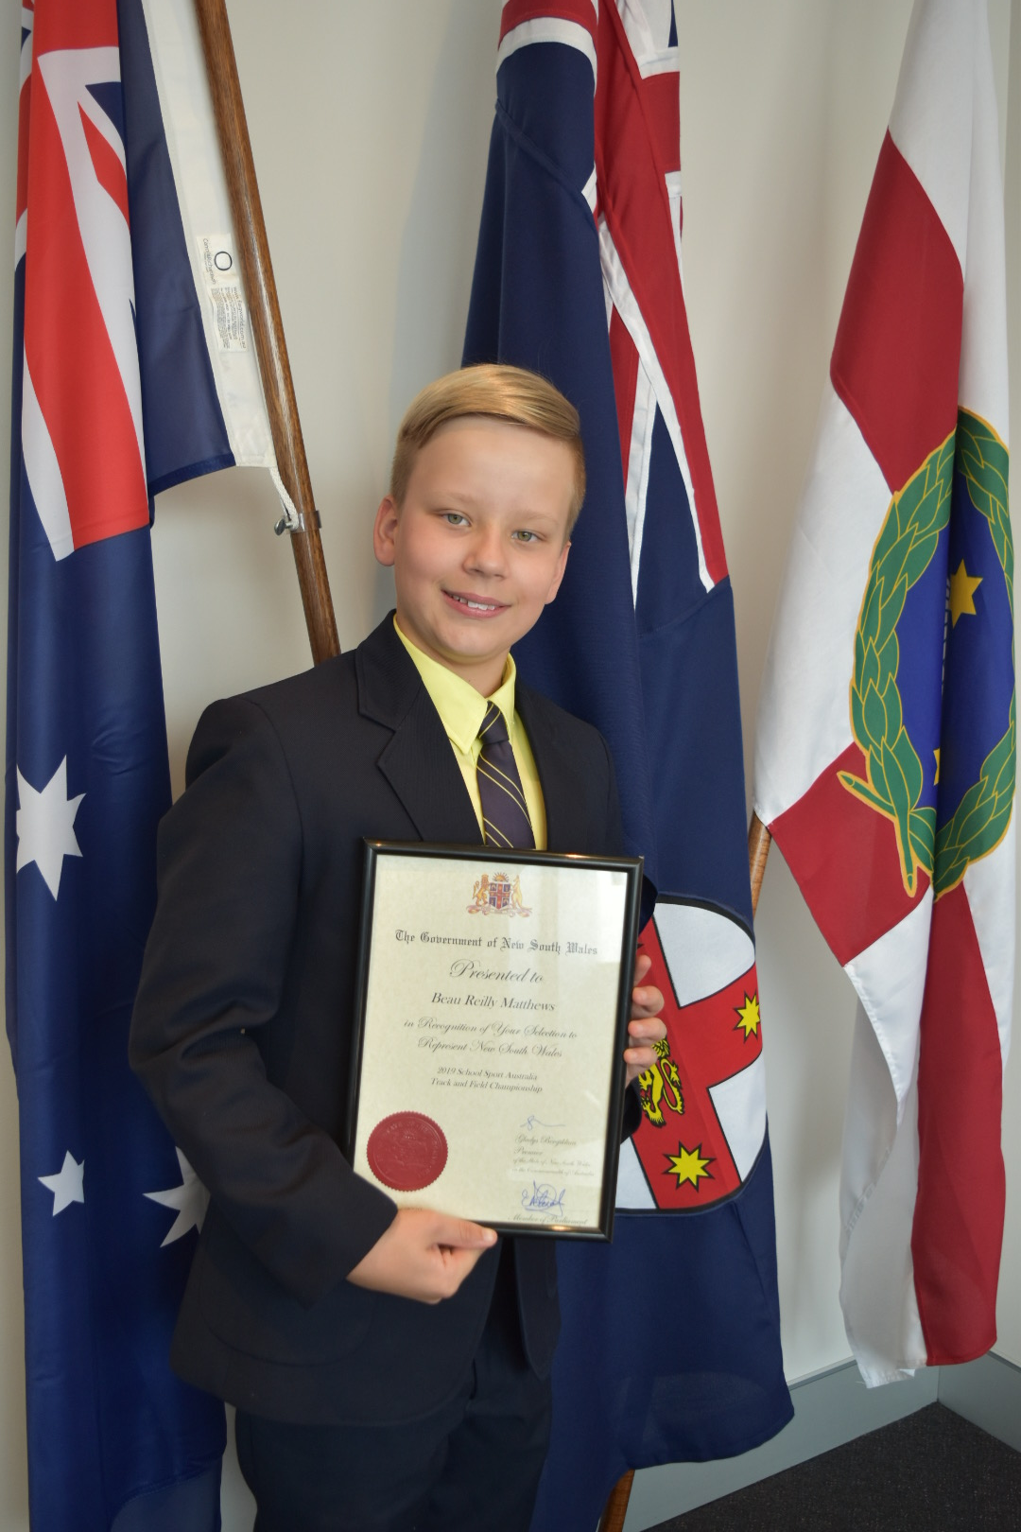
Margaret & Allan Gregson Encouragement Awards Athletics Male
Beau Matthews

Slide 24
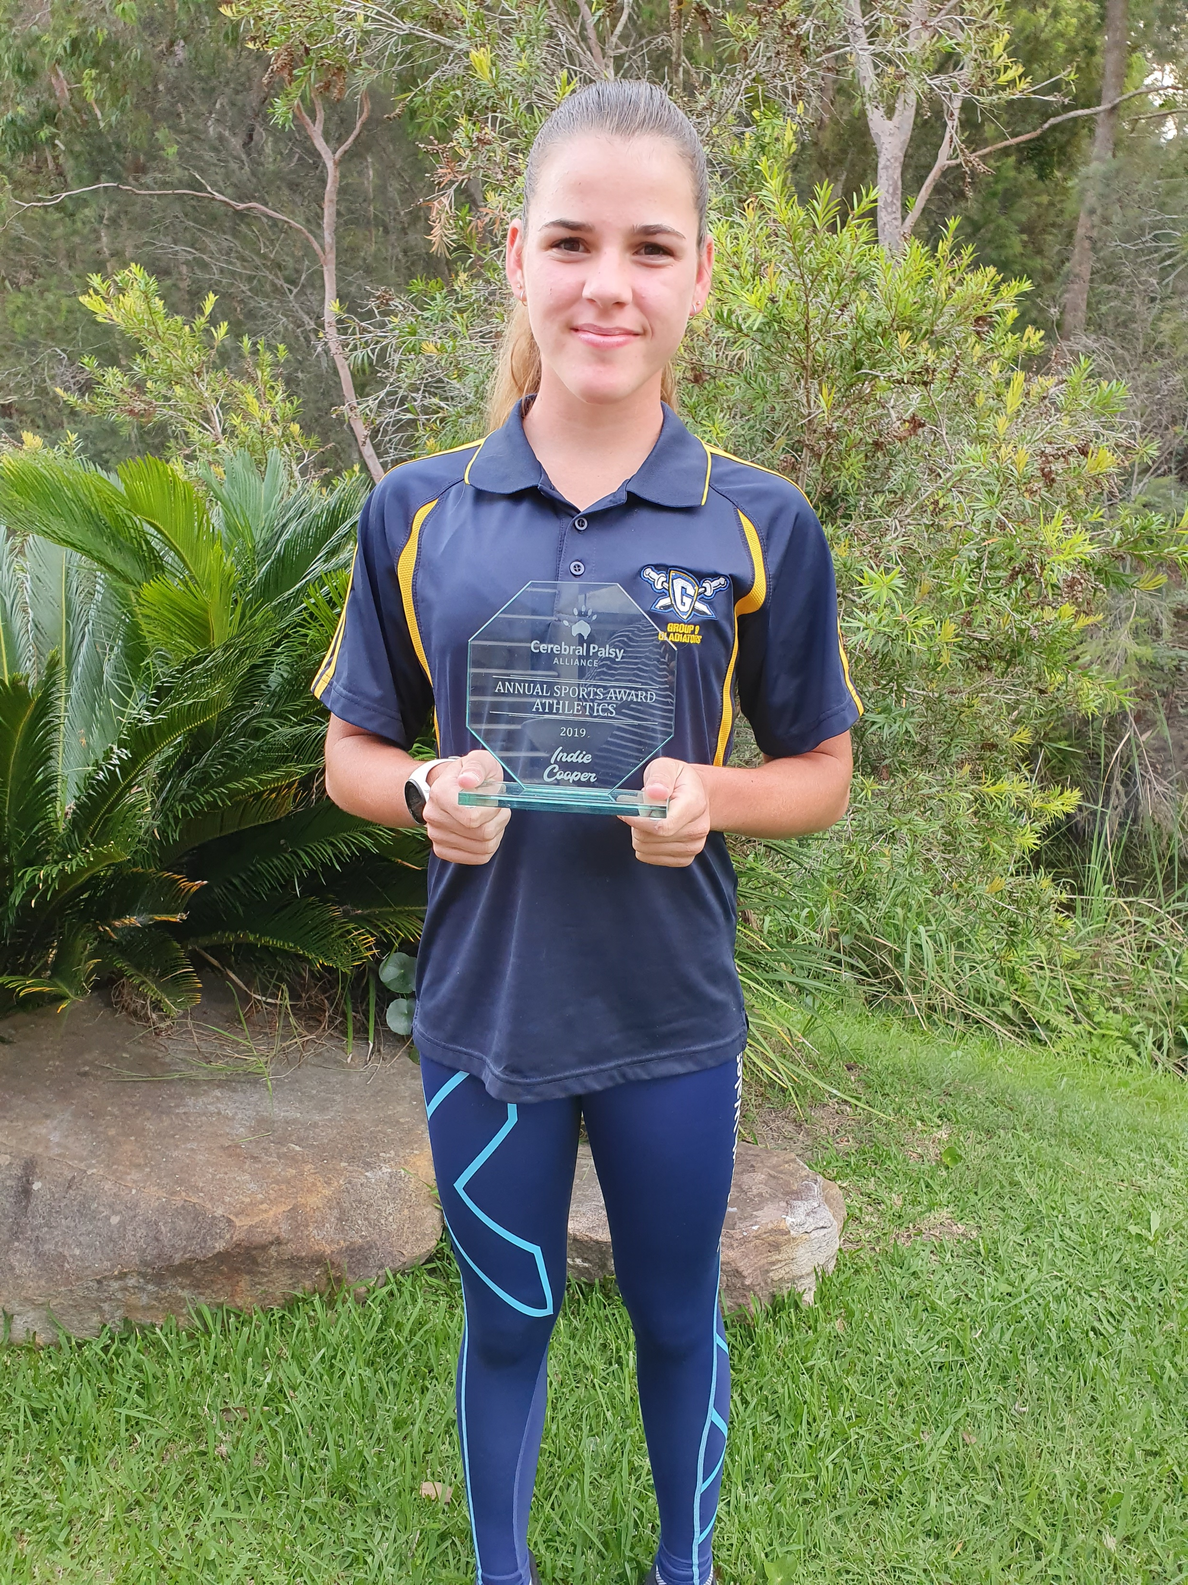
Margaret & Allan Gregson Encouragement Awards Athletics Female
Indiana Cooper

Slide 25
David Campbell Encouragement Award Football
Presented by Bill Gurney

Slide 26
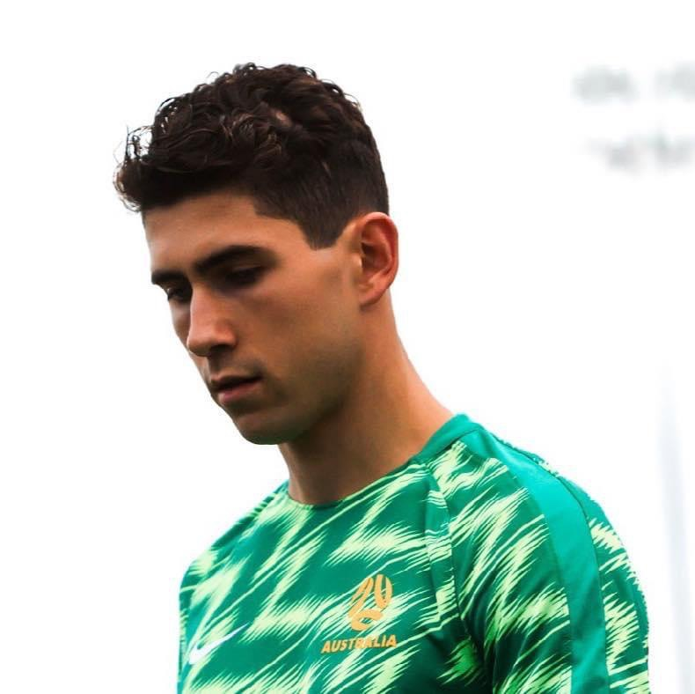
David Campbell Encouragement Award Football
Augustine Murphy

Slide 27
Bill Gurney Encouragement Award Football
Presented by Bill Gurney

Slide 28
Bill Gurney Encouragement Award Football
Georgia Beikoff

Slide 29
Ian Menzies Encouragement Award Football
Presented by Ian Menzies

Slide 30
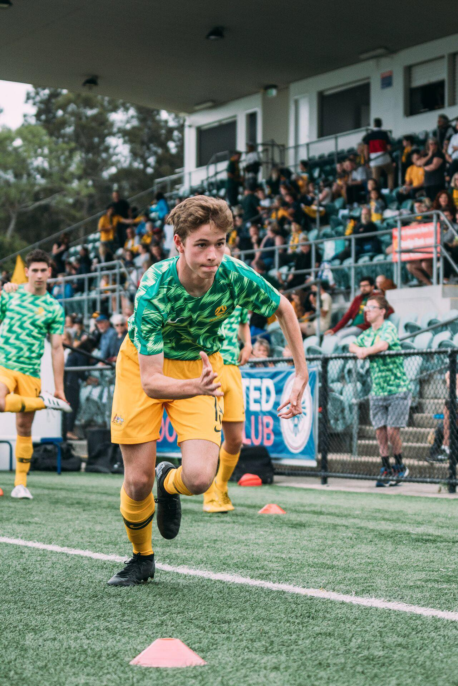
Ian Menzies Encouragement Award Football
Tim Blowes

Slide 31
Judy Webber Encouragement Award Various Sports
Presented by Murray Bartram

Slide 32
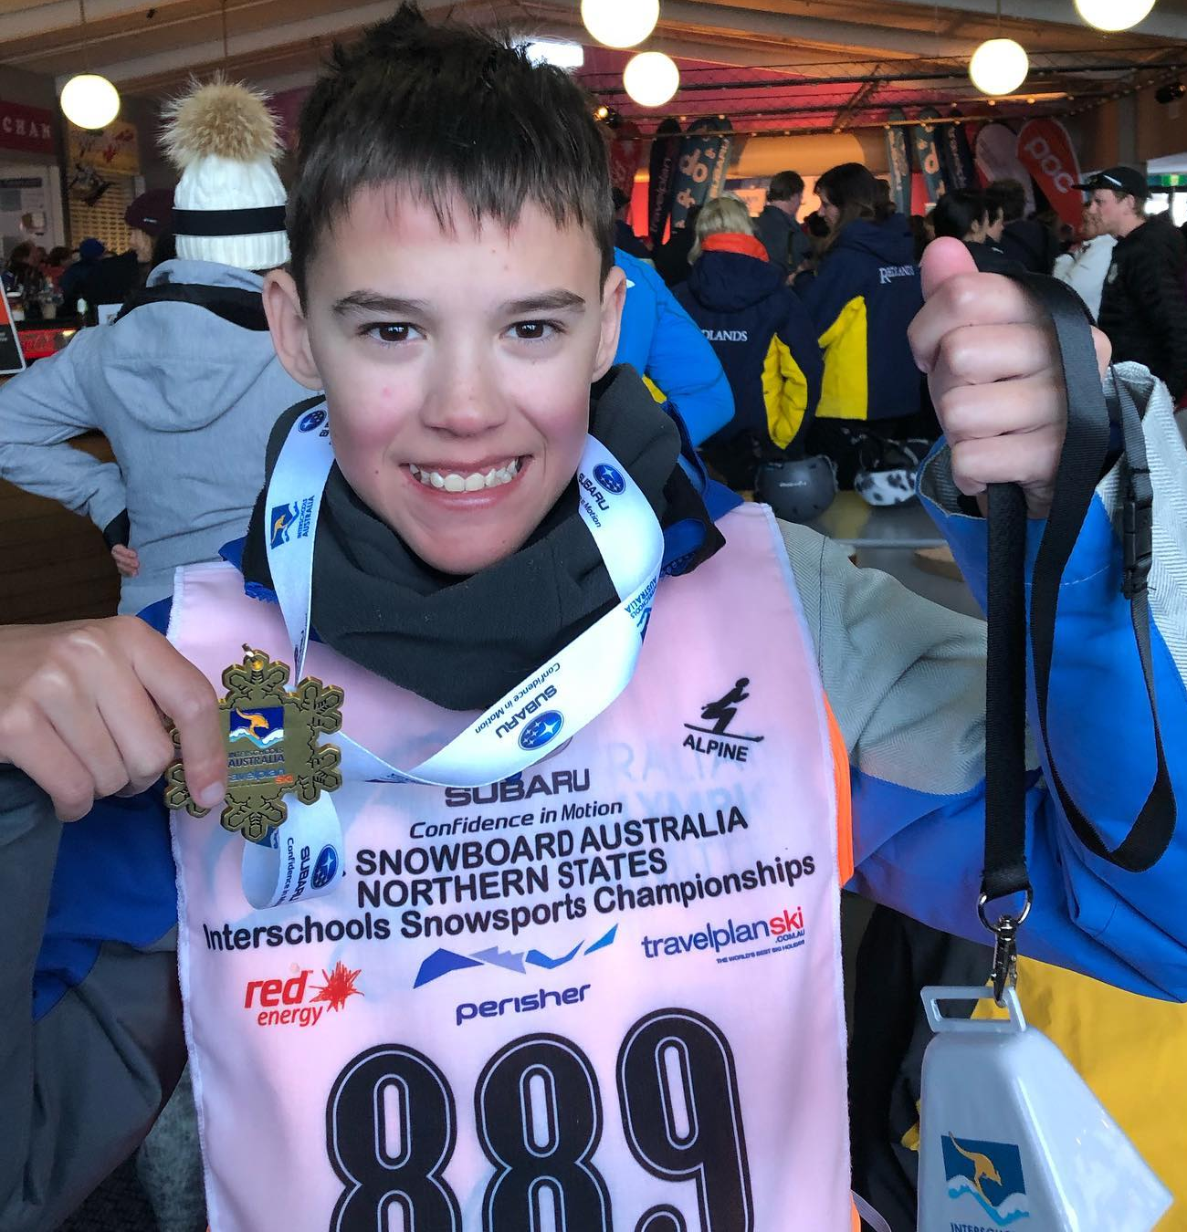
Judy Webber Encouragement Award Various Sports
Jackson Love

Slide 33
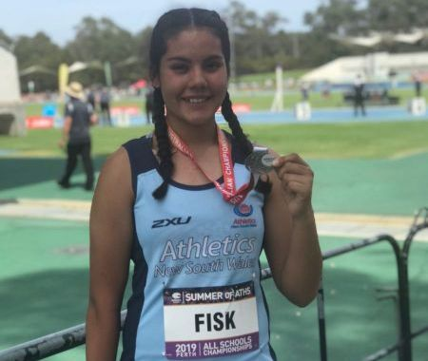
Judy Webber Encouragement Award Various Sports
Breanna Fisk

Slide 34
Dawn Fraser Award for Swimming
Presented by Margaret Gregson

Slide 35
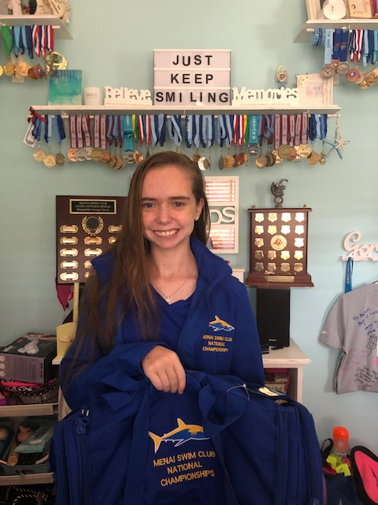
Dawn Fraser Award for Swimming
Rachel Vella

Slide 36
Tim Sherry Award for Athletics
Presented by Kim Georgallis

Slide 37
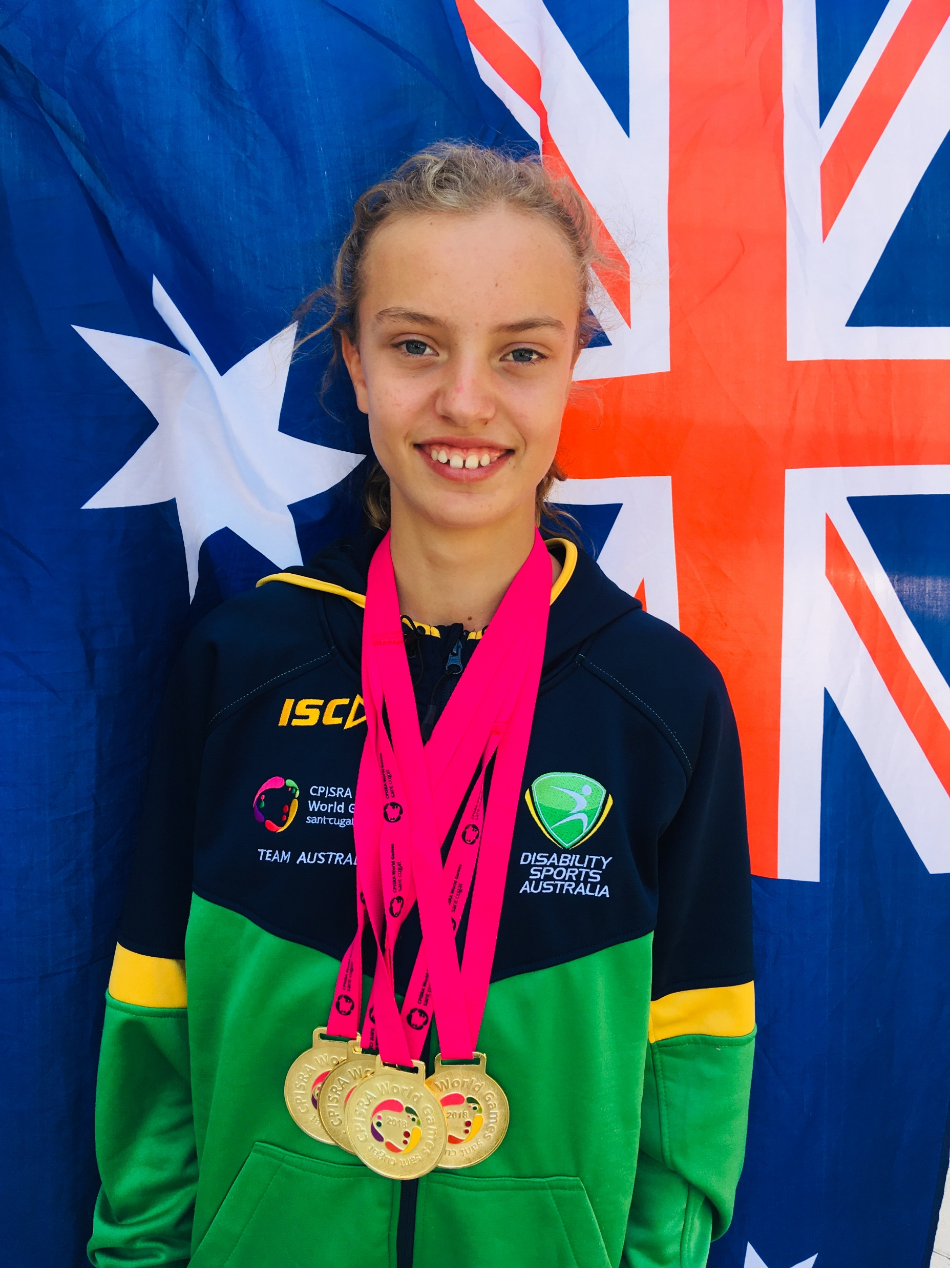
Tim Sherry Award for Athletics
Mali Lovell

Slide 38
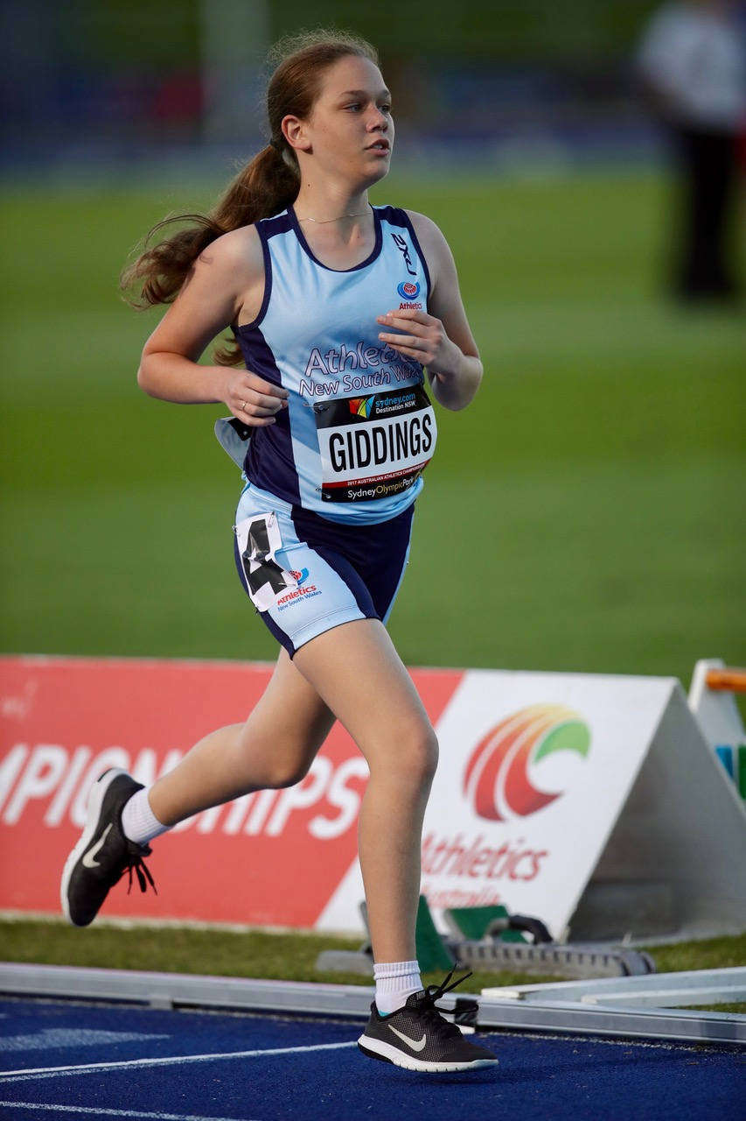
Tim Sherry Award for Athletics
Summer Giddings

Slide 39
Tim Sherry Award for Athletics
Mitchell Christiansen

Slide 40
Footballer of the Year
Presented by Ian Menzies

Slide 41
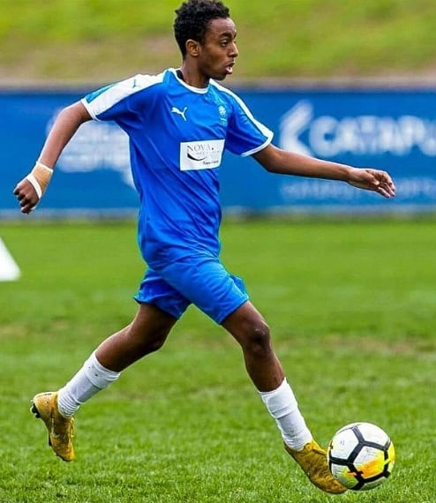
Footballer of the Year
Daniel Campbell

Slide 42
President’s Award
Presented by Brian Berry

Slide 43
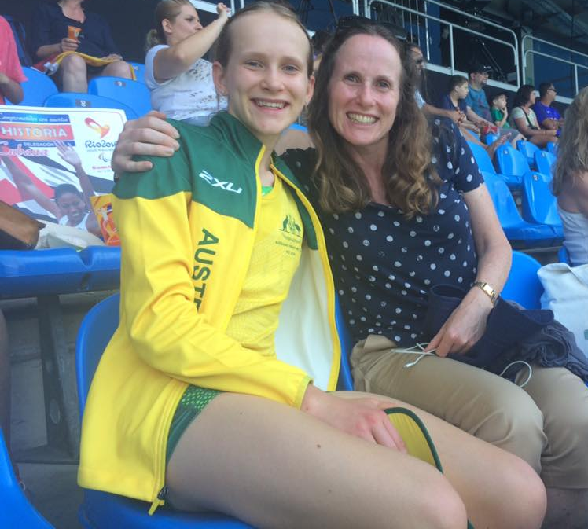
President’s Award
Cathie Sherrington

Slide 44
Daniel Berry Inspirational Award
Presented by Heather Berry

Slide 45
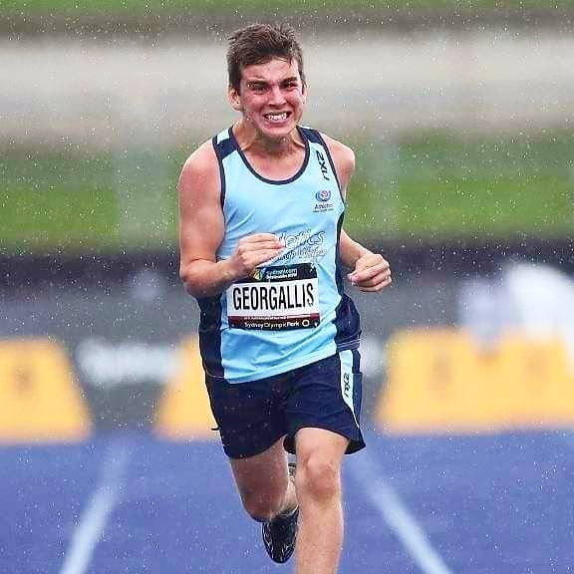
Daniel Berry Inspirational Award
Christian Georgallis

Slide 46
Athlete of the Year
Presented by Kerry West

Slide 47
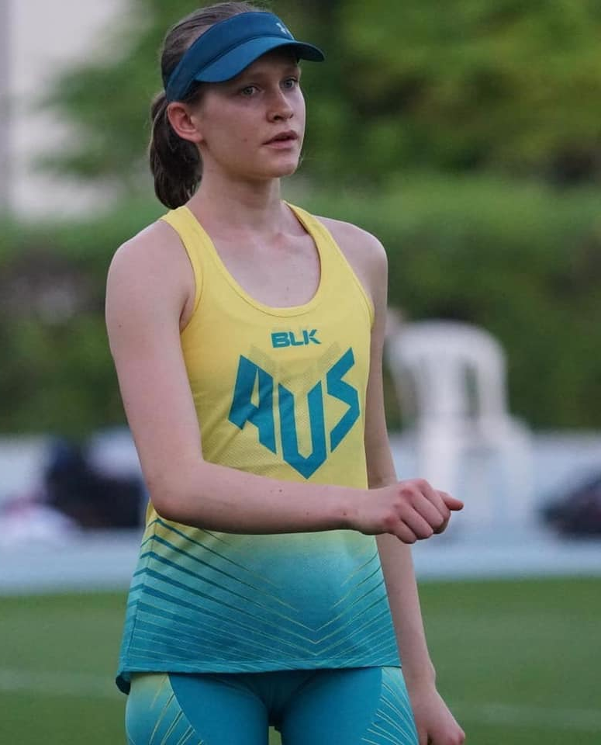
Athlete of the Year
Tamsin Colley

Slide 48
Athlete of the Year
Amanda Reid

Slide 49
International Recognition
Presented by Brian Berry

Slide 50
International Recognition
Gordon Allan
Tissot UCI Track Cycling World Cup 2019-2020

Slide 51
International Recognition
Amanda Reid
Tissot UCI Track Cycling World Cup 2019-2020

Slide 52
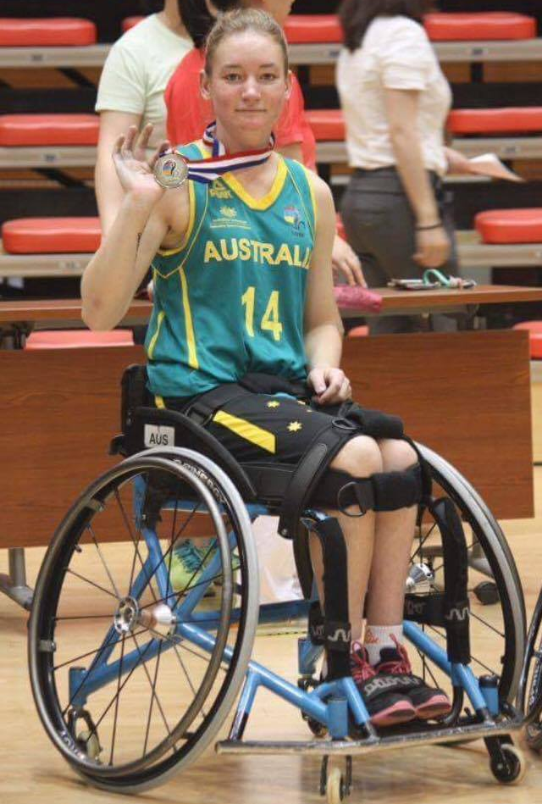
International Recognition
Jess Cronje
IWBF U25 Women’s Wheelchair Basketball World Championship.

Slide 53
International Recognition
Tamsin Colley
Para Athletics World Championships Dubai 2019

Slide 54
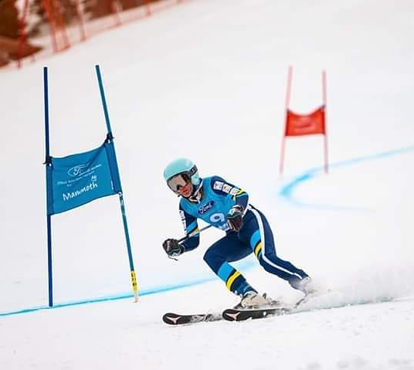
International Recognition
Rae Anderson
Mammoth Mountain World Para Alpine Skiing Competition 2019

Slide 55
Life Membership Awards
Presented by Nicki Ashton

Slide 56
Life Membership Awards
Ian Menzies

Slide 57
Life Membership Awards
Bill Gurney

Slide 58
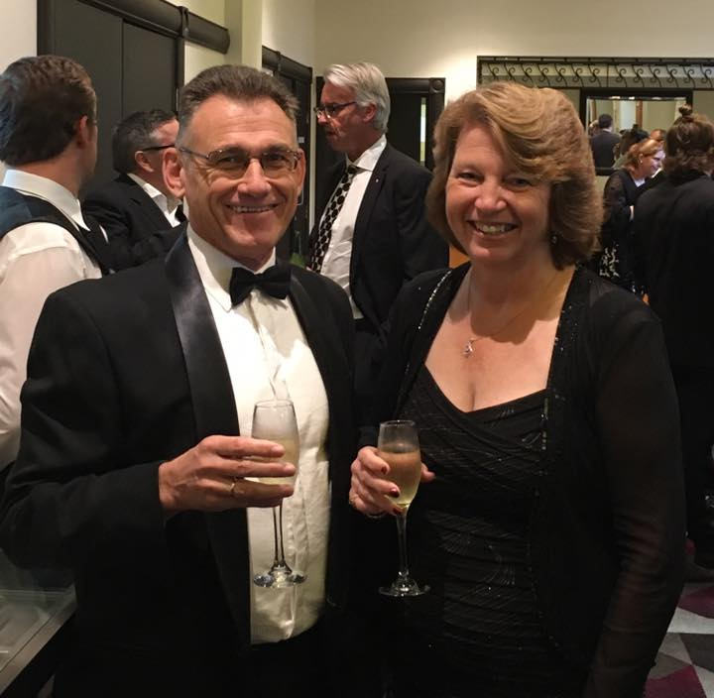
Life Membership Awards
Brian Berry

Slide 59
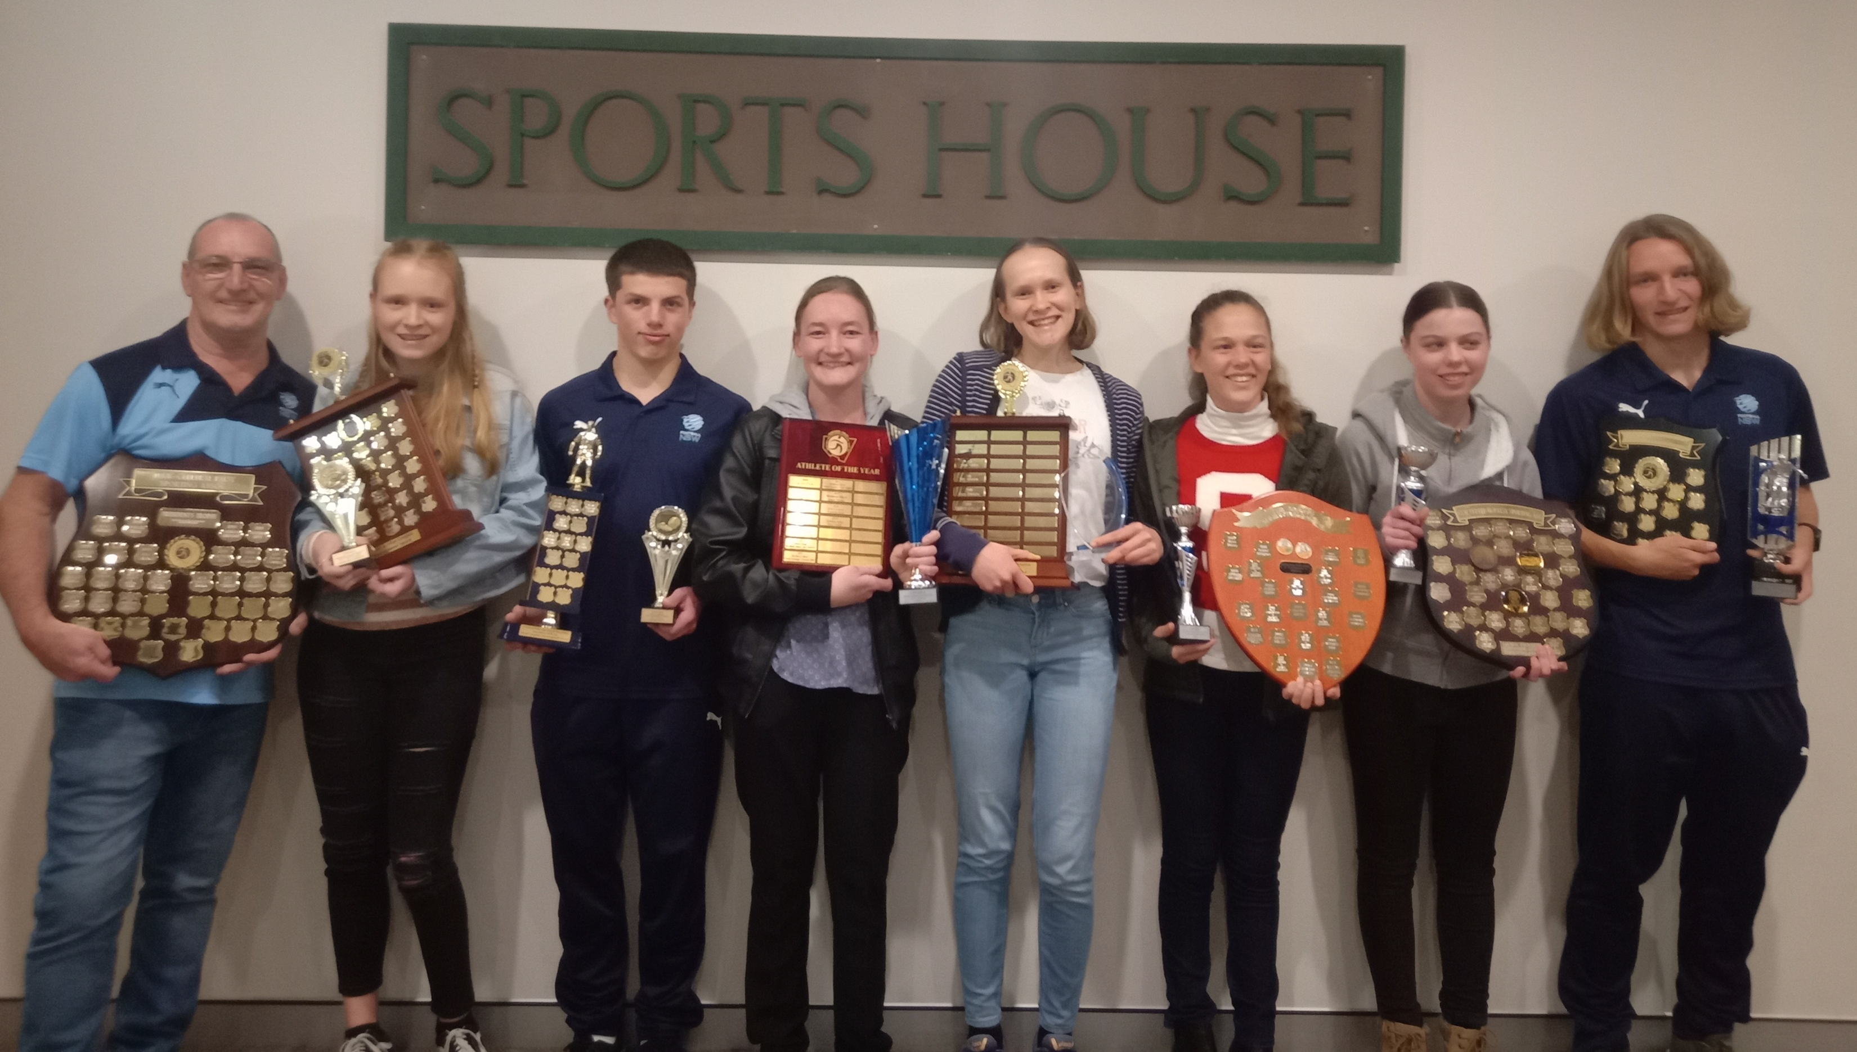
Congratulations to all award winners and to all CPSARA members on your outstanding accomplishments Thank you for celebrating our CPSARA athletes’ achievements with us for the 2019/2020 season
Thank you to our sponsors:

