Slide 1
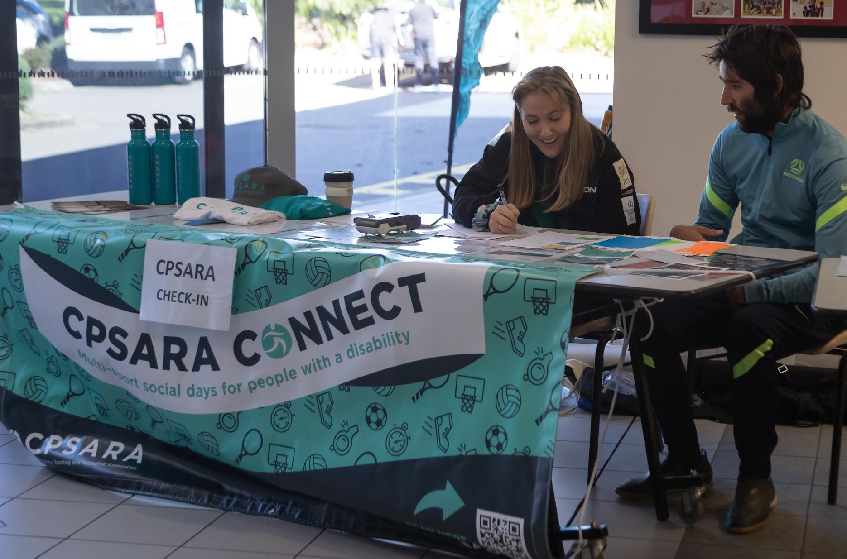
AGM/AWARDS NIGHT 2022
Welcome to
Thank you to our sponsors:

Slide 2
PRESENTATION OF AWARDS Margaret & Allan Gregson Encouragement Awards: Presented By Kerry West/Kim Georgallis David Campbell Encouragement Award Football: Presented By Ian Menzies Ian Menzies Encouragement Award Football: Presented By Ian Menzies Bill Gurney Encouragement Award Football: Presented By Ian Menzies Judy Webber Encouragement Award Various Sports: Presented By Murray Bartram Dawn Fraser Award For Swimming : Presented By Kerry West Tim Sherry Award For Athletics: Presented By Kim Georgallis Footballer Of The Year: Presented By Ian Menzies President’s Award: Presented By Brian Berry Daniel Berry Inspirational Award: Presented By Heather Berry & Brian Berry Athlete Of The Year: Presented By Kerry West Community Spirit Awards: Presented By Brian Berry First International Representation Award: Presented By Brian Berry
Agenda
ANNUAL GENERAL MEETING 26th August 2022 1. Opening and Welcome 2. Apologies 3. Minutes of the Previous Annual General Meeting held 13th August 2021 4. Adoption of Annual Report 5. Adoption of the Financial Statement 6. Election of Office Bearers President – (2-year term) Treasurer – (2-year term) Ordinary Member – 3 Positions (1-year term) 7. Close of Meeting

Slide 3
Annual Report
See Annual Report 2021 on CPSARA website (Link sent in Zoom chat)

Slide 4
MINUTES OF THE 2021 ANNUAL GENERAL MEETING
Annual Report
See Annual Report 2022 on CPSARA website (Link sent in Zoom chat)

Slide 5
CPSARA PRESIDENTS REPORT – 2022
Annual Report
See Annual Report 2022 on CPSARA website (Link sent in Zoom chat)

Slide 6
TREASURER’S REPORT FOR AGM 2021/2022 FINANCIAL YEAR
Annual Report
See Annual Report 2022 on CPSARA website (Link sent in Zoom chat)

Slide 7
Adoption of Annual Report
See Annual Report 2022 on CPSARA website (Link sent in Zoom chat)

Slide 8
Adoption of the Financial Statement
See Annual Report 2022 on CPSARA website (Link sent in Zoom chat)

Slide 9
Election of Office Bearers
President (2 year term)
See Annual Report 2022 on CPSARA website (Link sent in Zoom chat)

Slide 10
Election of Office Bearers
Treasurer (2 year term)
See Annual Report 2022 on CPSARA website (Link sent in Zoom chat)

Slide 11
Ordinary Member – 3 Positions (1-year term)
See Annual Report 2022 on CPSARA website (Link sent in Zoom chat)

Slide 12
Close of Meeting/Start of Awards Night
See Annual Report 2022 on CPSARA website (Link sent in Zoom chat)

Slide 13
AWARDS NIGHT 2022
Welcome to
Thank you to our sponsors:

Slide 14
Margaret & Allan Gregson Encouragement Award Swimming
Presented by Kerry West

Slide 15
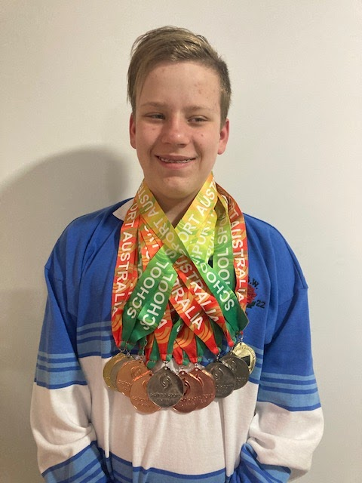
Margaret & Allan Gregson Encouragement Awards Swimming Male
Beau Matthews

Slide 16
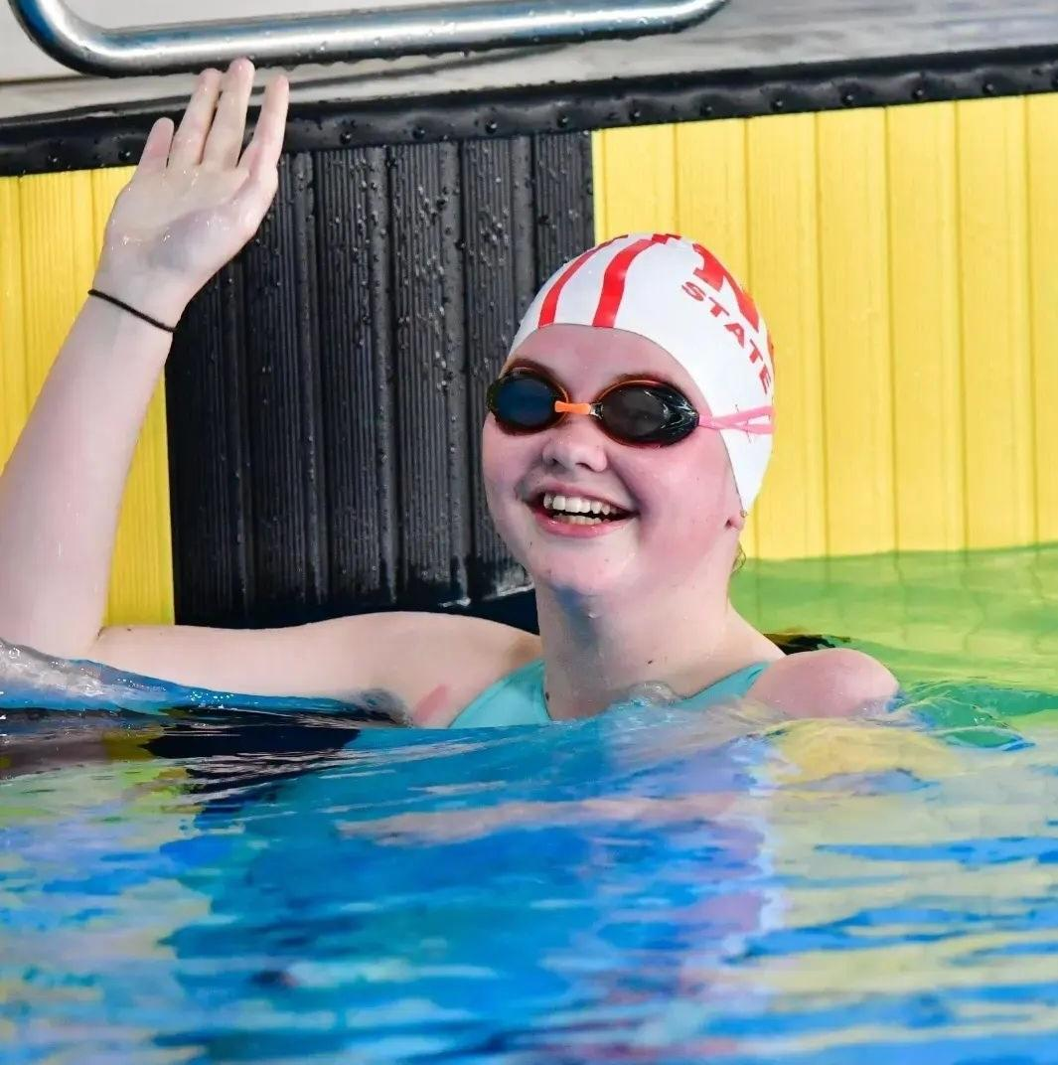
Margaret & Allan Gregson Encouragement Awards Swimming Female
Victoria Robinson

Slide 17
Margaret & Allan Gregson Encouragement Awards Athletics
Presented by Kim Georgallis

Slide 18
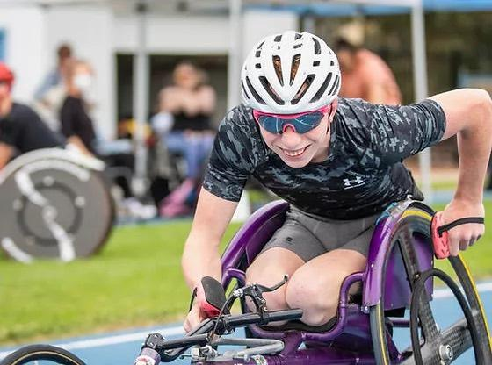
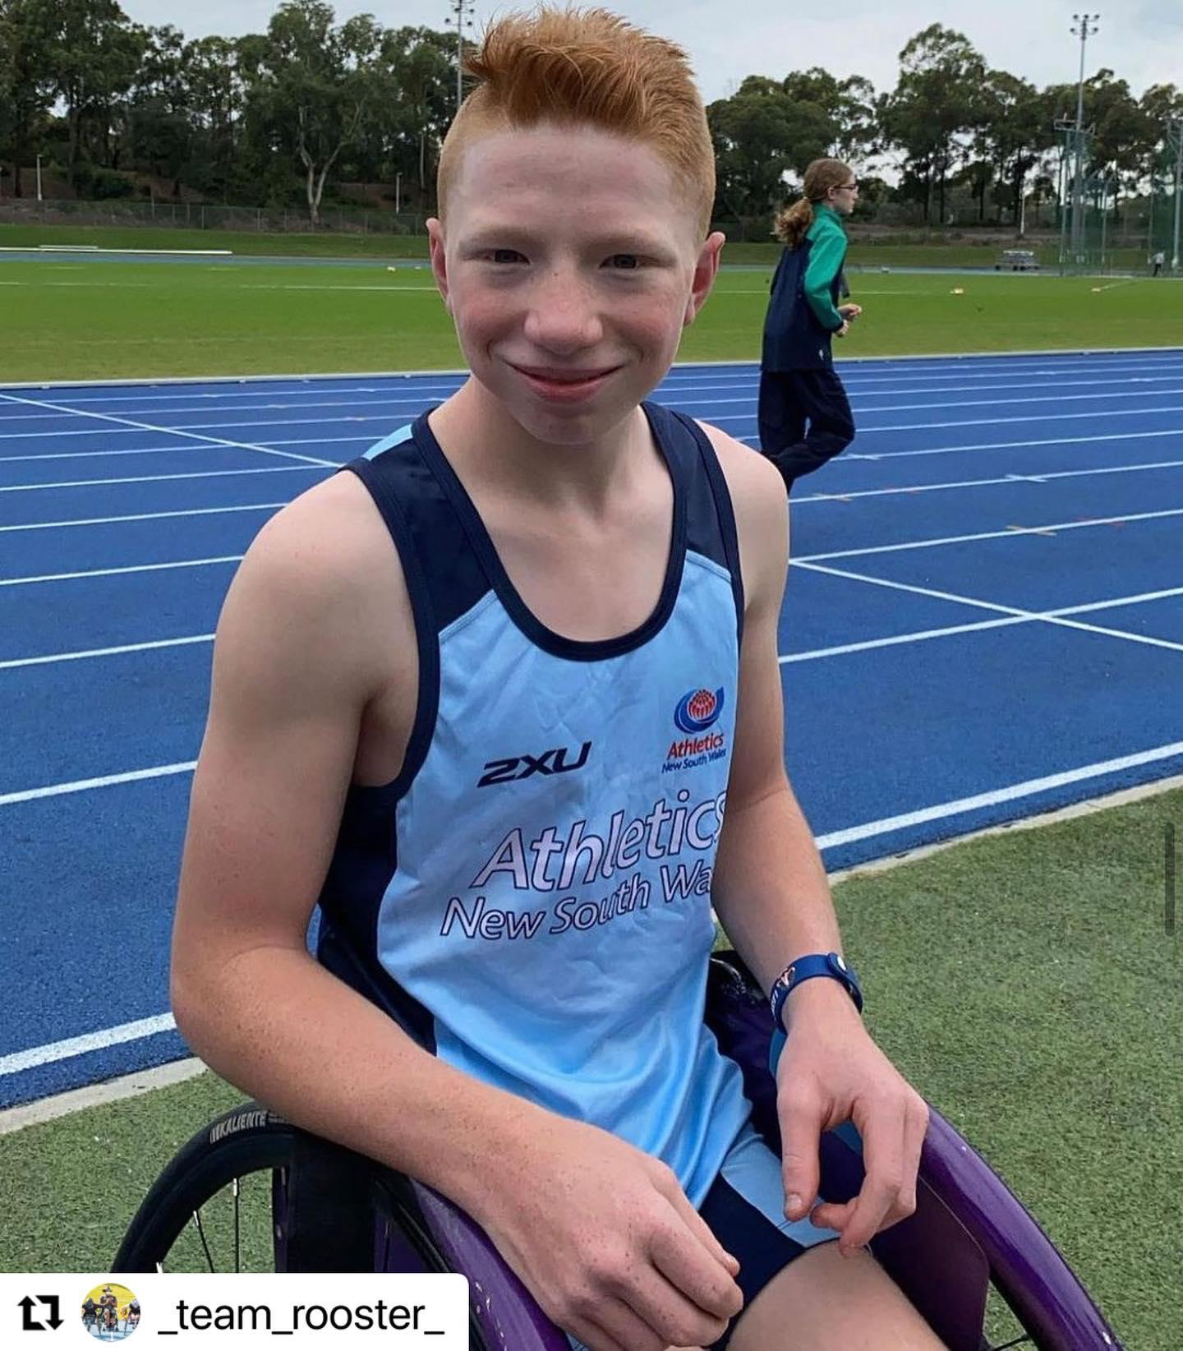
Margaret & Allan Gregson Encouragement Awards Athletics Male
Waryk Holmes

Slide 19
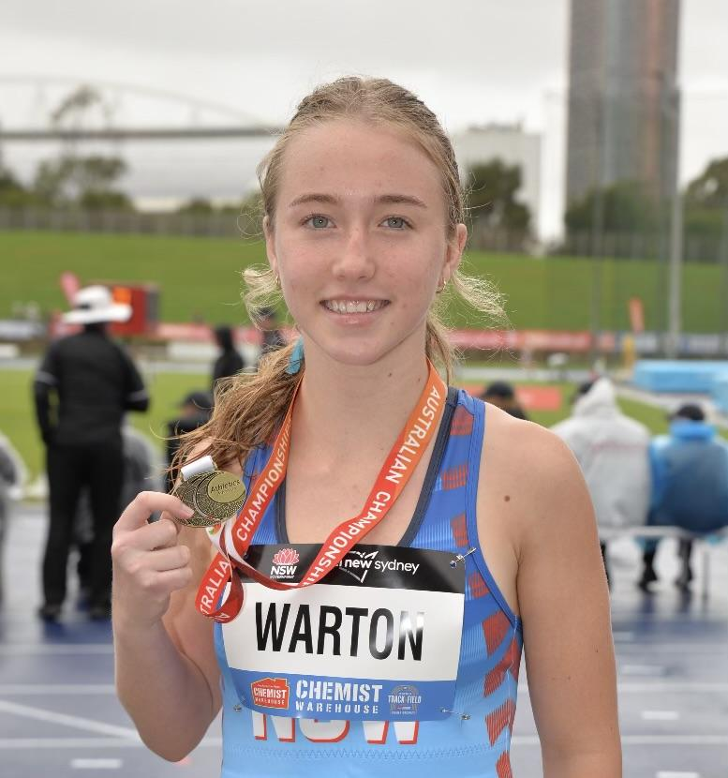
Margaret & Allan Gregson Encouragement Awards Athletics Female
Sybella Warton

Slide 20
David Campbell Encouragement Award Football
Presented by Ian Menzies

Slide 21
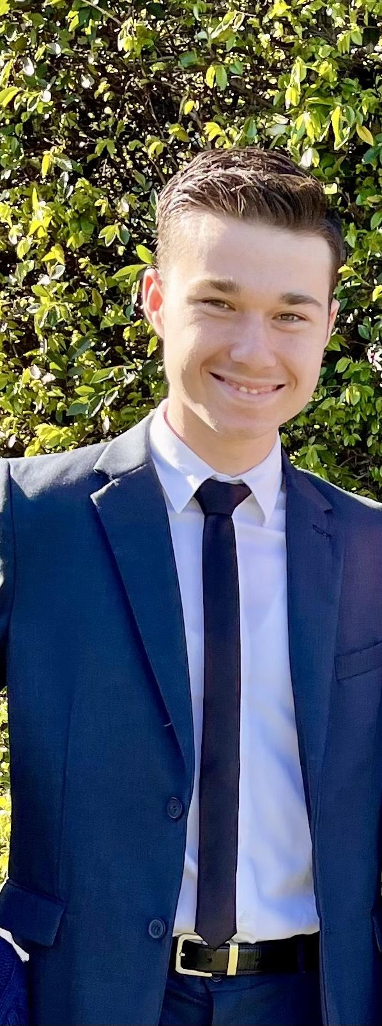
David Campbell Encouragement Award Football
Tomas Scotti

Slide 22
Ian Menzies Encouragement Award Football
Presented by Ian Menzies

Slide 23
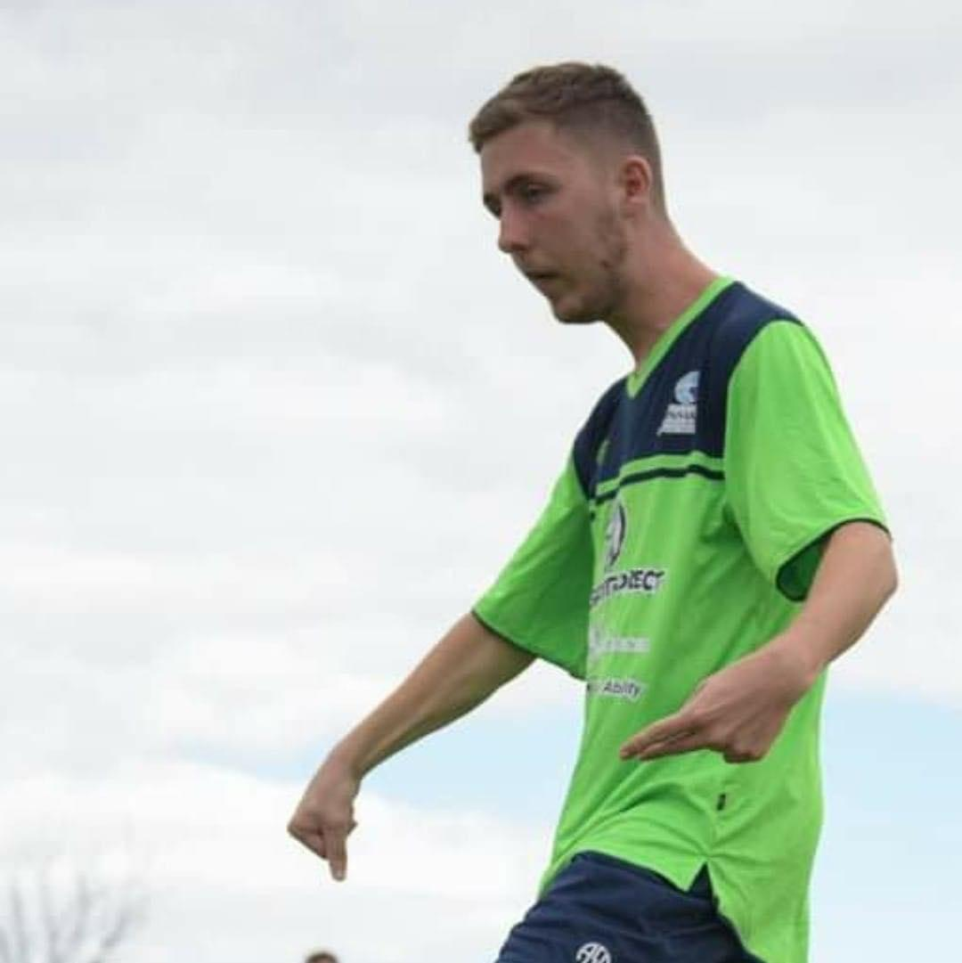
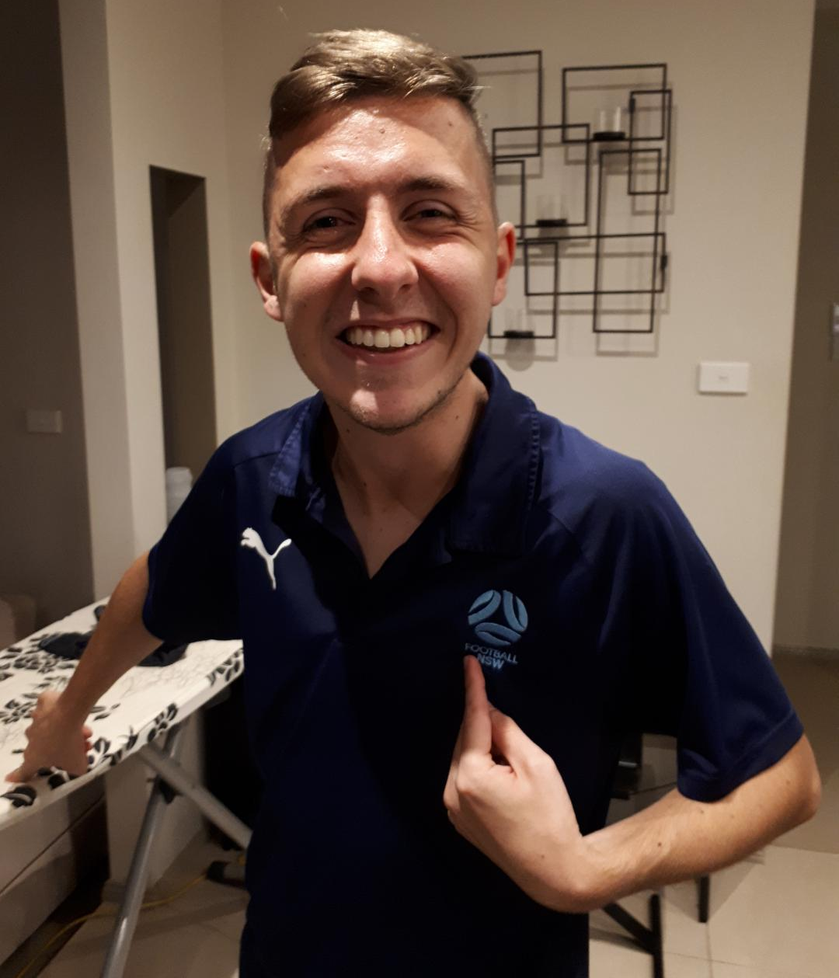
Ian Menzies Encouragement Award Football
Daniel Penrinich

Slide 24
Bill Gurney Encouragement Award Football
Presented by Ian Menzies

Slide 25
Bill Gurney Encouragement Award Football
Goki Saito

Slide 26
Judy Webber Encouragement Award Various Sports
Presented by Murray Bartram

Slide 27
Judy Webber Encouragement Award Various Sports
Matthew Engesser

Slide 28
Judy Webber Encouragement Award Various Sports
Summer Giddings

Slide 29
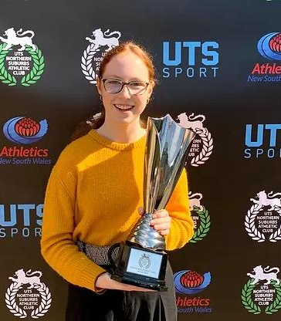
Judy Webber Encouragement Award Various Sports
Isla Gillespe

Slide 30
Dawn Fraser Award for Swimming
Presented by Kerry West

Slide 31
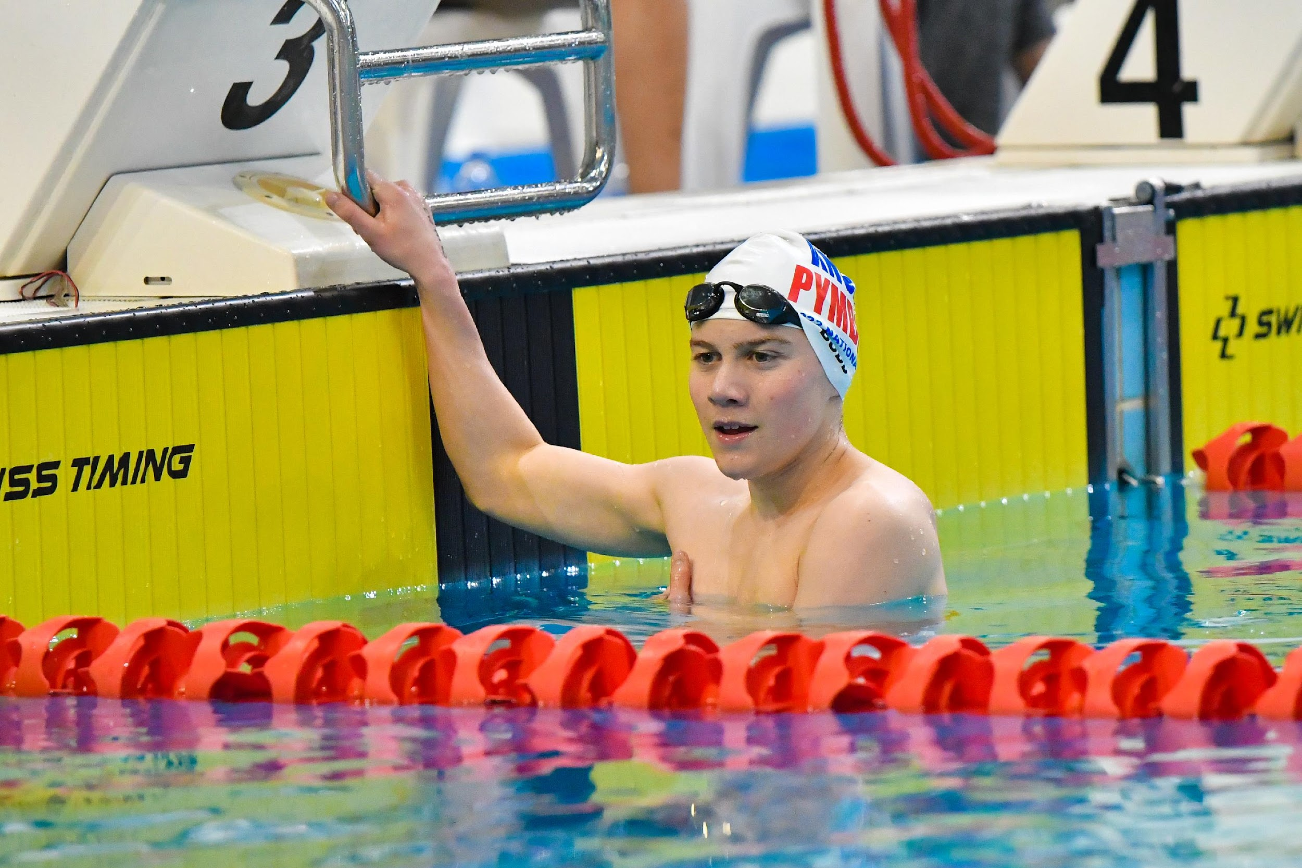
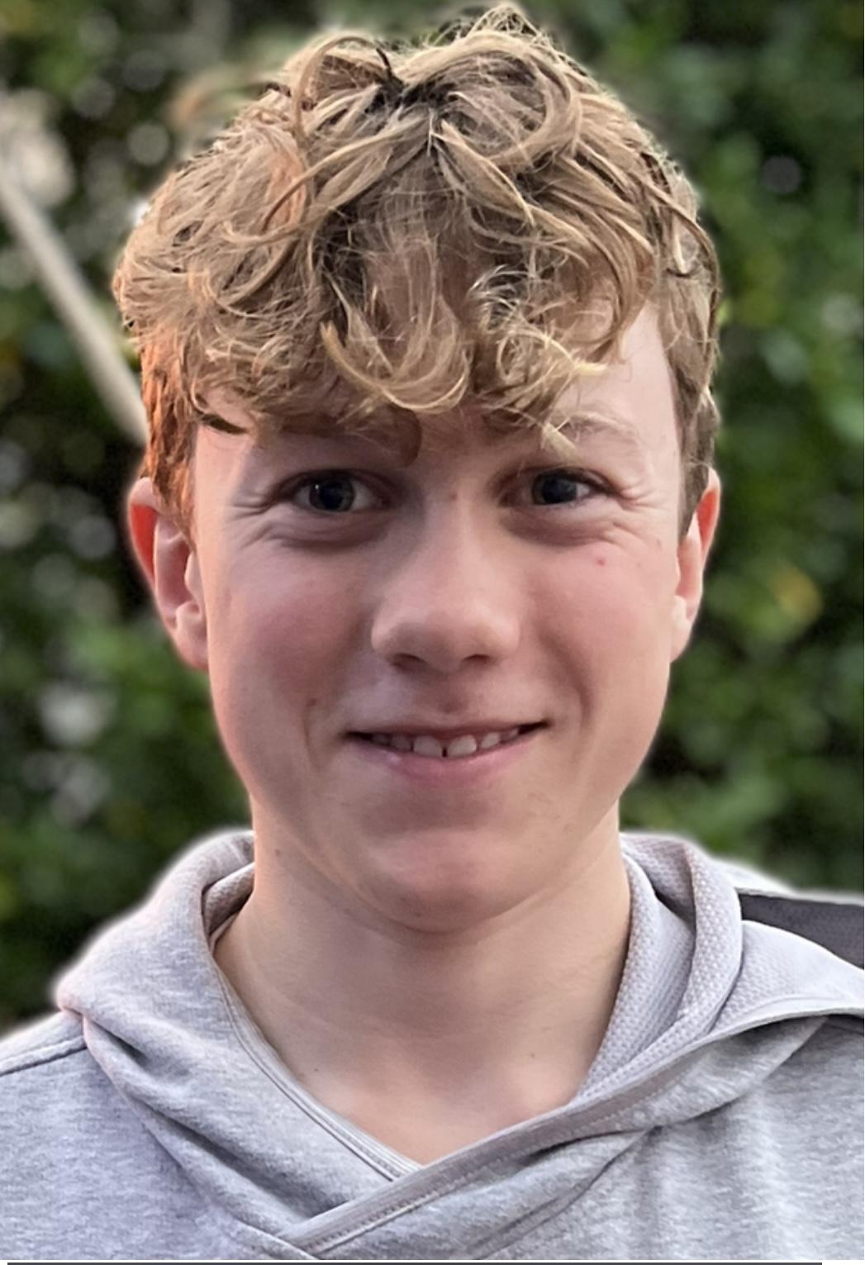
Dawn Fraser Award for Swimming Junior
Declan Budd

Slide 32
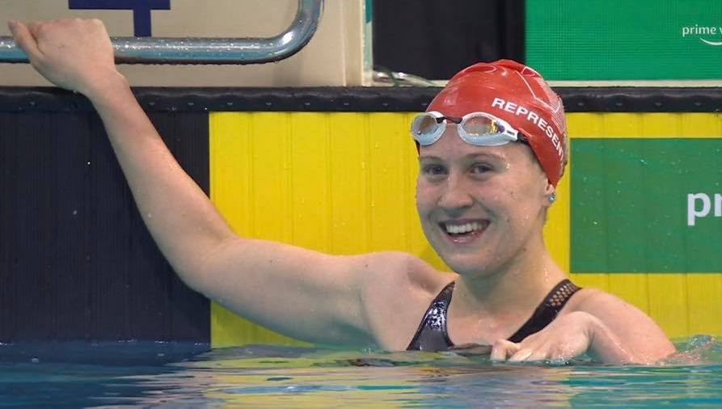
Dawn Fraser Award for Swimming Senior
Tahlia Blanshard

Slide 33
Tim Sherry Award for Athletics
Presented by Kim Georgallis

Slide 34
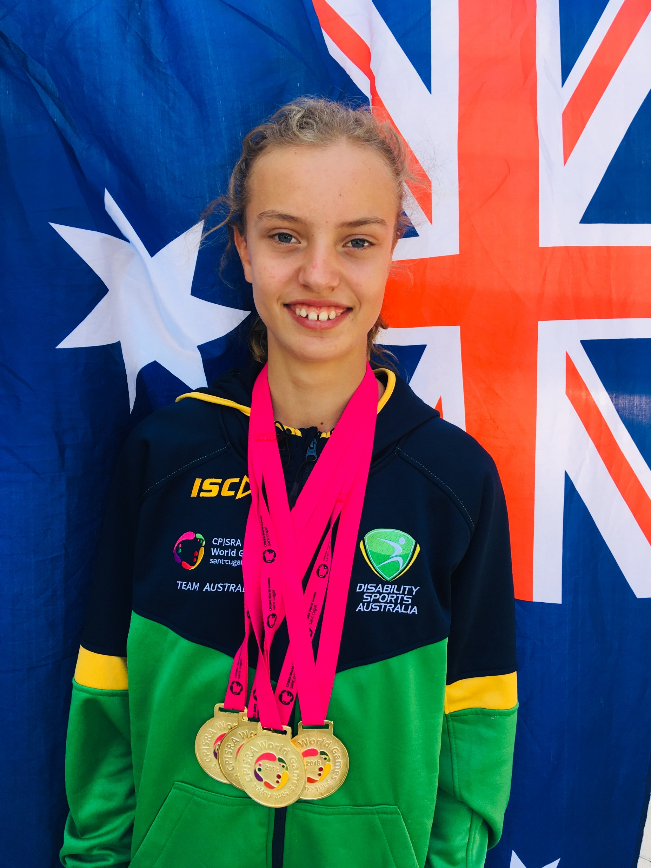
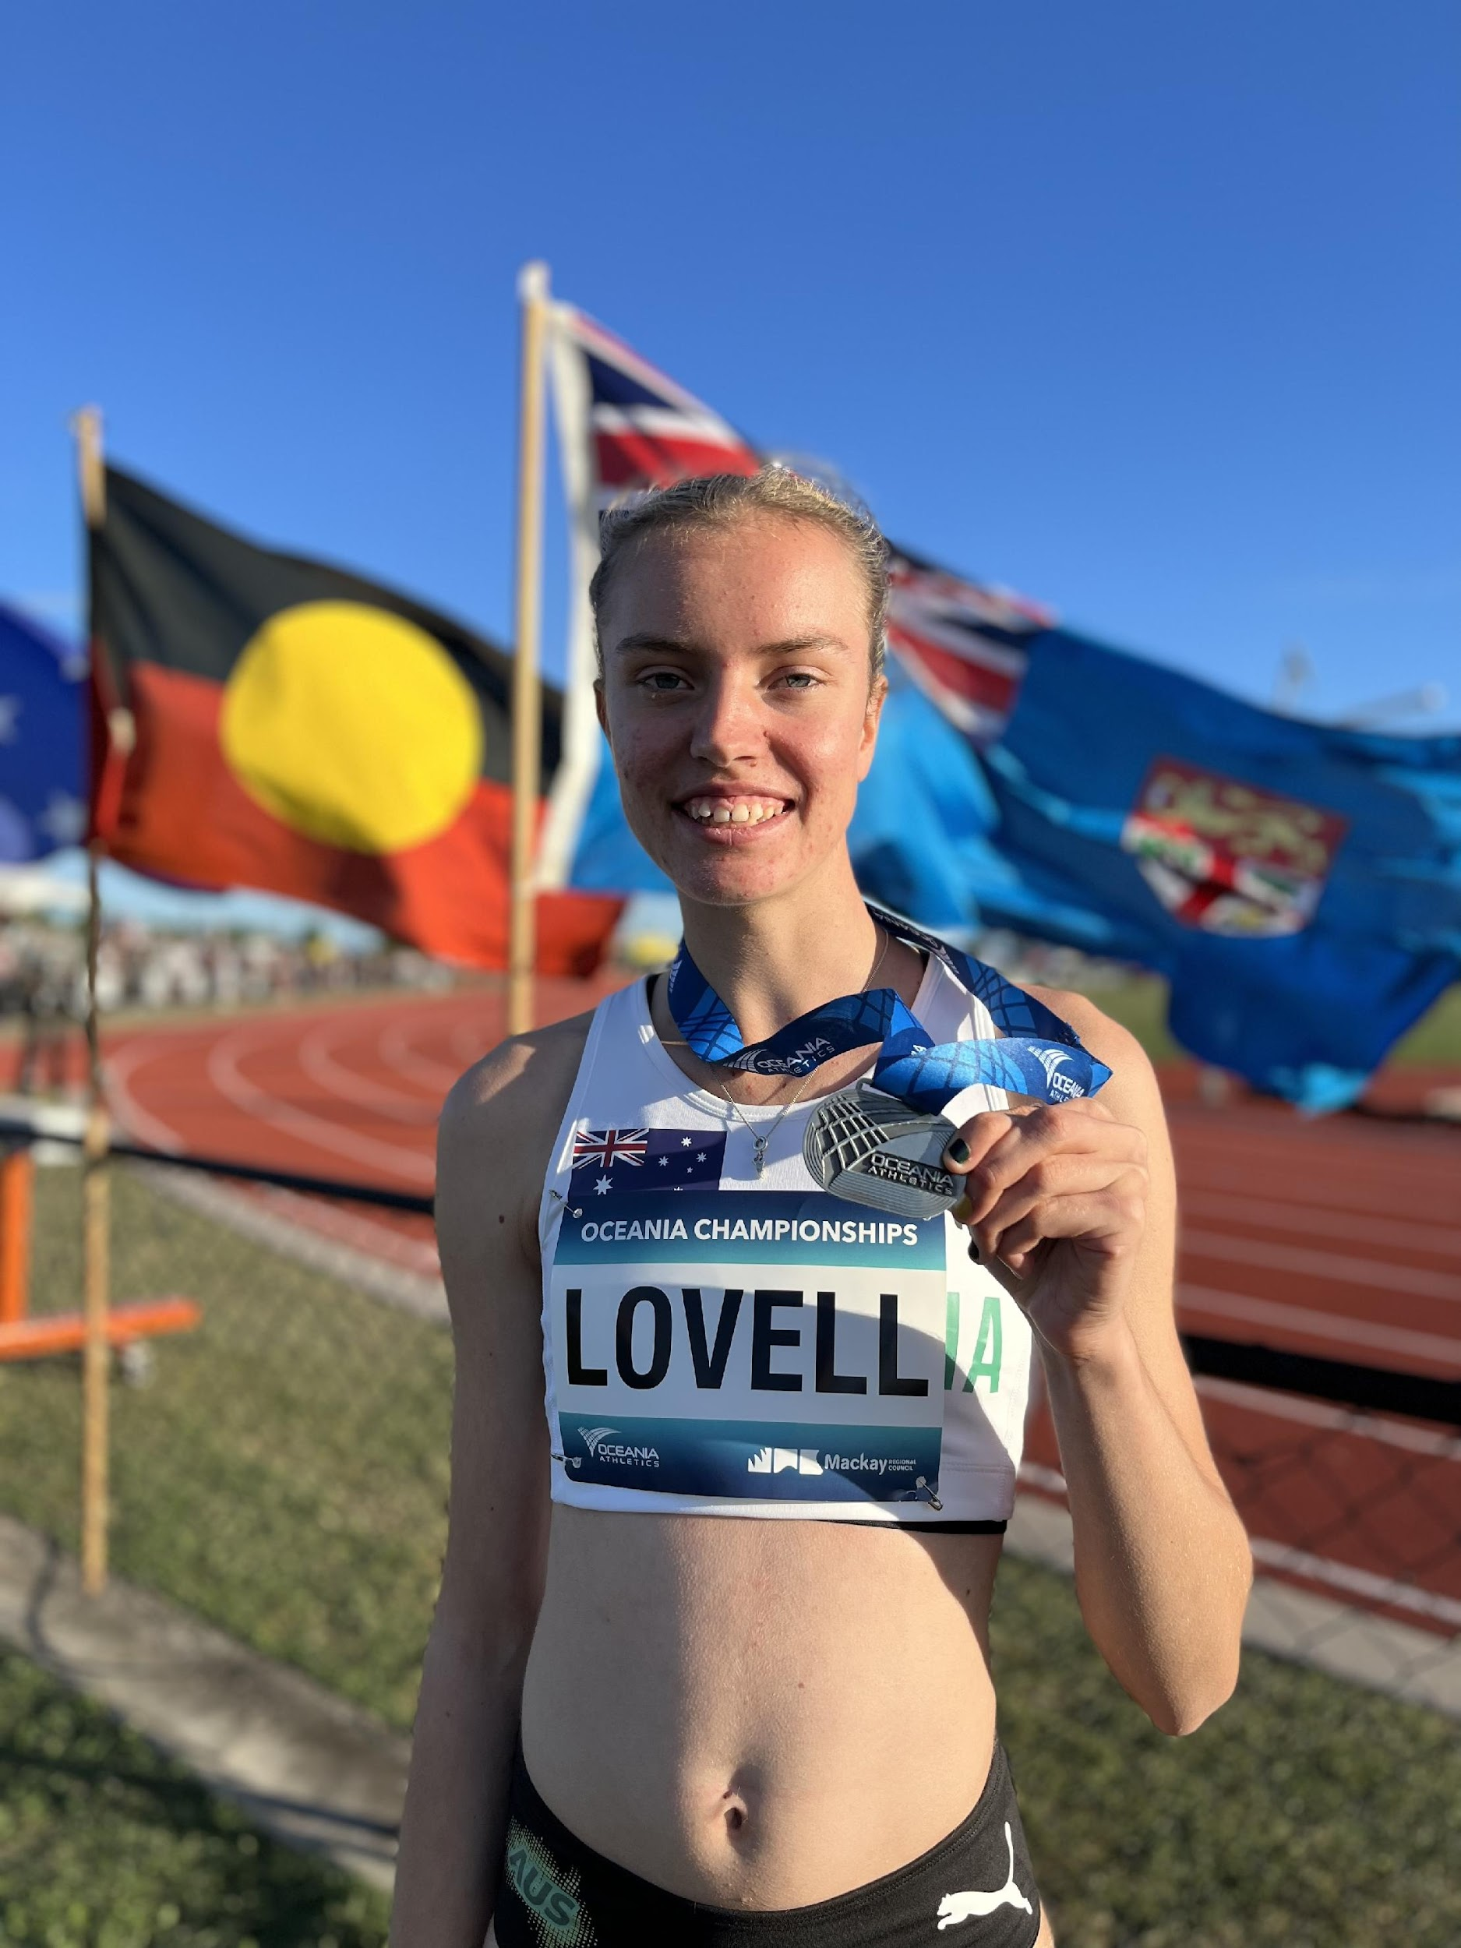
Tim Sherry Award for Athletics
Mali Lovell

Slide 35
Footballer of the Year
Presented by Ian Menzies

Slide 36
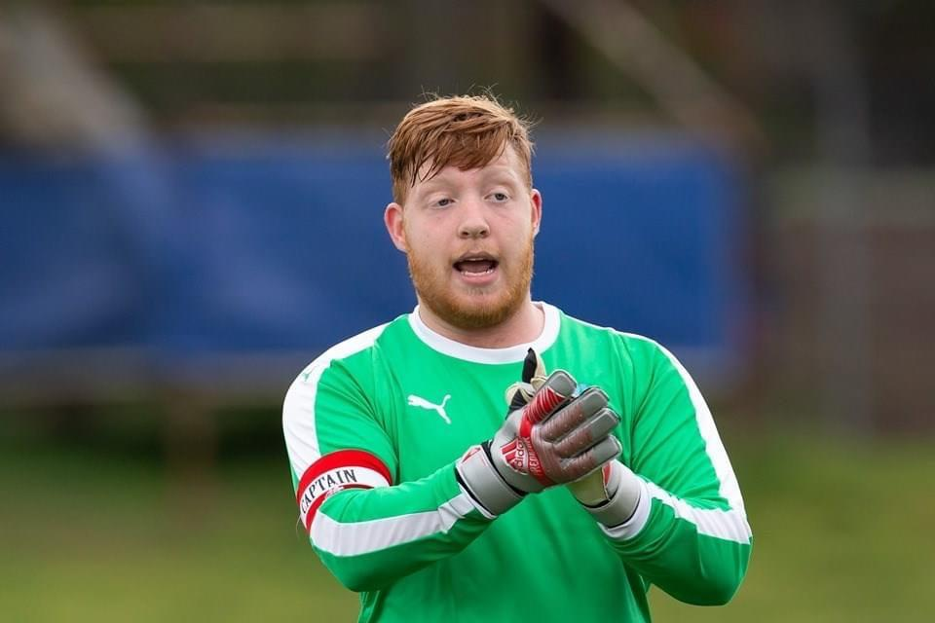
Footballer of the Year Male
Jack Starkey

Slide 37
Footballer of the Year Female
Tahlia Blanshard

Slide 38
President’s Award
Presented by Brian Berry

Slide 39
President’s Award
Tamsin Colley

Slide 40
Daniel Berry Inspirational Award
Presented by Heather Berry & Brian Berry

Slide 41
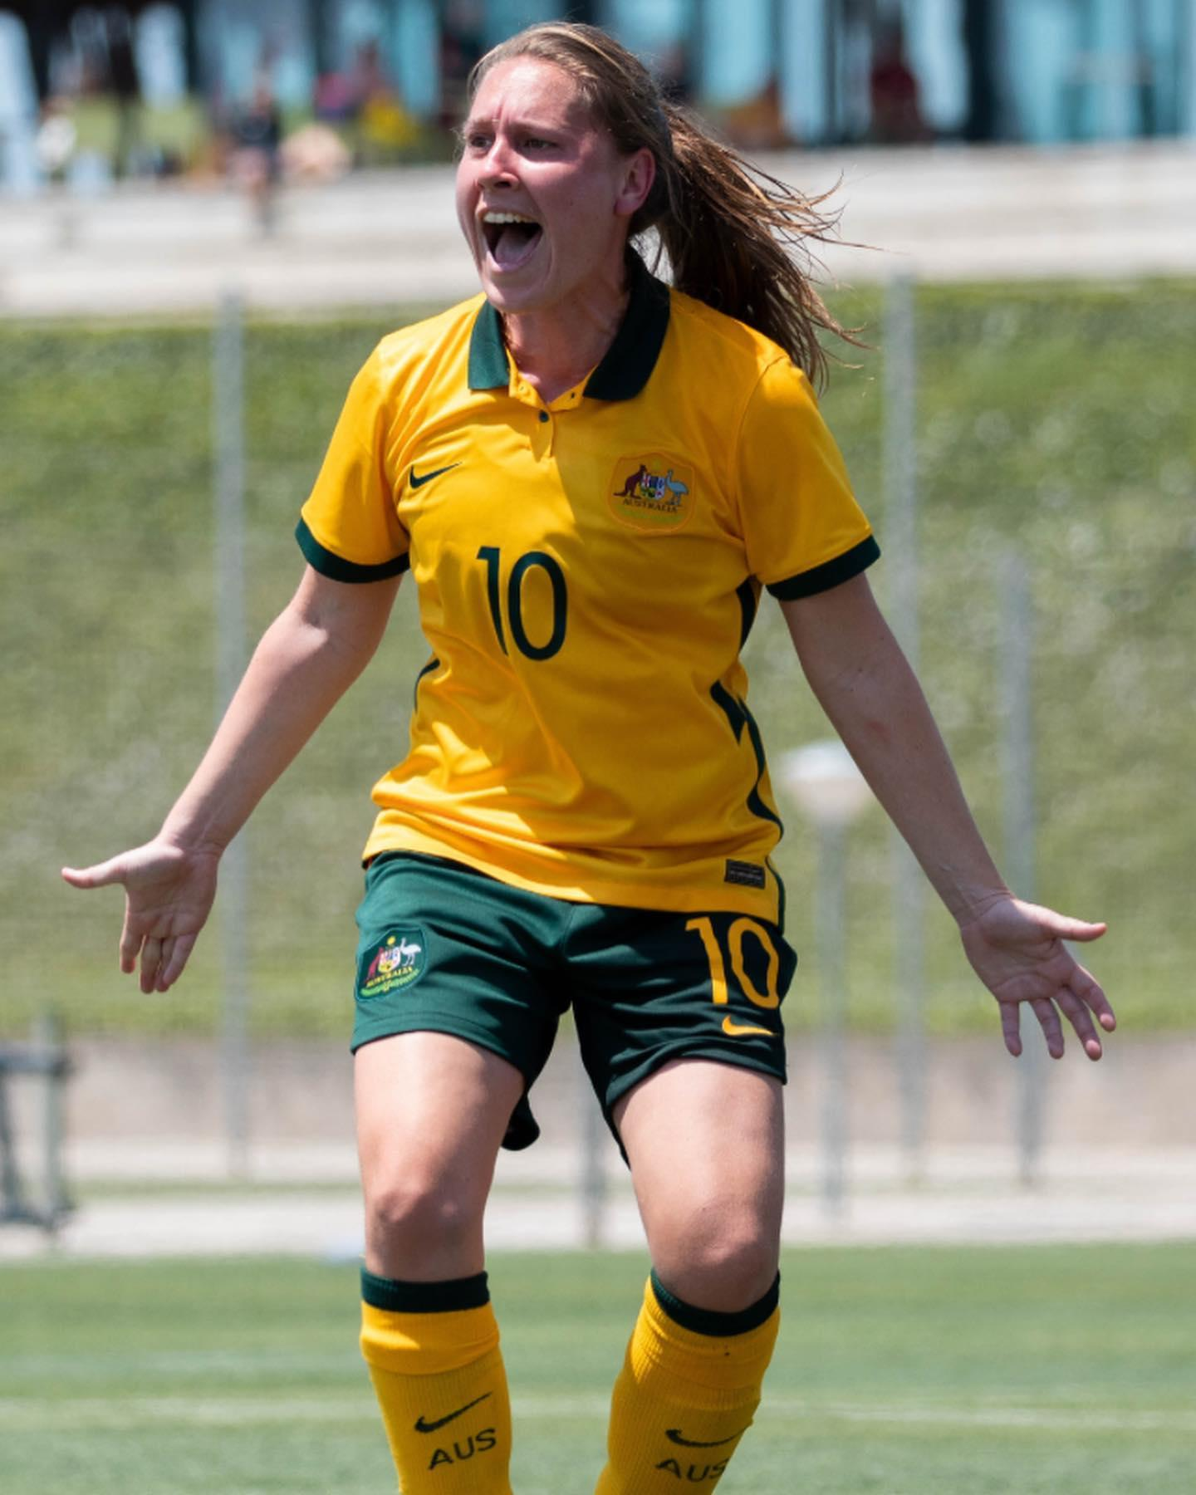
Daniel Berry Inspirational Award
Georgia Beikoff

Slide 42
Athlete of the Year
Presented by Kerry West

Slide 43
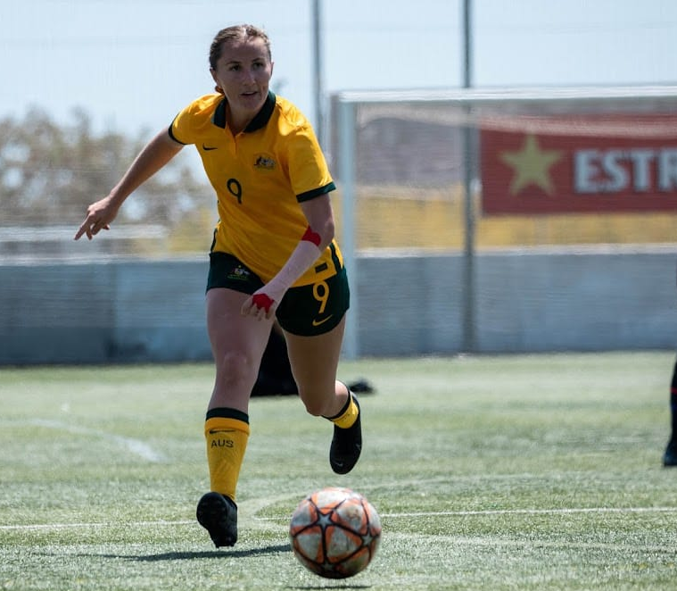
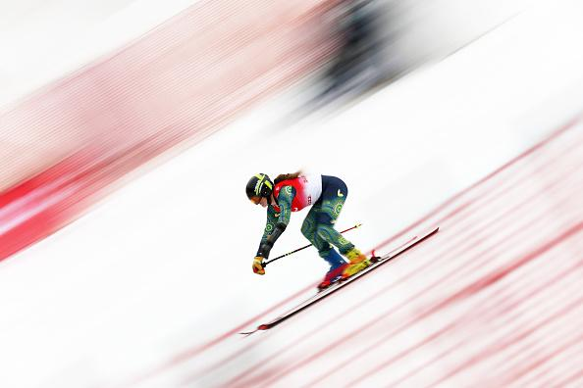
Athlete of the Year
Rae Anderson

Slide 44
Athlete of the Year
Amanda Reid

Slide 45
Community Spirit Award
Presented by Brian Berry

Slide 46
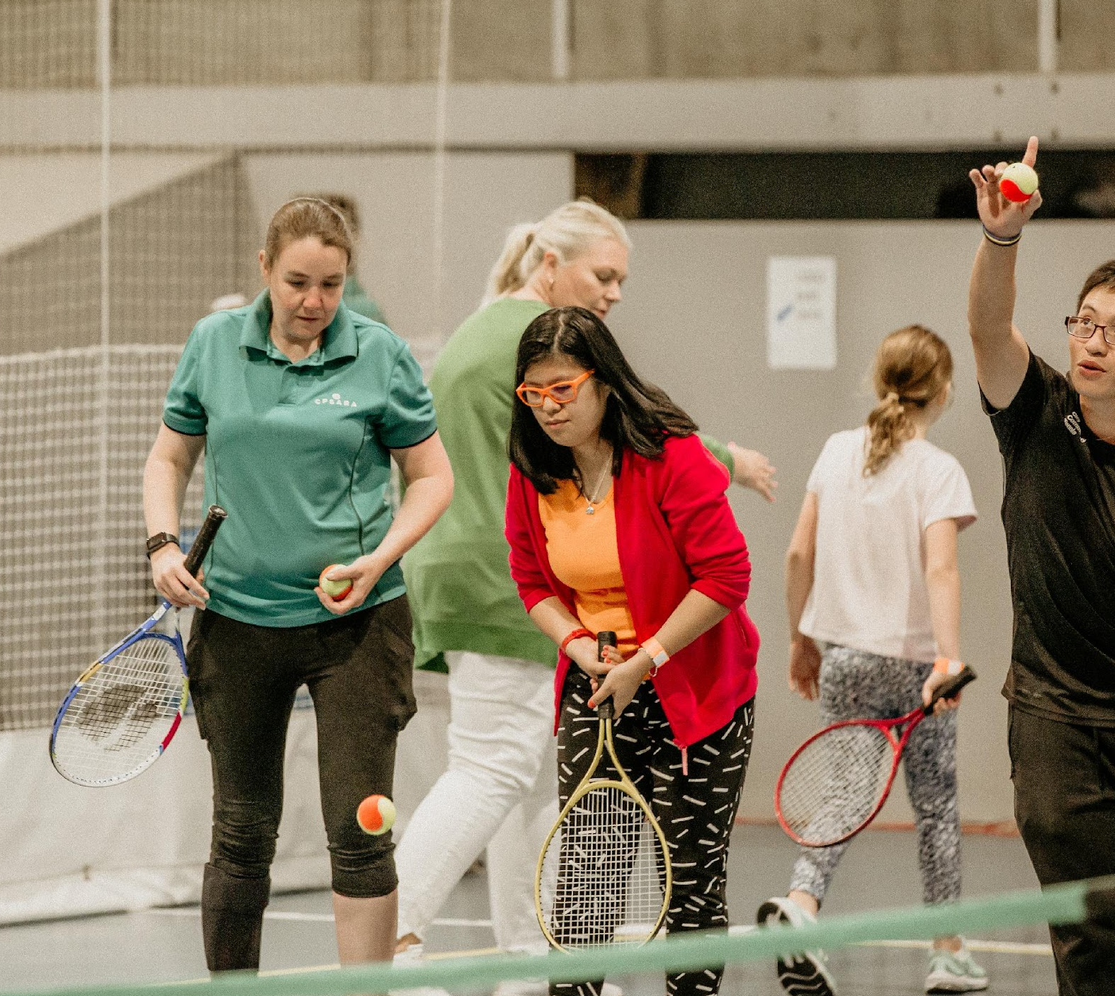
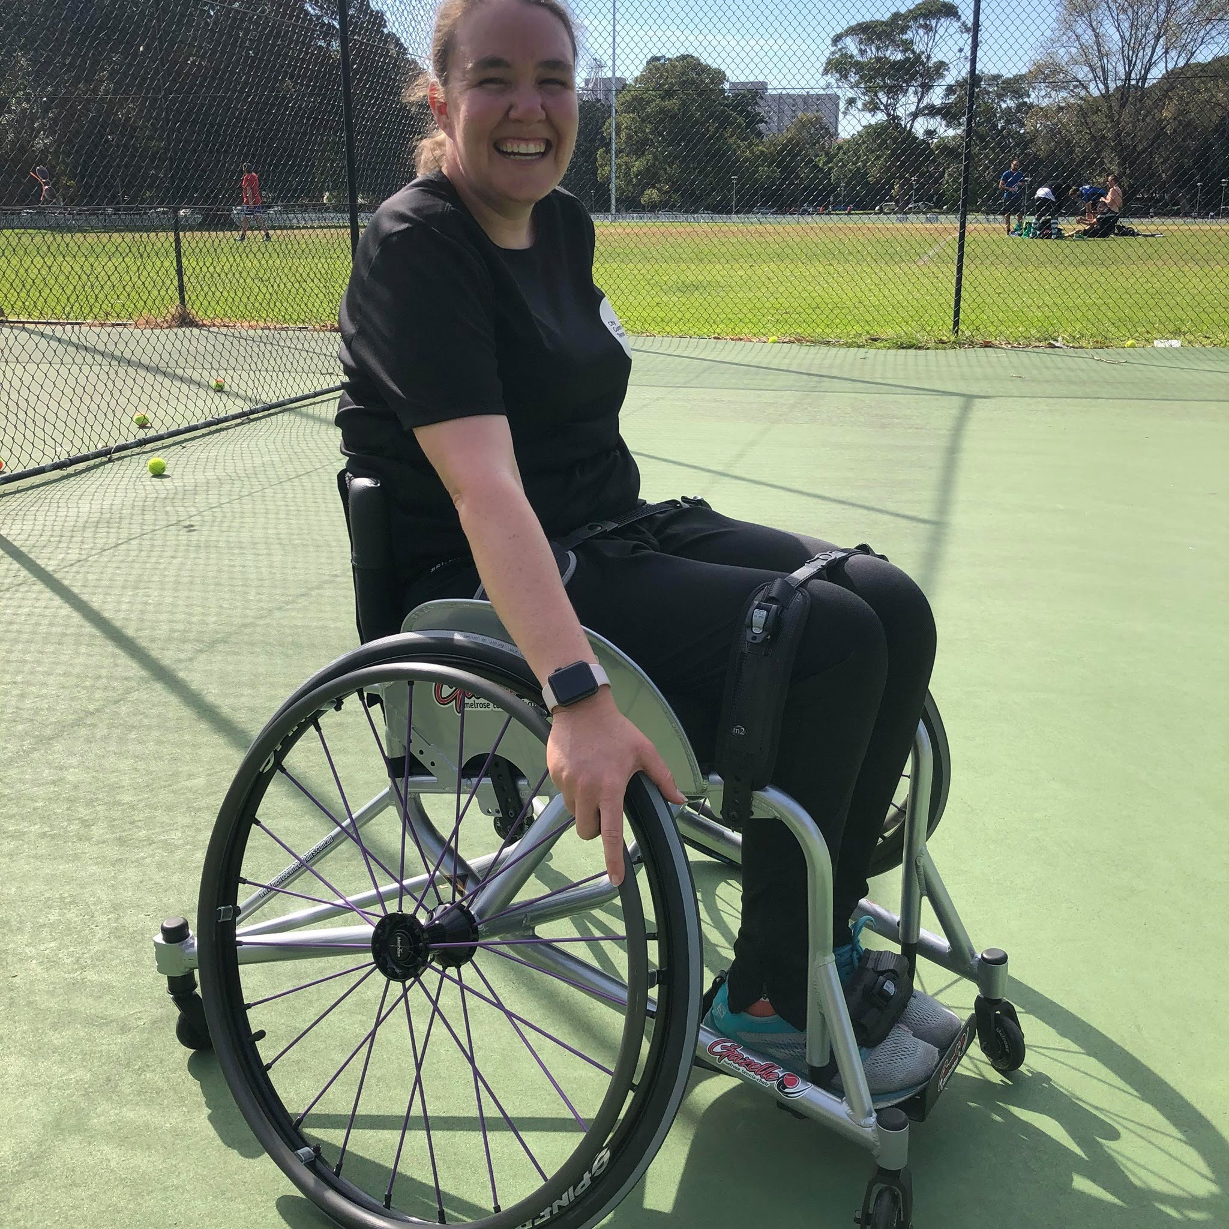
Community Spirit Award
Marita Morgan

Slide 47
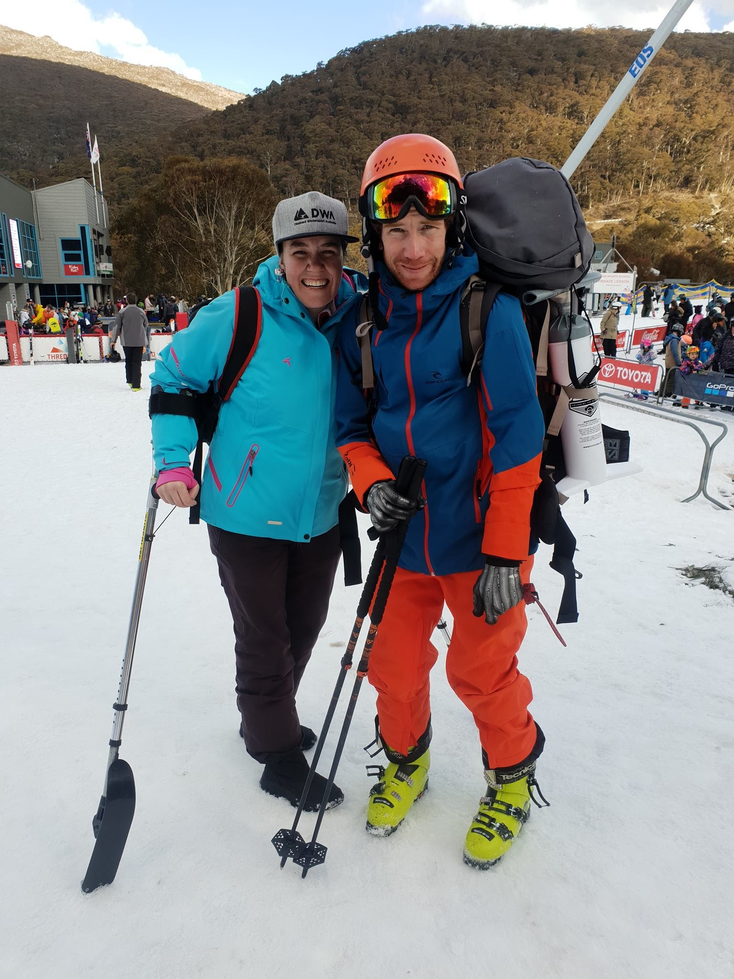
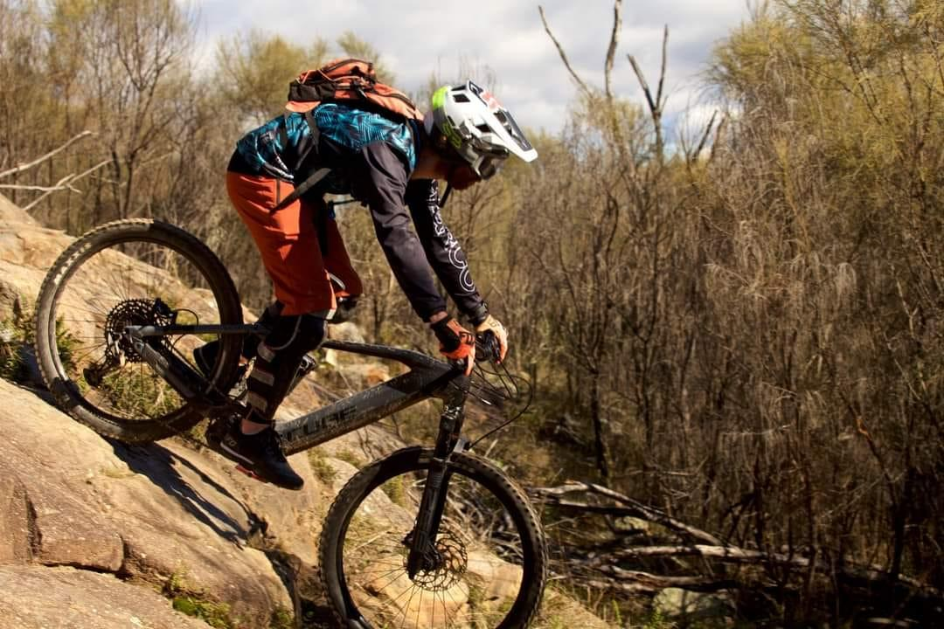
Community Spirit Award
Murray Bartram

Slide 48
Recognition of High Achievement Award
Presented by Brian Berry

Slide 49
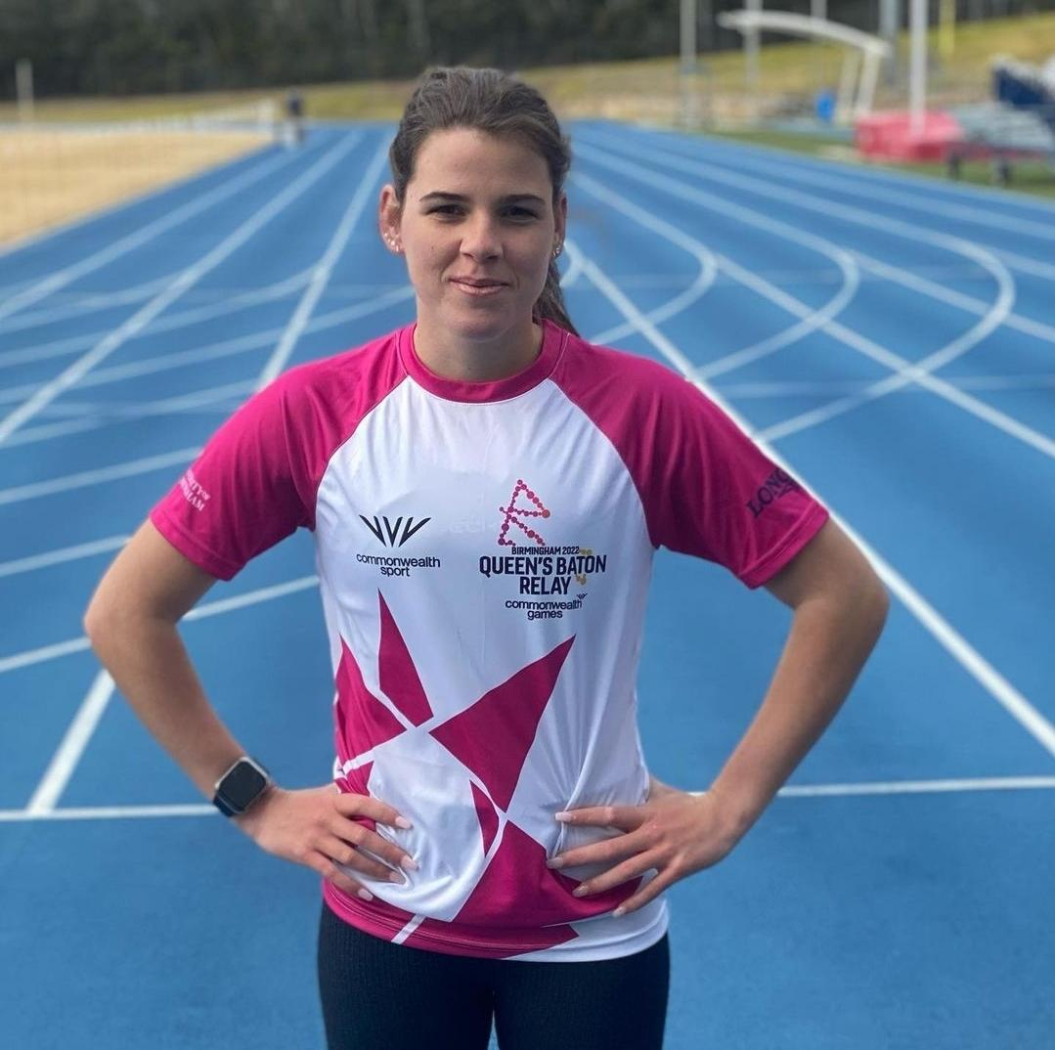
First International Representative Award
Indiana Cooper

Slide 50
CPSARA Athlete Interviews
Interviewed by Rae Anderson

Slide 51
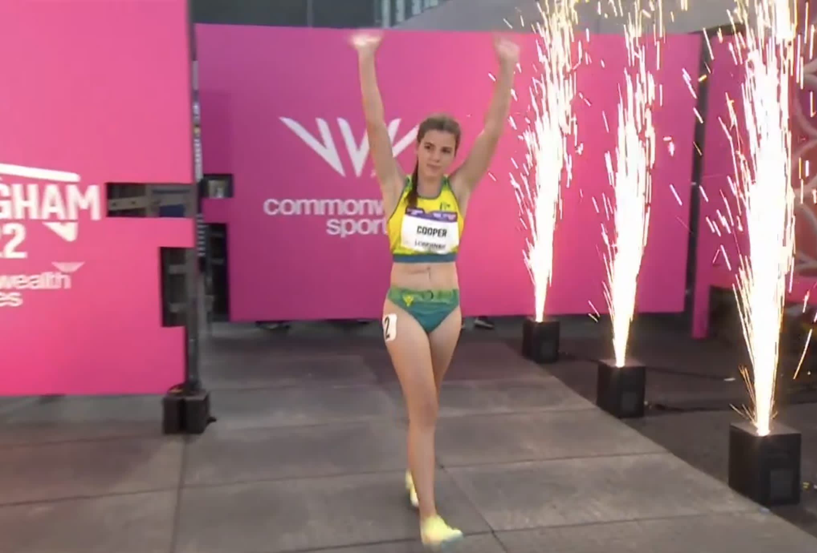
Indi Cooper Commonwealth Games Representative

Slide 52
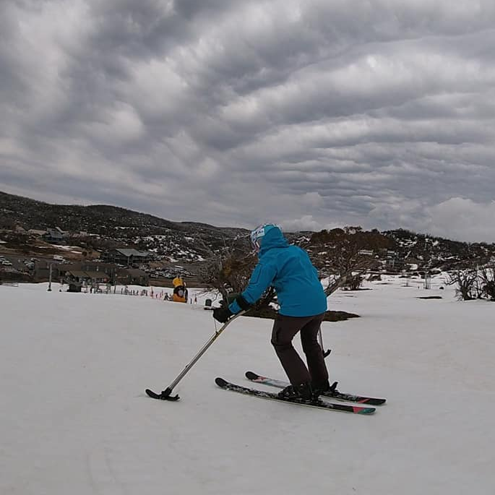
Marita Morgan Recreational Athlete Operations Manager - City Community Tennis

Slide 53
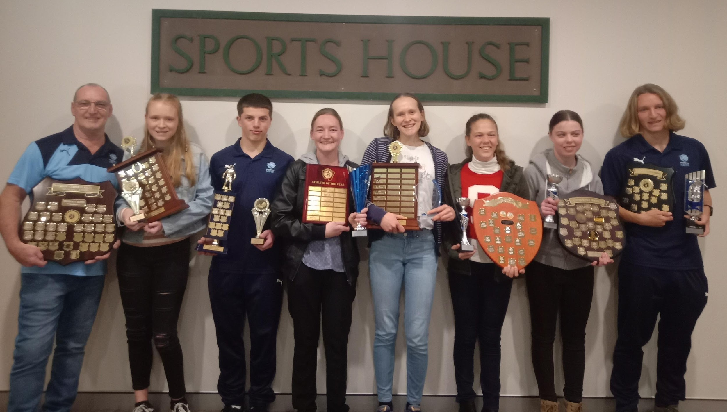
Congratulations to all award winners and to all CPSARA members on your outstanding accomplishments Thank you for celebrating our CPSARA athletes’ achievements with us for the 2021/2022 season
Thank you to our sponsors:

